Slide 1

Bilingual Education
Yesterday and Today
BME 210, Week 13
Jon Reyhner

Slide 2
Checking Prior Knowledge
What are your experiences with bilingual education?
What have you heard about bilingual Education?

Slide 3
Myths About Bilingual Education
Bilingual Education is a fad born out of President Johnson’s Great Society and War on Poverty Programs.
Bilingual Education Does Not Work.

Slide 4
Tom Horne the current Arizona Superintendent of Public Education
Wants to End Bilingual Education
In Arizona
https://www.azfamily.com/2023/01/04/new-arizona-school-superintendent-discusses-priorities-improving-public-education/

Slide 5
Bilingual Education Is Not New
Stephen R. Riggs and his wife Mary started missionary work with the Sioux in 1837. In 1852 he published a Grammar and Dictionary of the Dakota Language. They found teaching English “to be very difficult and not producing much apparent fruit.” It was not the students' lack of ability that prevented them from learning English, but rather their unwillingness. “Teaching Dakota was a different thing. It was their own language.”

Slide 6
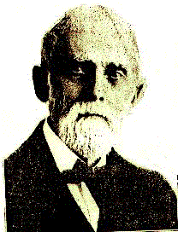
A correspondent with
Secretary of the Interior Schurz
reported in 1880 that, “Mr.
[Alfred] Riggs is of the opinion
that first teaching the children to
read and write in their own language enables them to master English with more ease when they take up that study; and he thinks, also, that a child beginning a four years’ course with the study of Dakota would be further advanced in English at the end of the term than one who had not been instructed in Dakota.”

Slide 7
Luther Standing Bear (1928) complained that his students did better than the students of white teachers who got all their knowledge from books “but outside of that, they knew nothing.” He felt, “The Indian children should have been taught how to translate the Sioux tongue into English properly; but the English teachers only taught them the English language, like a bunch of parrots. While they could read all the words placed before them, they did not know the proper use of them; their meaning was a puzzle.”

Slide 8
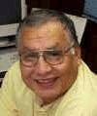
Gangs
Dr. Richard Littlebear writes that,
“Even in our rural areas, we are
encountering gangs. Our youth are apparently looking to urban gangs for those things that will give them a sense of identity, importance, and belongingness. It would be so nice if they would but look to our own tribal characteristics because we already have all the things that our youth are apparently looking for and finding in socially destructive gangs.”

Slide 9
“We have all the characteristics in our tribal structures that will reaffirm the identities of our youth. Gangs have distinctive colors, clothes, music, heroes, symbols, rituals, and “turf”.... We American Indian tribes have these too. We have distinctive colors, clothes, music, heroes, symbols, and rituals, and we need to teach our children about the positive aspects of American Indian life at an early age so they know who they are. Perhaps in this way we can inoculate them against the disease of gangs.”

Slide 10
“Another characteristic that really makes a gang distinctive is the language they speak. If we could transfer the young people’s loyalty back to our own tribes and families, we could restore the frayed social fabric of our reservations. We need to make our children see our languages and cultures as viable and just as valuable as anything they see on television, movies, or videos.”

Slide 11
Northern Arizona University Professor Angela Willeto’s (1999) study of 451 Navajo high school students from 11 different Navajo schools confirms that students’ orientation towards traditional culture, as measured by participation in ritual activities and cultural conventions as well as Navajo language use, does not negatively effect these students’ academic performance. Thus “a difference between the cultural values of the school and child per se is not the essential reason for Navajo children doing poorly at school.”

Slide 12
Cecelia Fire Thunder, President of the Oglala Sioux declared in 2005, “I speak English well because I spoke Lakota well…. Our languages are value based. Everything I need to know is in our language.” Language is not just communication, “It’s about bringing back our values and good things about how to treat each other.” And she called for tribal language total immersion head start programs in Indian country.

Slide 13
Bilingual Education Act of 1968
Supported by Influential Texas Senators because of the poor quality of 100 years of English-only education in Texas.
Signed by President Lyndon Johnson, who taught Mexican American students in Texas (Great Society, War on Poverty, Fair Housing, Civil Rights Act).
Was seen as an panacea to solve problems of 100 years of failed English-only instruction
Lacked materials, trained teachers, professors to train teachers, etc.

Slide 14
Types of Bilingual Programs
Passed in 1968 as Title VII of Elementary and Secondary Education Act (ESEA) & Funded:
  English as a Second Language (ESL) Programs
  Transitional Bilingual Programs
  Developmental/Maintenance Bilingual Programs
  Dual Language/Two-way Bilingual Programs
  Newcomer Programs
  Repealed by No Child Left Behind Act of 2001

Slide 15
No Program
Submersion
English-only
Subtractive
Banned by Supreme Court Case Lau vs. Nichols in 1974

Slide 16
English As A Second Language Programs
Immersion
ESL Pull-out
Structured English Immersion (SEI)
Sheltered English
SIOP (Sheltered Instruction Observation Protocol)
Subtractive in United States

Slide 17
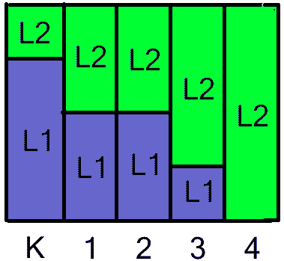
Transitional Bilingual Programs
Students stay in them usually 3 to 4 years
Mostly L₁ at beginning
All L₂ at end
Subtractive
Criticized for
Segregating Students

Slide 18
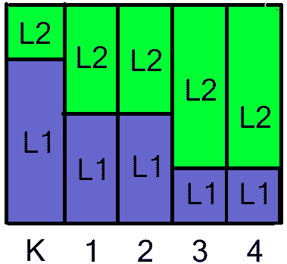
Maintenance or Developmental
L₁ is maintained
L₂ gradually introduced
Additive
Criticized for Segregating Students

Slide 19
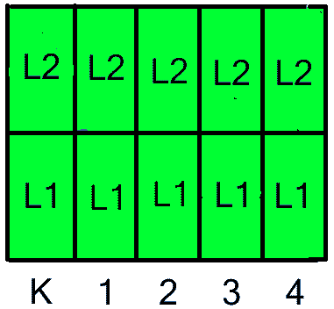
Two-way or Dual Language
1/2 English Speakers; 1/2 2nd language
Students stay together thru grades
Uses immersion teaching methodologies
Flagstaff’s Puente de Hozho Magnet School
Additive
Non-segregating

Slide 20
Newcomer Program
For recent immigrants
Intense oral English for about six months
Subtractive

Slide 21
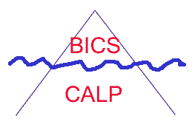
Language Learning
BICS: Basic Interpersonal Communication Skills. Takes 2 to 3 Years to Learn.
CALP: Cognitive Academic Language Proficiency (Academic English). Takes 5 to 7 years to learn.
Iceberg Metaphor
Dual Iceberg Metaphor

Slide 33
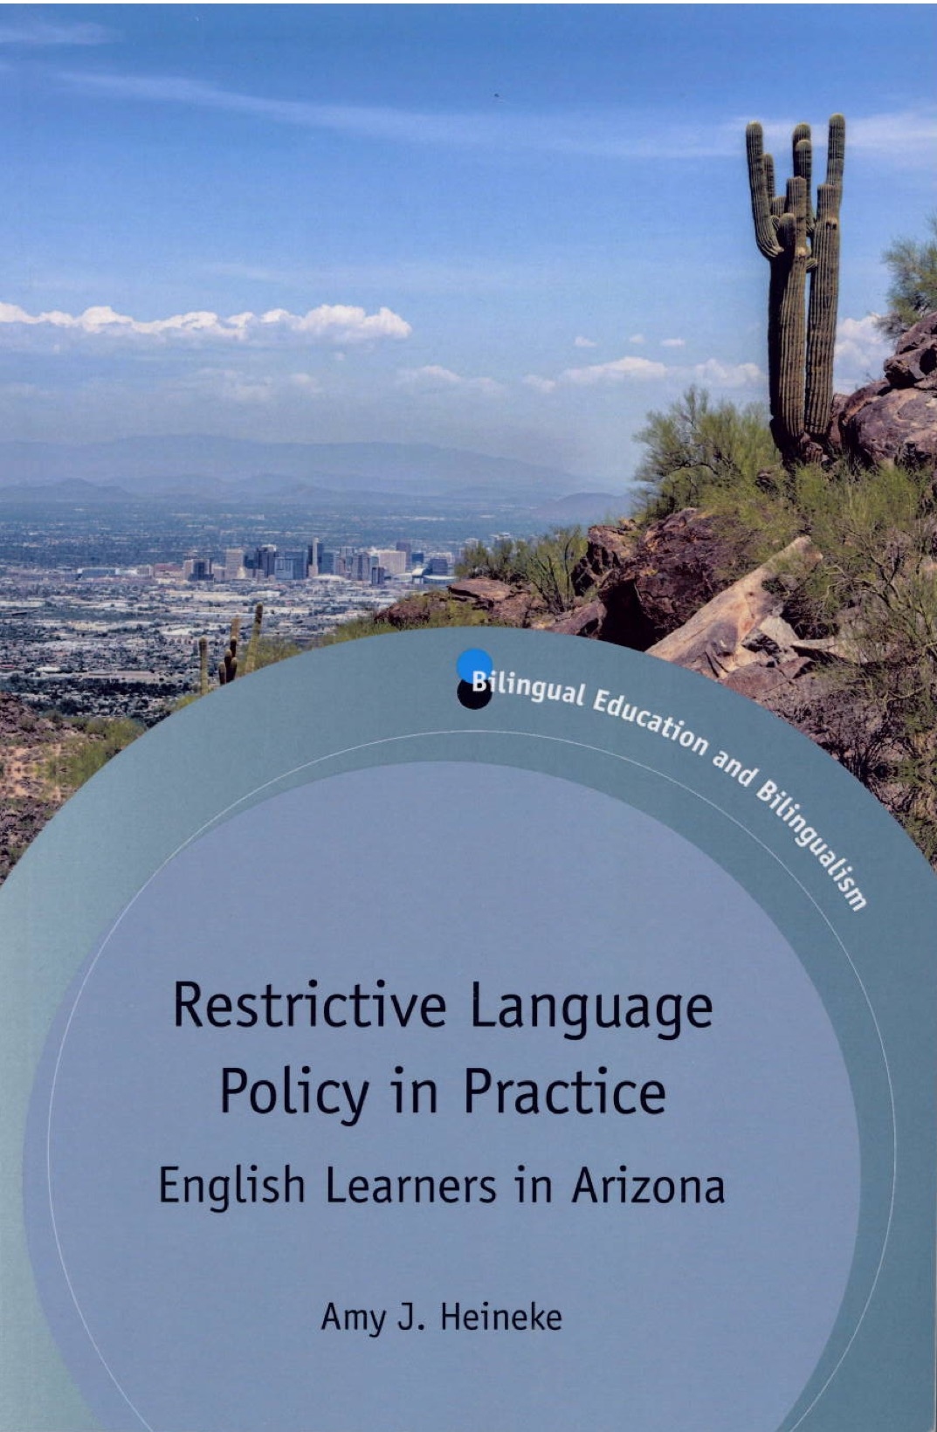
Amy J. Heineke in her 2017 study Restrictive Language Policy in Practice: English Learners in Arizona documents how Arizona’s efforts after the passage of Proposition 203 are failing English language learners.
She describes how Arizona’s schools first tried structured English immersion (SEI) that included teach content subjects like math along with English after its passage that taught content along with English language with poor results.

Slide 34
In the face of the lack of success with Structured English Immersion (SEI) in 2006 the Arizona legislators passed House Bill 2064 that shifted to teaching only English in a four-hour immersion block every day that focuses only on teaching English. Teachers are to only provide skill-based language instruction, which is still the approach in 2018. This is despite the fact that, “Data demonstrated that students test out of the EL [English Learner] label in an average of four years in the ELD model, slightly longer than the time frame in the previous SEI model” and during that time they get little or no math, science, and social studies instruction (Heineke, 2017, 159).
In addition, the English language development (ELD) classes were too often stigmatization as the “stupid class” (2017, p. 11)
f

Slide 35
Arizona’s Proposition 203
Passed by Arizona voters in 2000 and similar to the Propositions in California, “outlawing” bilingual education. Also passed in Massachusetts but defeated in Colorado.
Sold as “English for the Children” panacea.
Calls for one year of English immersion and then mainstreaming (Now a 4 hour block).
AZ State Department of Education now requires all teachers to have two courses in Structured English Immersion (SEI). Uses SIOP model.
Arizona was under federal court order to do more for its English Language Learners.

Slide 36
English Immersion programs such as being implemented in Arizona under Proposition 203 “are known to be poorly conceived and extremely ineffective among educators and researchers. While the program promises children will learn English quickly in such programs and enter the mainstream overnight, the facts tell us otherwise. In Arizona, the state's all-English program failed 89 percent of its English learners, putting them at serious risk of falling behind academically in classrooms with incomprehensible instruction rendered entirely in English. Research conducted on such programs predicted the disaster. In bilingual programs, kids learn English faster, and they also have higher academic achievement as a result.”
--Jeff MacSwan, Associate Professor of Education, ASU

Slide 37
No Child Left Behind (NCLB) Act of 2001
Changed “Office of Bilingual Education and Multilingual Affairs” to “Office of English Language Acquisition.”
California voters in 2016 repealed their ban on bilingual education, but Arizona has not done the same.

