Slide 1
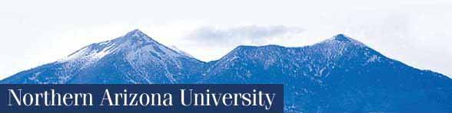
Indigenous Language Revitalization
BME 210, Week 14
Jon Reyhner

Slide 2
Language Death
The National Geographic Society's Enduring Voices Project notes: "Every 14 days a language dies. By 2100, more than half of the more than 7,000 languages spoken on Earth--many of them not yet recorded--may disappear, taking with them a wealth of knowledge about history, culture, the natural environment, and the human brain." It identified five language "hot spots" around the world where Indigenous languages are most rapidly being lost, two of which are in the United States.

Slide 3
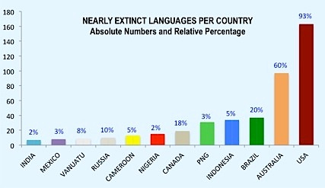

Slide 4
Writing in The Wall Street Journal in 2002, John J. Miller declared that the increasing pace of language death is “a trend that is arguably worth celebrating [because] age-old obstacles to communication are collapsing” and primitive societies are being brought into the modern world.
However, far too often this modern world is one of individualistic, materialistic, and hedonistic cultures characterized by mass shootings, drug overdoses, etc., etc. Miller’s call for celebration is nothing new, and I will show in this presentation today how arguable his call for celebration is.

Slide 5
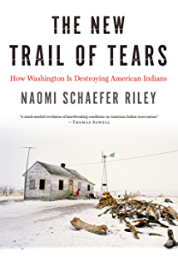
  There are various explanations for the challenges faced by Indigenous people today. For example Naomi Schaefer Riley in her 2016 book, The New Trail of Tears: How Washington is Destroying American Indians, points to government welfare policies as leading to the family disintegration and culture of dependency found on many Indian reservations today.

Slide 6
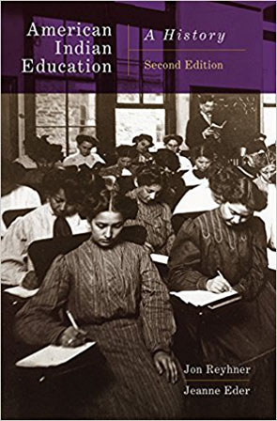
Riley and other conservative critics tend to ignore the long ethnocentric history of efforts in the United States and other colonizing countries to educate Indigenous peoples by bringing them from “savagery to civilization” (see, e.g. Adams, 1995; Reyhner & Eder, 2017; Szasz, 1999) by denigrating their languages and cultures and seeking to replace them with English and a Euro-American culture.

Slide 7
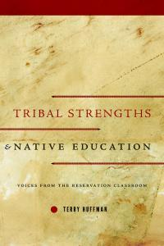
In contrast to Naomi Schaefer Riley who spent a short time studying Indian education, researchers like Terry Huffman who have spent decades studying American Indian classroom teachers and school administrators point to the importance of American Indian student identity and tribal strengths, which are too often ignored or even devalued by teachers.
A principal Huffman interviewed lamented
“We are leaving the child behind because we have forgotten teaching styles and, like I said, the language and the culture. That has all been put on the back burner when they should actually be up front” (Huffman, 2013, p. 95).

Slide 8
Huffman (2010), among others, has marshaled considerable evidence that “rejects the notion that American Indian students must undergo some form of assimilation to succeed academically.” He found through his research how a “strong sense of cultural identity serves as an emotional and cultural anchor. Individuals gain self-assuredness, self-worth, even a sense of purpose from their ethnicity. By forging a strong cultural identity, individuals develop the confidence to explore a new culture and not be intimidated. They do not have to fear cultural loss through assimilation. They know who they are and why they are engaged in mainstream education.”

Slide 9
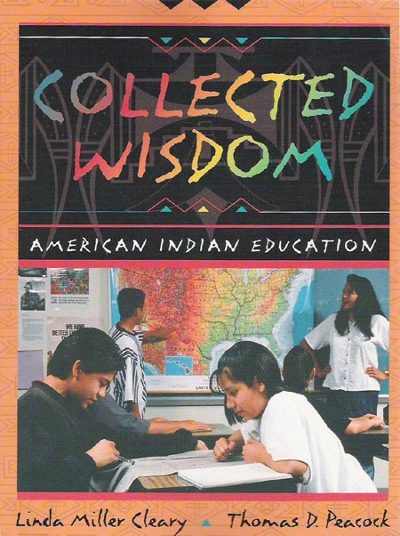
Cleary and Peacock who interviewed over 100 teachers of Indigenous students summed up what they learned from the educators they interviewed, writing “The key to producing successful American Indian students in our modern educational system...
is to first ground these students in their American Indian belief and value systems” (1998, p. 101).

Slide 10
No Child Left Behind (NCLB) Act of 2001
Changed “Office of Bilingual Education and Multilingual Affairs” to “Office of English Language Acquisition.”
Why Save a Language?
https://www.youtube.com/watch?v=x7BLBUS1IXc

Slide 11
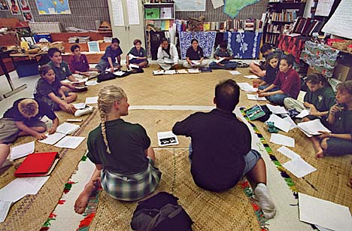
Hawaiian-Medium Education at Näwahïokalani’opü (Näwahï) Laboratory School
Begun in 1997-98.
Hawaiian-medium, early childhood through high school program.
College preparatory curriculum rooted in Native Hawaiian language and culture.

Slide 12

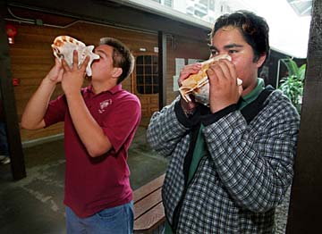
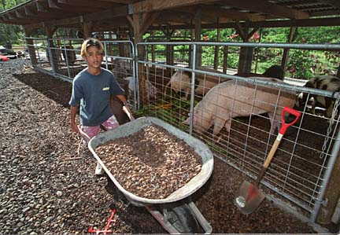
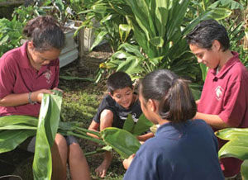
All subjects taught through Hawaiian language and values

Slide 13
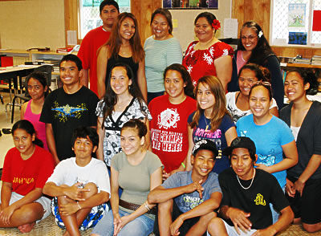
Findings from Näwahï:
Students surpass non-immersion peers on English standardized tests.
100% high school graduation rate.
80% college attendance rate.
Bilingualism and biliteracy (“additive bilingualism”) – “holding Hawaiian language and culture high.” (Wilson & Kamanä, 2001, 2006)

Slide 14
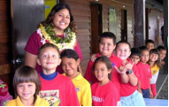
“The benefit of [Näwahï’s] approach…is a much higher level of fluency and literacy in the Indigenous language plus psychological benefits to their identity that encourage high academic achievement and pursuit of education to the end of high school and beyond.” — William Wilson, Kauanoe Kamanä, & Nämaka Rawlins (2006, p.43)

Slide 15
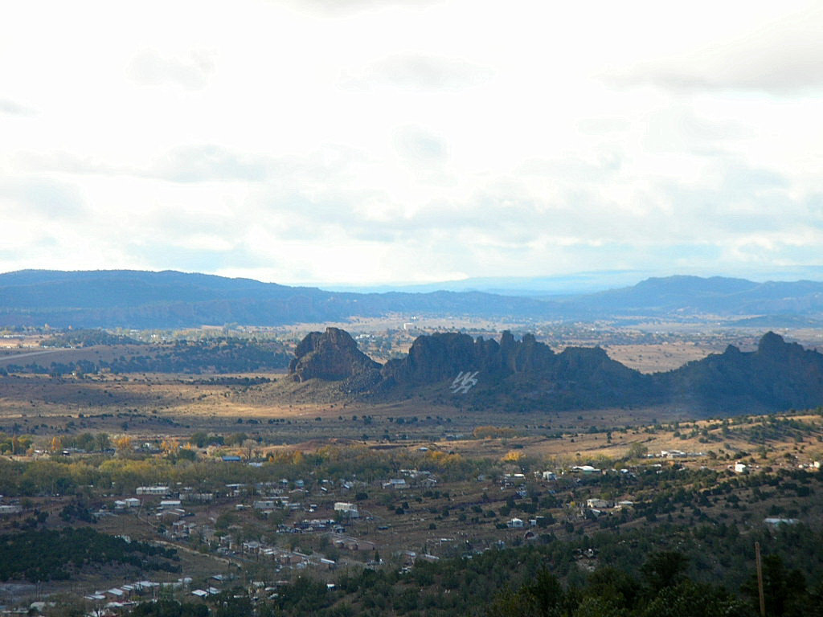
Navajo-Medium Education at Tséhootsooí Diné Bi’ólta’, Fort Defiance, AZ)
(Sources: Arviso & Holm, 2001; Holm, 2006; Johnson & Legatz, 2006; Johnson & Wilson, 2004, 2005)
Began in 1986 as a Navajo-medium track in an all-English school.
1/10th of kindergartners fluent in Navajo when the program began.
Almost all considered Limited English Proficient (LEP).

Slide 16
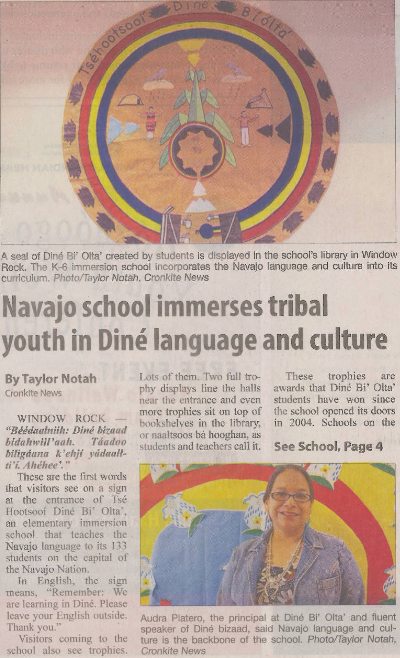

Slide 17
Notes:
This graph shows the comparison in percentage, between one immersion classroom of 10 students to several combined Mainstream classrooms of 117 students. We are looking at the 5th Grade because in immersion programs, you look at the whole program as a whole, not individually by grade level. The whole point to an immersion program is to see English achievement results at the end of a program. Evaluating individual years for English achievement of an immersion program will be like expecting English achievement gains while the process of English transition hasn’t yet complete its cycle.
Immersion students at WRUS, are not expected to have the same English achievement as their English classroom peers from year to year, but are expected to achieve at or above their English classroom peers at the end of a program. For WRUSD, the end of a program is at 5th grade. To get the full benefits of an immersion program, the following are needed:
A set curriculum articulated by grade level
Trained teachers to implement immersion classroom strategies
An assessment that is aligned to an immersion curriculum
A systematic response system addressing immersion students who have difficulty
Timely monitoring and evaluation of program
As always, there is room for improvement. The current action plan to enhance the immersion program will only increase the numbers seen above.

Slide 18
Early findings from Navajo immersion at Ft. Defiance, AZ:
Navajo immersion students –
Performed as well in oral English as non-Navajo immersion students.
Performed better on local assessments of English writing.
Were “way ahead” in math.
Were on par with non-Navajo immersion students in English reading.
Had the benefit of bilingualism and biliteracy (additive bilingualism).
(Arviso & Holm, 2001; Holm & Holm, 1995)

Slide 19
One additional finding:
By 4th grade, Navajo Immersion students performed significantly better in oral and written Navajo.
This is not surprising, but….

Slide 20
In contrast, non-Navajo Immersion students performed lower on assessments of Navajo than they did in kindergarten. (They experienced “subtractive bilingualism.”)

Slide 21
The initial program blossomed into a K-8 Navajo-medium school.
(Johnson & Legatz, 2003, 2006)
Grade Level | % Navajo Instruction | % English Instruction
Kindergarten | 100% (7.5 hrs) | 0%
1st | 100% (7.5 hrs) | 0%
2nd | 90% (6.75 hrs) | 10% (.75 hrs)
3rd | 80% (6 hrs) | 20% (1.5 hrs)
4th | 70% (5.5 hrs) | 30% (2.25 hrs)
5th | 60% (4.5 hrs) | 40% (3 hrs)
6th —>8th | 50% (3.75 hrs) | 50% (3.75 hrs)

Slide 22
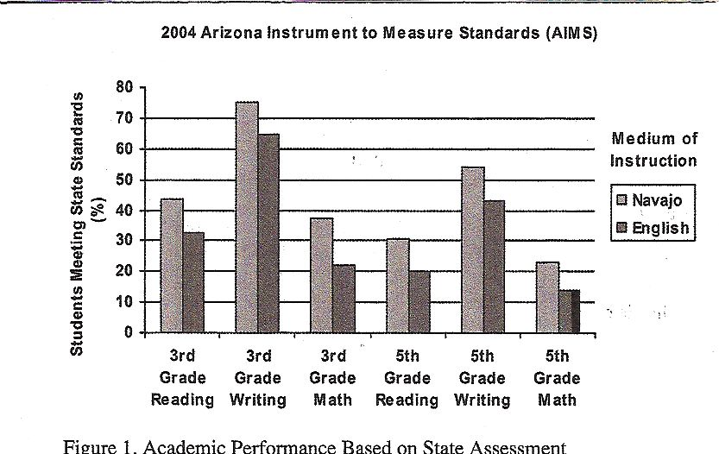
Comparison of Navajo Immersion and Mainstream English Student Performance
(Johnson & Legatz, 2006)

Slide 23
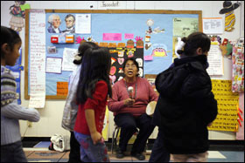
Promising Practices at Tséhootsooí Diné Bi’ólta’
Tribal standards for Navajo language and culture integrated with state content standards.
Navajo-rich environment: classrooms, cafeteria, playground, hallways, school bus.
High involvement of parents and families.

Slide 24
Beyond the tests – other evidence of promising practices at
Tséhootsooí Diné Bi’ólta’:
“What the children and their parents taught us was that Navajo immersion gave students Navajo pride in an urbanizing situation in which many students were not proud to be Navajo.”
— Wayne Holm, “The Goodness of Bilingual Education for Native American Students” (2006)

Slide 25
Māori language revitalization efforts in New Zealand, Native Hawaiian efforts, and the results of Navajo language immersion in Window Rock held lead to the Puente de Hózhó (Bridge of Beauty) School here in Flagstaff.

Slide 26
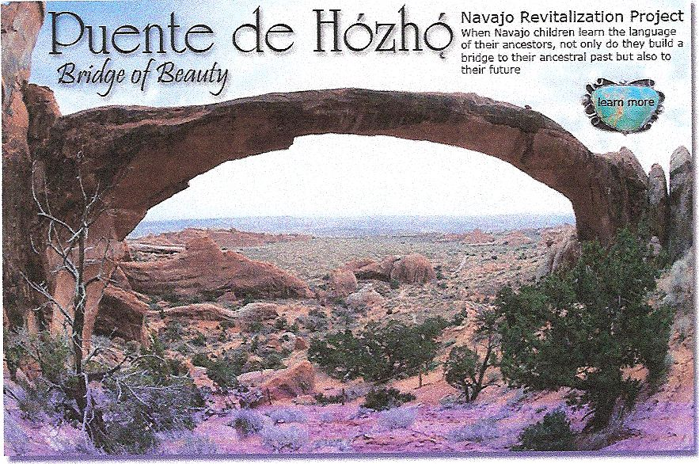

Slide 27
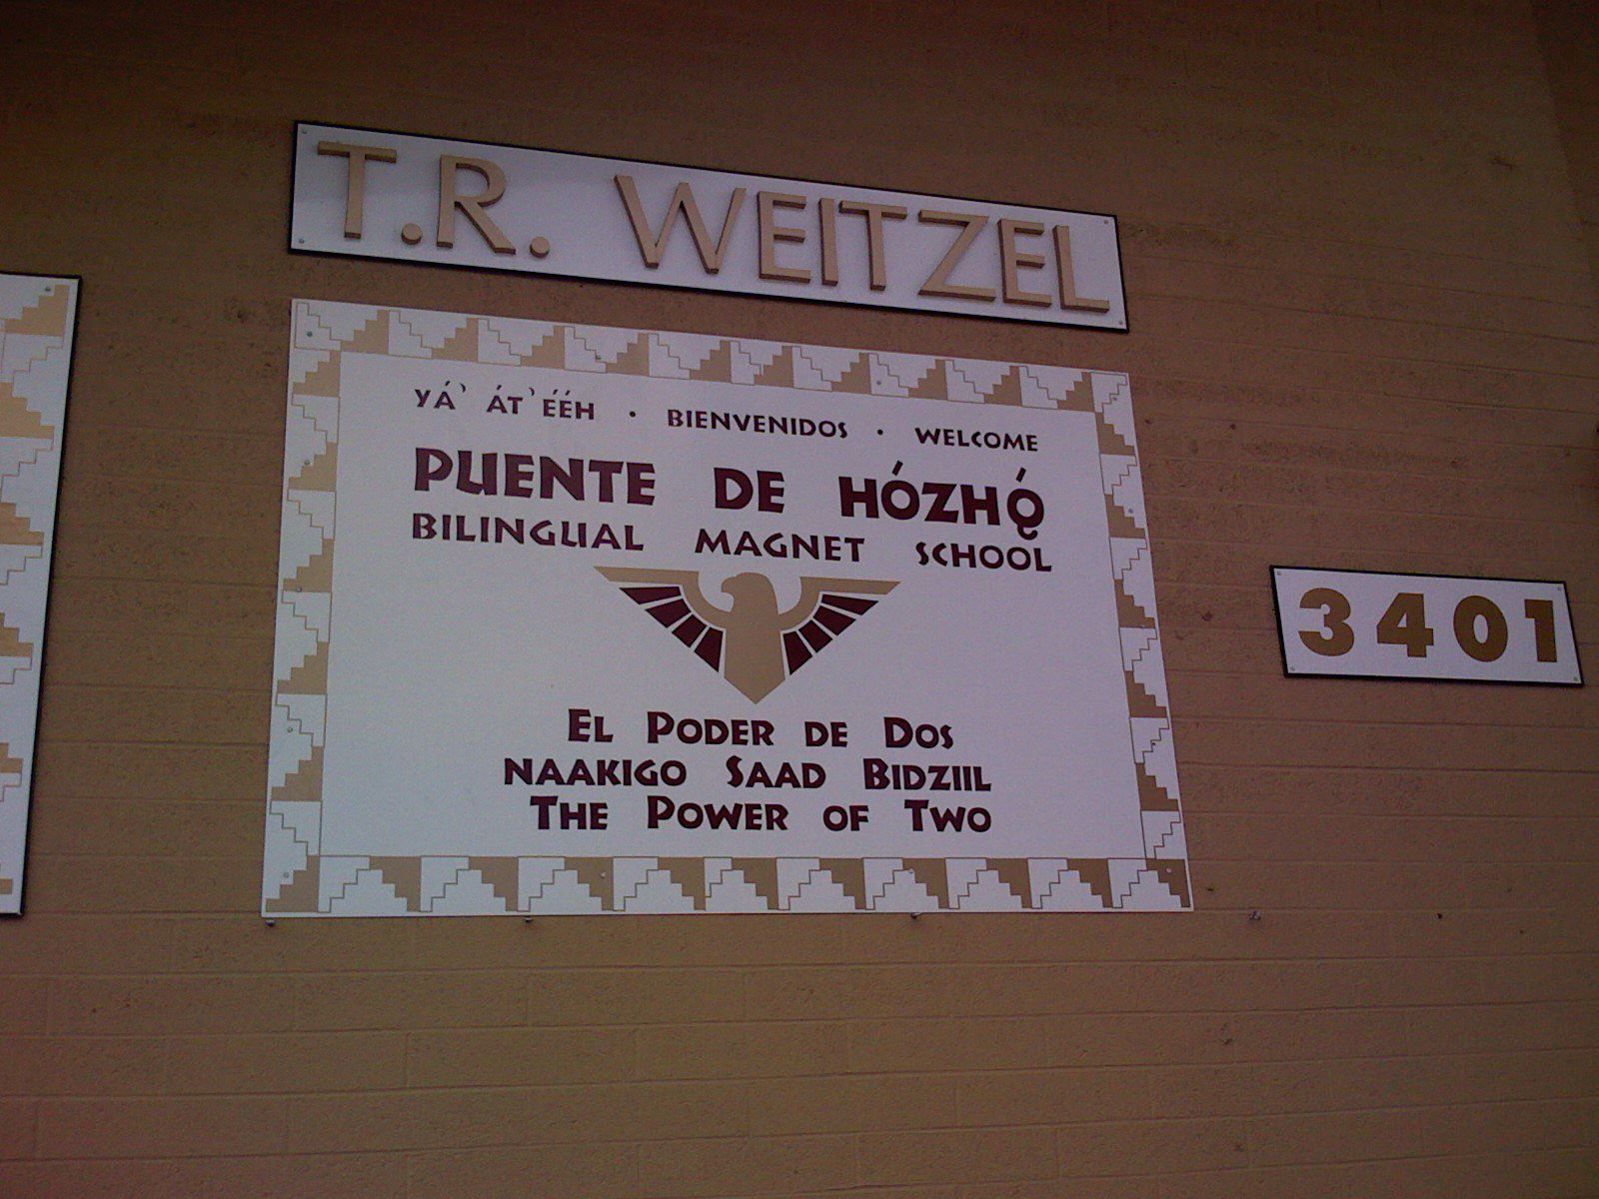
Puente de Hózhó (Bridge of Beauty) School, Flagstaff, AZ
• K-8 public magnet school: 32% Hispanic, 25% Native American (Navajo), 32% White, 1% “other”

Slide 28
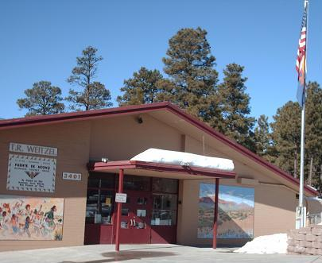

Slide 29
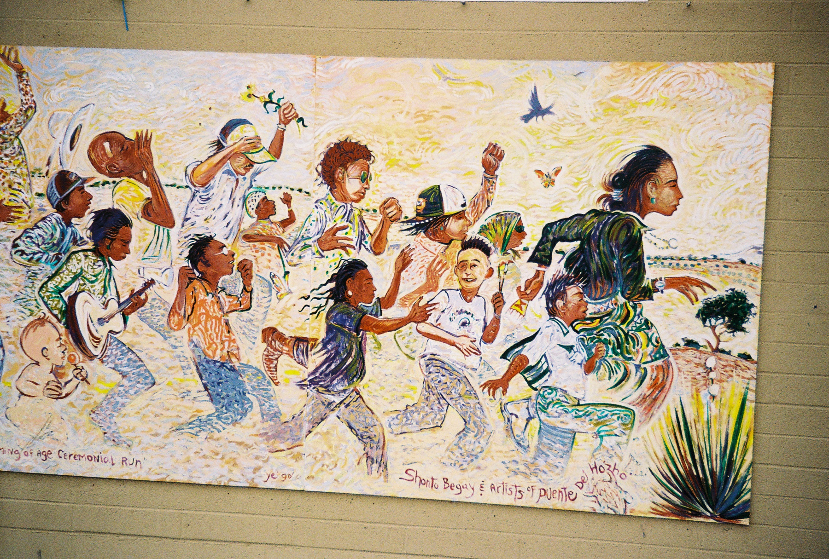

Slide 30
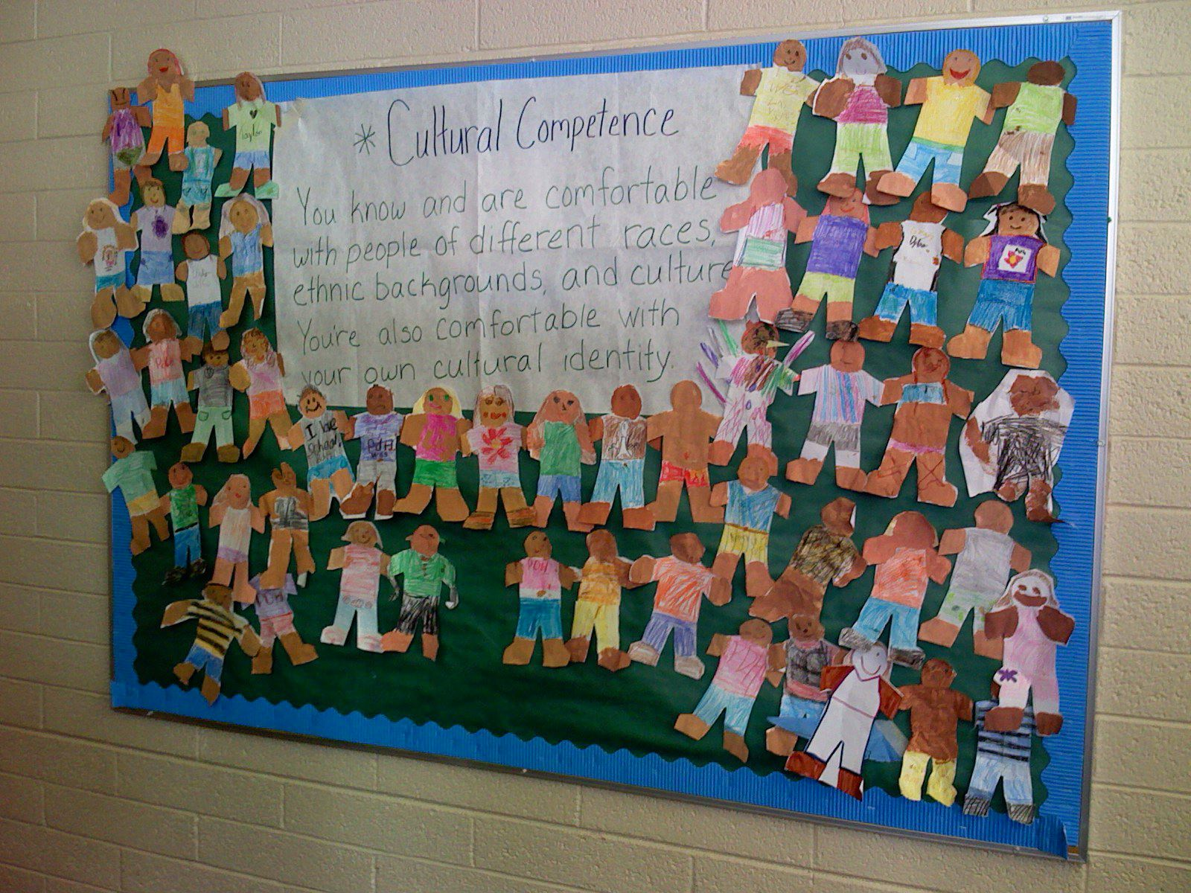
Puente de Hózhó Mission – “Harmonizing without Homogenizing”
Bilingual, biliterate, multicultural competence for all (“the power of two”). (Photographs by Larisa Warhol)
30
Notes:
30

Slide 31
“…the vision was to create a school where each child’s language and culture was regarded not as a problem…but as an indispensable resource, the very heart and soul of the school itself….English speakers would learn Spanish, Spanish speakers would learn English, Navajo children would acquire their tribal language, and all students would interact harmoniously and achieve academically.” (Fillerup, 2008, p. 1)

Slide 32
Promising Practices at PdH:
1. Two Parallel Programs
Conventional Spanish-English dual immersion model
50/50 Spanish-English
One-way Navajo immersion (Navajo L2 students taught in Navajo)
– Kindergarten: 100% Navajo
– 1st grade: 80/20
– 3rd grade: 60/40
– Grades 4-6: 50/50

Slide 33
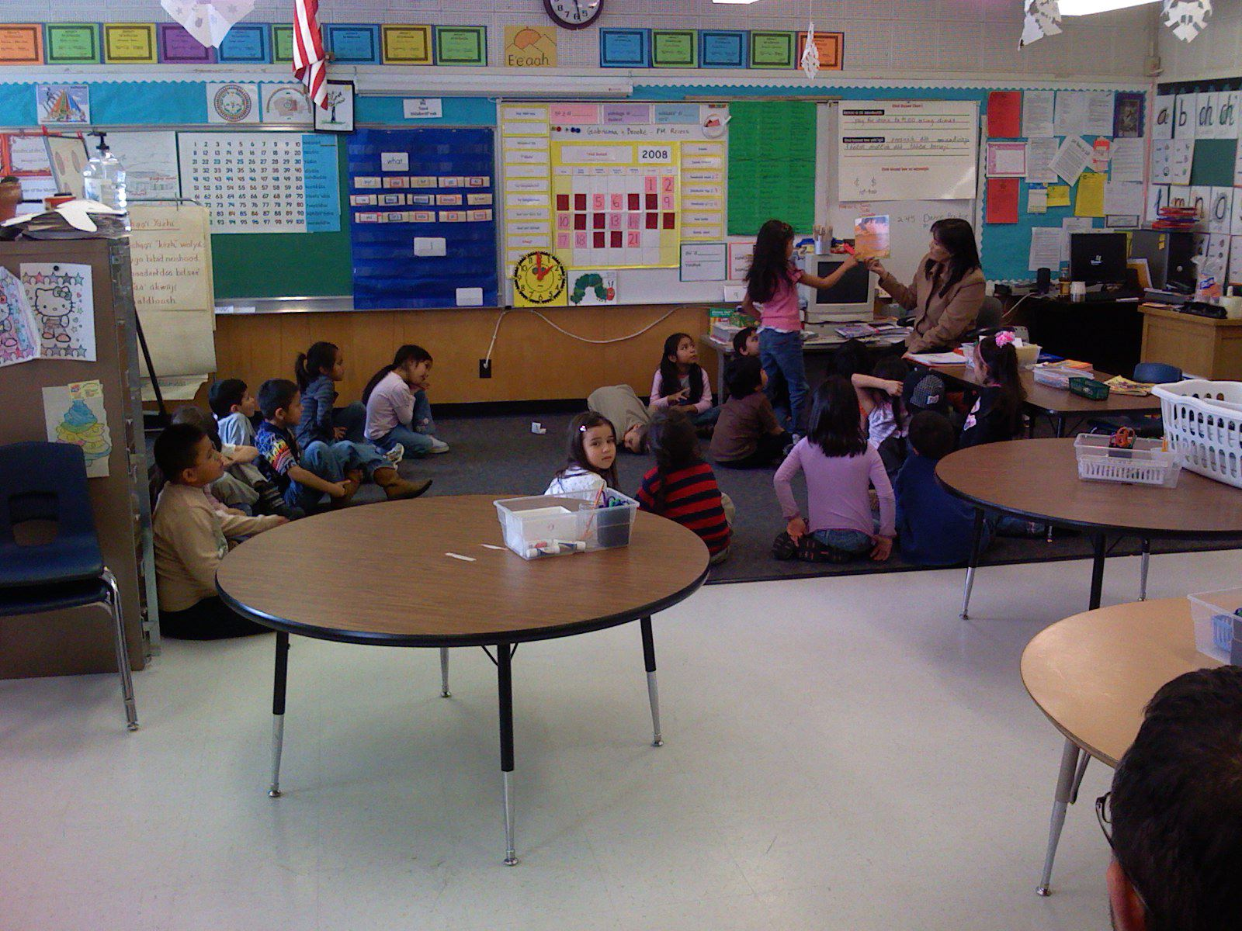
What the Diné teachers say about their mission: “We’re fighting for our kids!”

Slide 34
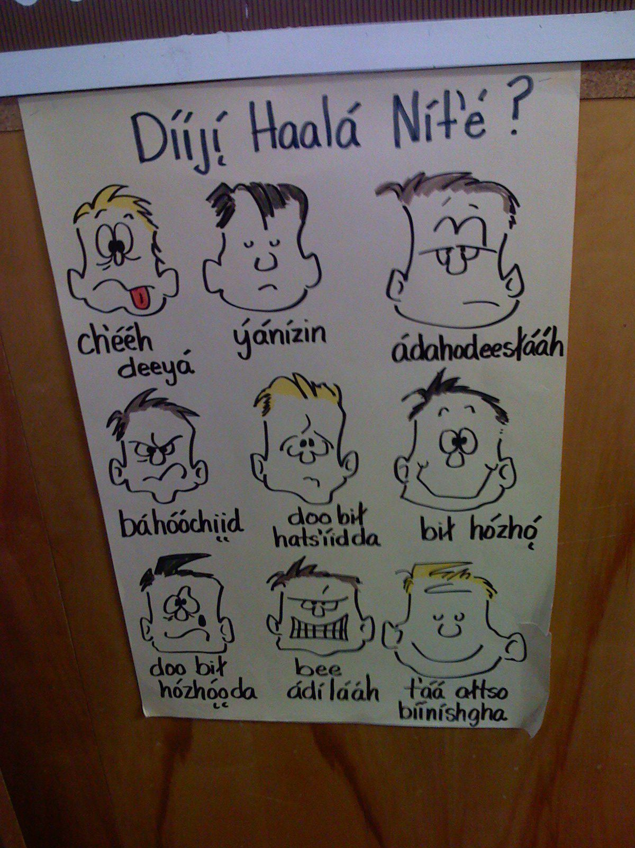
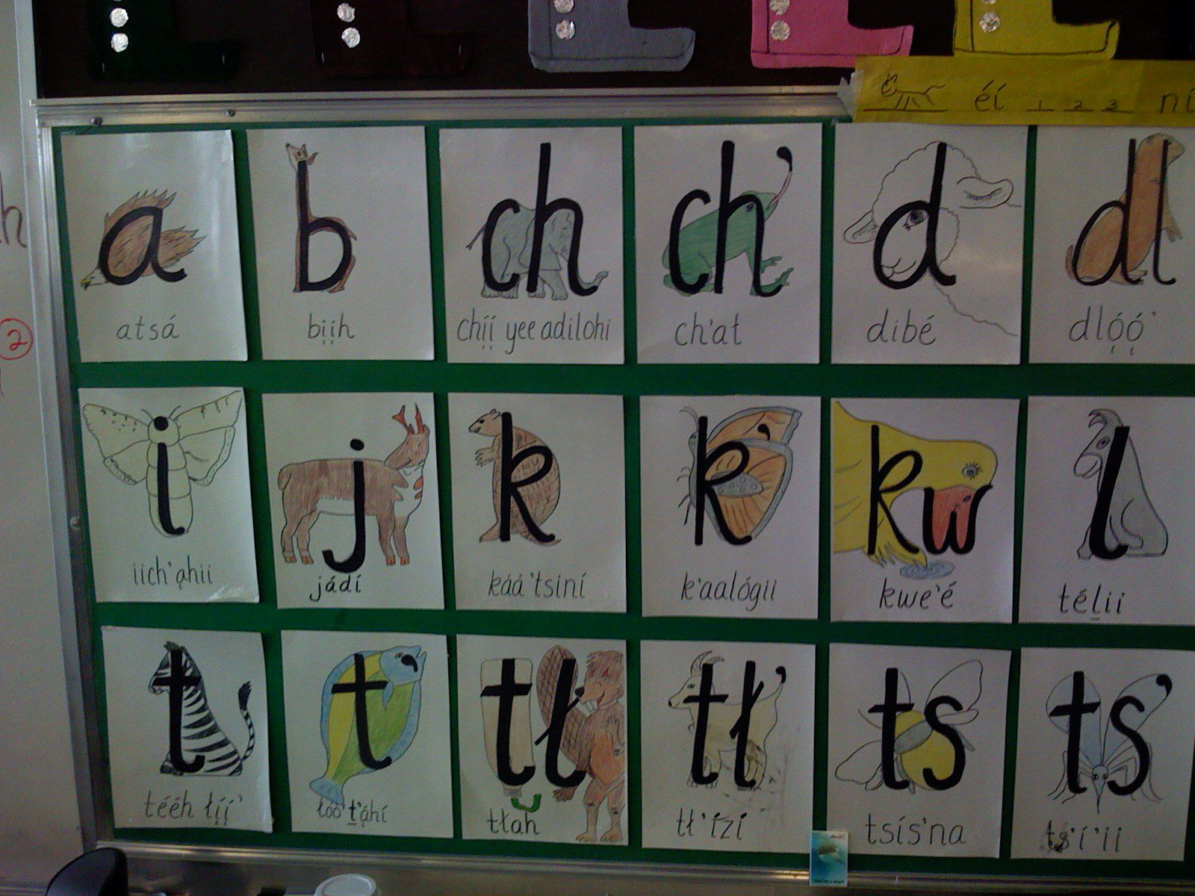
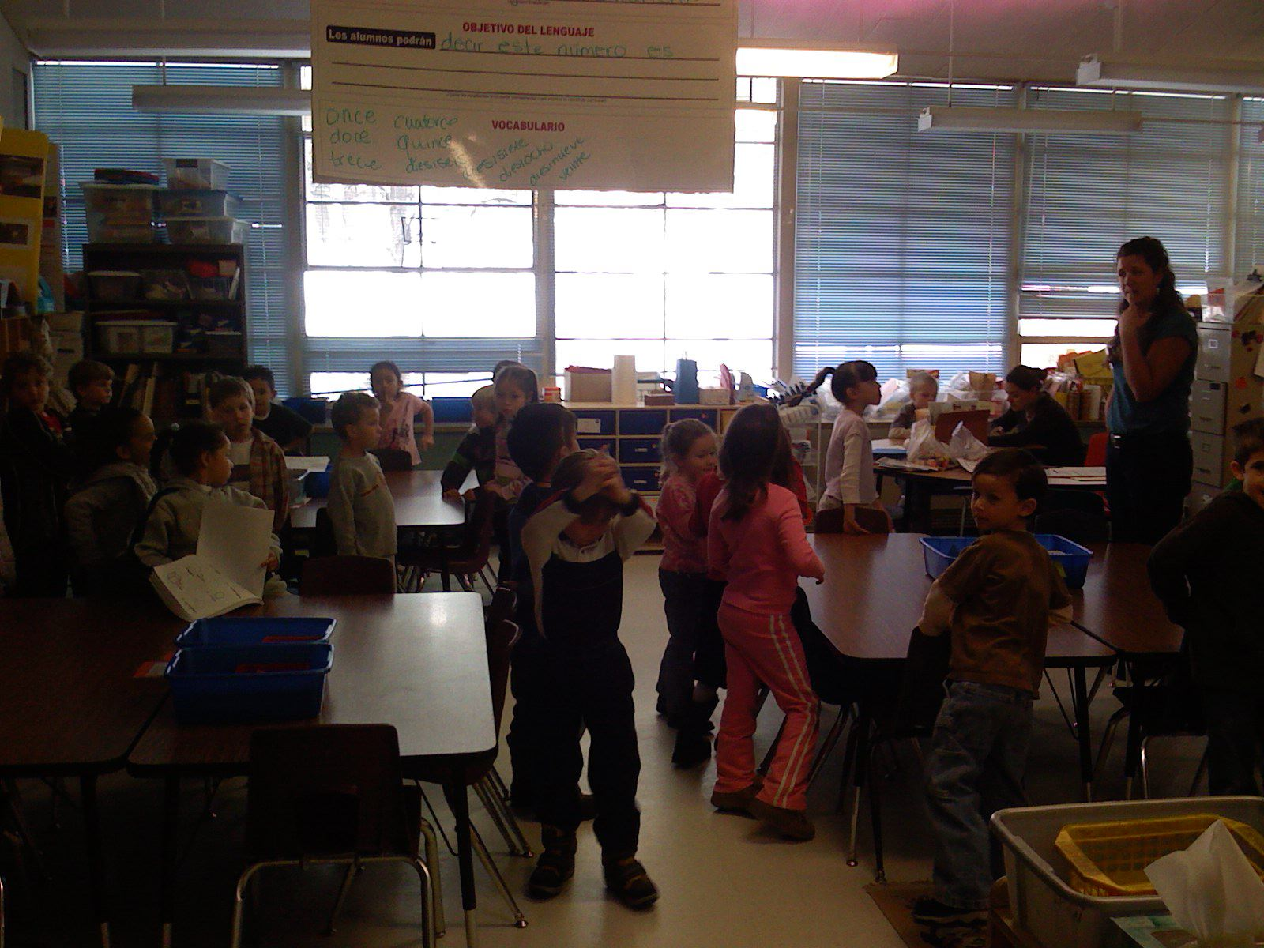
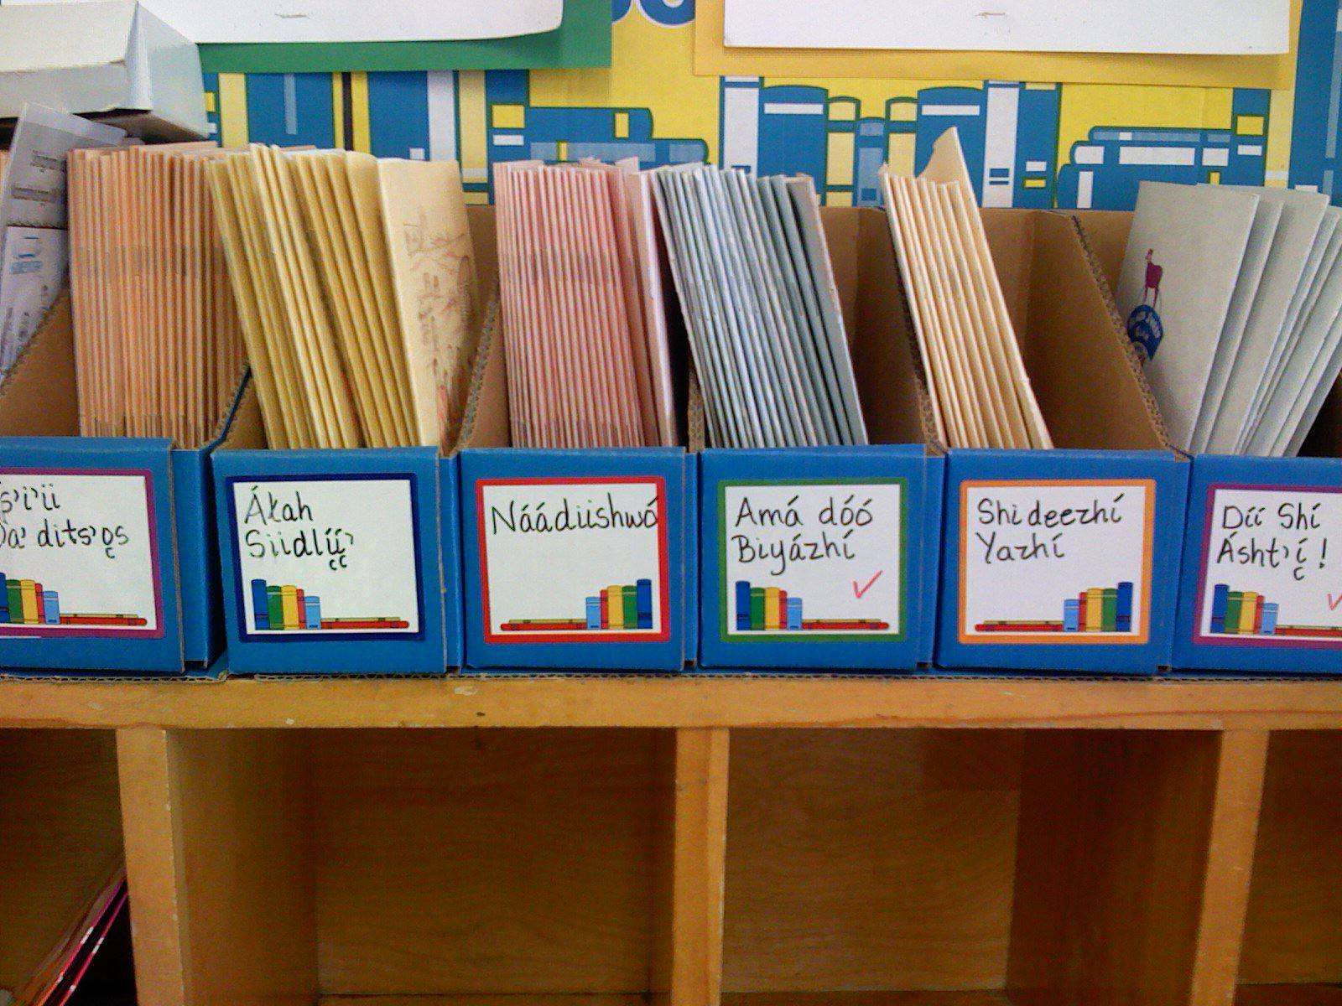
2. Navajo validated for academic purposes
34
Notes:
34

Slide 35
“We have to tell the parents – this is not what they were used to [in their own schooling].…Navajo has an academic standing. And [the] parents see, ‘Wow, this is how much my child knows,’ instead of, ‘This is what your child doesn’t know.’ We … celebrate the growth they’re making.” – Diné teacher (Field notes, January 2010)
35

Slide 36
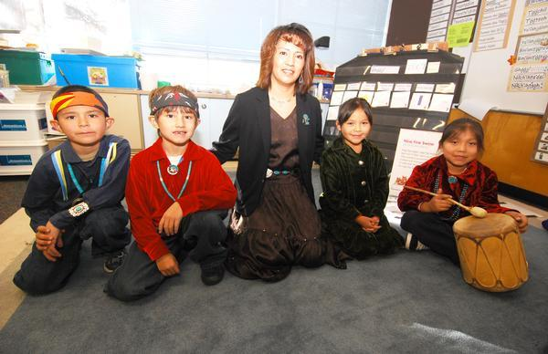
3. Rejection of deficit labels: PdH students are considered an educational “elite.”
“What we’ve done here is make speaking Navajo a status symbol. Because in the past it was…looked down upon, but here, it’s like, ‘What’s wrong with you if you can’t speak it?’” – Diné 2nd/3rd grade teacher, interview, January 2010
36

Slide 37
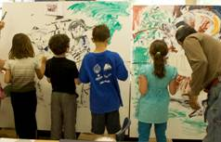
Promising practices at Puente de Hózhó, cont’d –
4. High levels of parent-community involvement.

Slide 38
The “Spirit of the School” –
…The school represents real life. English is taught …, Spanish is taught…, Navajo is taught…. And that really is how the world is…. … and when the children leave the classroom they know out there, there will be children speaking Spanish and English and Navajo…and it’s ok. It’s ok to be different and that is what the spirit of the school is…” — Diné 1st grade teacher, interview, January 2010

Slide 39
Let’s look at the data — Puente de Hózhó SAT 9 scores, 1st grade, 2003
(Source: M. Fillerup, in press)
Subject Area Tested | Mean Diné Student Percentile Rank
Reading | 71st
Math | 84th
Language | 53rd

Slide 40
AIMS reading scores, 2008: % of Puente de Hózho Native American students meeting or exceeding standards
(Source: M. Fillerup, in press)
Grade | District % | PdH %
3 | 57% | 71%
4 | 54% | 75%
AIMS math scores, 2008: % of Puente de Hózho Native American students meeting or exceeding standards
(Source: M. Fillerup, in press)
Grade | District % | PdH %
3 | 68% | 76%
4 | 61% | 63%

Slide 41
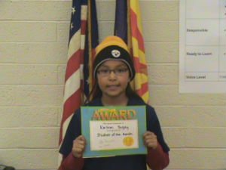
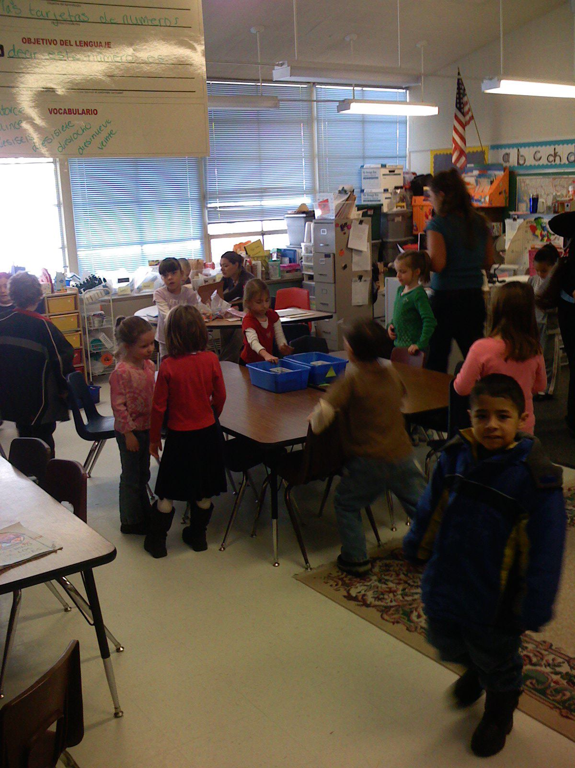
And then there are the unquantifiables…
Enhanced student motivation and “the smiles on the faces of parents, grandparents, and students” as they communicate in the language of their elders. — Dr. Michael Fillerup, PdH cofounder, FUSD Bilingual/ESL Education Director (2005)

Slide 42
A Final Data Set:
The Native Language Shift and Retention Study
(Arizona State University and the University of Arizona)
5-year (2001-06), United States Department of Education-funded study of the nature and impacts of Native language loss and revitalization on Native American students’ school achievement at 7 Southwest Native school-community sites.
(McCarty, Romero-Little, Warhol, & Zepeda, 2009; Romero-Little et al., 2007)

Slide 43
What youth said:
“It’s my language, and I think it makes me more O’odham when I speak it.”
“It’s our blood language.”
“I would like to know my cultural language.”
“Knowing my language helps me not to lose the identity of who I am and where I come from…”

Slide 44
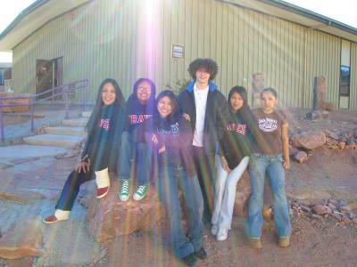
What youth are telling us:
The Native language and culture are sources of identity and pride.
Youth are not indifferent to their tribal language and culture; they want to learn it and pass it on to future generations.
They need our support.
(Photograph by C.M. Roessel, 2007)

Slide 45
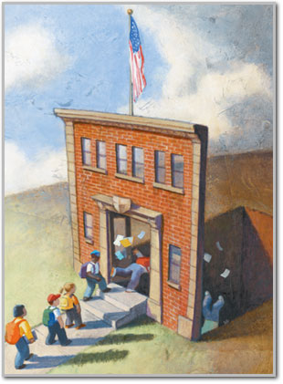
But –
We also found the pressures of the No Child Left Behind (NCLB) and Every Student Succeeds Act are leaving Indigenous languages and cultures behind.

Slide 46
Summing Up:
The State of the Field on the Role of Native Languages and Cultures in American Indian/Alaska Native Student Achievement

Slide 47
State of the Field: What the Research Says
1. Strong, academically rigorous Native language and culture programs improve student achievement, as measured by multiple assessments (including, but not limited to, standardized tests).
2. This approach enhances self-esteem, cultural pride, and promotes learning the Native language and culture.

Slide 48
3. Time spent learning the Native languate and culture is not time lost learning academic English.
When provided with sustained, high quality Native language and culture instruction, students perform as well or better than their peers in mainstream classes.
Meanwhile, they have the benefit of developing proficiency in two (or more) languages.

Slide 49
4. Strong Native language and culture programs offer unique opportunities to involve parents and elders in their children’s learning — a factor universally associated with improved achievement.

Slide 50
5. Native teacher preparation (“growing our own”) is an essential element of research-based promising practices.

Slide 51
6. The effectiveness of Navajo language and culture programs (their ability to achieve their promise) rests on the ability of tribes and Native school boards to exercise SOVEREIGNTY in their children’s education.

Slide 52
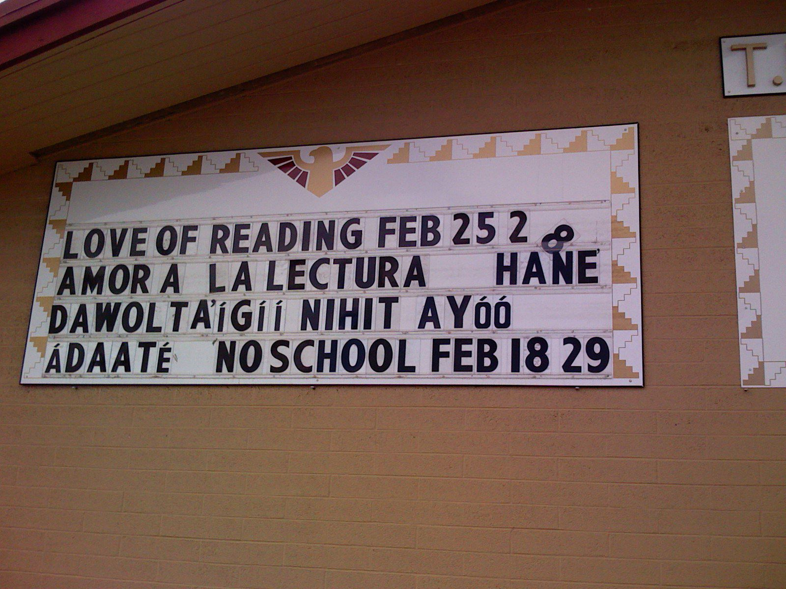
The possibilities …

Slide 53
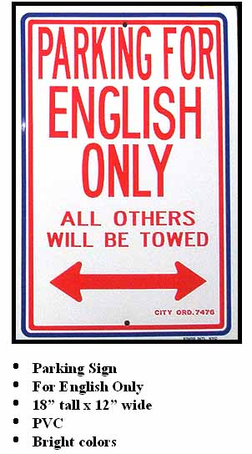


And the constraints

Slide 54

“Awakening the Spirit” —
Recommendations for NCLB Reauthorization:
What we must ask of any education policy:
Accountable to whom?

Slide 55
“Authentic Accountability”
(Crawford, 2007; McCarty, 2008)
Flexible – day-to-day decisions made locally
Constructive – helping schools improve
Valid – using multiple measures
Reasonable – evaluation based on growth
Balanced – test scores are only one measure
Equitable – fair to all
Research based – not just clinical trials

Slide 56
They are the promise in “promising practices”…

Slide 57
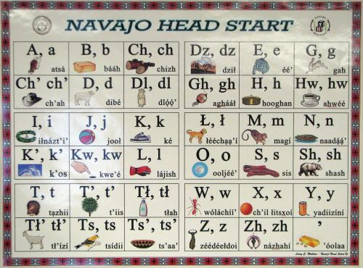

Slide 58
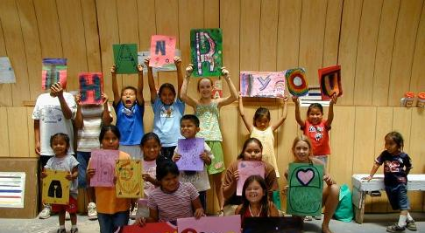
Ahéhee’ — Thank you!

Slide 59
Hallett, Chandler and LaLonde (2007) examined data from 150 First Nations communities in British Columbia and found that communities with less conversational knowledge of their native language had suicide rates six times greater than those with more knowledge.

