Slide 1
Religion and Education in the United States
BME 210 Week 15

Slide 2
Religion in the United States
90% of the U.S. population claims a preference to some religious group.
About 43% of adults attend a church or synagogue in an average week.

Slide 3
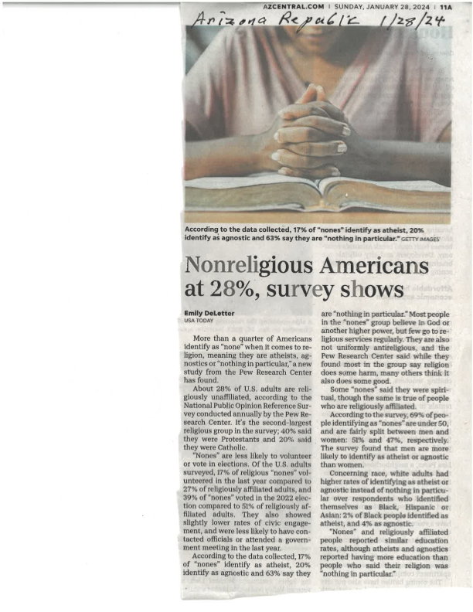
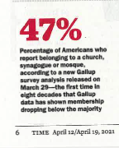

Slide 4
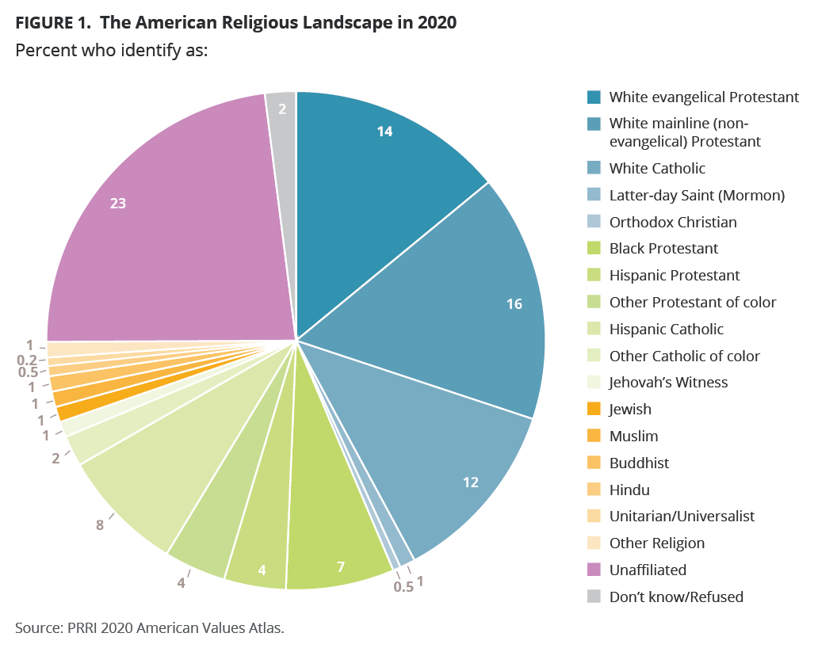

Slide 5
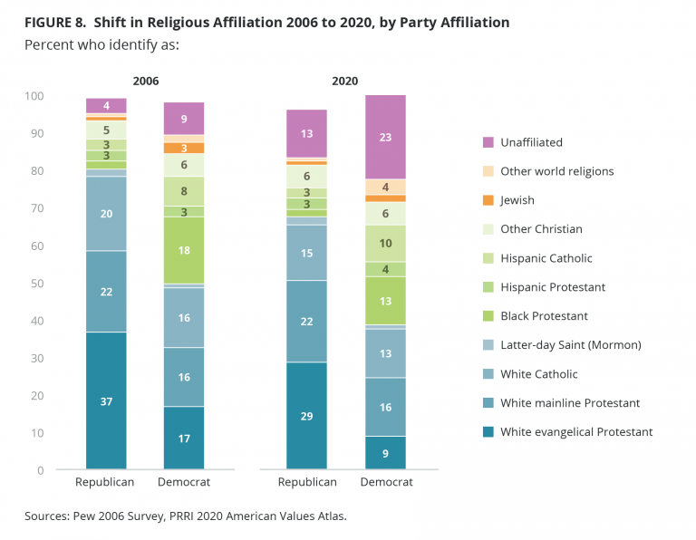

Slide 6
American’s View of Religion
Americans strongly equate religion with personal ethics and behavior
They believe that society’s problems would be solved if people were more religious
A majority of people do not feel that any certain religion is better than another, only that religion in general has a strong place in American society

Slide 7
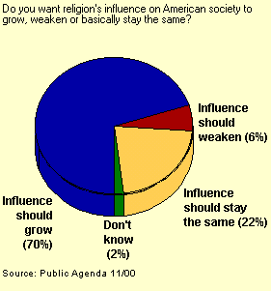
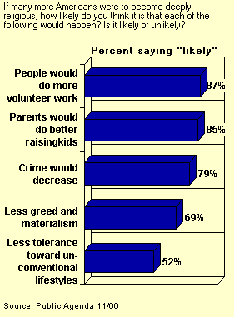
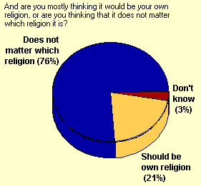
Charts

Slide 8
A Complex Issue: Religion In Public Schools
Many Americans feel that religion has been separated from the schools too much
They also do not want to isolate students of differing beliefs from one another
Parents also want to have the right to teach their children the aspects of religion that are important to them, not necessarily to the entire nation

Slide 9
Recap
Americans feel religion plays an important role in helping solve society’s ills, no matter what religion it is
Americans want religion to play a bigger role in the nation’s public schools
Americans do not want to infringe on anyone’s right to practice and teach religion

Slide 10
Question and Answer
Question: Can having a prayer during the school day help restore some of the crumbling values that people see in our society?
Answer: 79% of Americans think so. Where the answer become difficult is in what form that prayer is.

Slide 11
Prayer In Public Schools

Slide 12
Only Two Choices
Since the courts have firmly stated that there is to be no school led prayer of any kind, there are only two legitimate choices that schools may choose between:
Nothing
A moment of silence were the student can reflect, relax, pray if he or she wants to, or do nothing

Slide 13
Religion and Education
Religious groups exert powerful influences in education.
The dominant protestant groups have often determined the moral teachings that have been integrated into the public schools.

Slide 14
The First Amendment
The United States is unique among nations regarding the separation of church and state.
It is one of the most controversial, yet valued, parts of the U.S. Constitution
Most Americans support separation of church and state—if it favors their group and other religious groups’ values are not imposed on them

Slide 15
Multicultural Education
Multicultural education is sometimes maligned as supporting movements that detract from basic moral values.
Multicultural education, however, provides a foundation for understanding and appreciating diversity.

Slide 16
Religion and Schools
Religion may be particularly troublesome for teachers as perspectives vary greatly about the role of religion in education.
Religion may be an important part of the cultural makeup of an individual.

Slide 17
Religion and Culture
In 2006, 57% of Americans reported their religious beliefs to be very important in their lives.
27% indicated that it is fairly important.
This suggests that religion is important to more than four out of every five Americans.

Slide 18
Religion and Culture
Most people identify with a religious perspective that is reflected in their daily living.
Religious behavior is learned as a normal part of the socialization pattern.
Age, gender, geographical background, and political affiliation appear to influence people’s religious nature.

Slide 19
Religious Pluralism
Religion in the United States is dynamic, constantly changing.
Within each major religious group is considerably heterogeneity.

Slide 20
Protestantism
Protestants make up approximately 49% of the U.S. population (Gallup Poll, 2006).
Although not a numerical majority, their influence is still continued in society and institutions.
Among Protestants there is considerable diversity in views (denominational pluralism).
  Liberal/Conservative Protestants
  Evangelical/Fundamentalist Christians
Fundamentalist and Evangelical Christians exert particular influence in education and politics.

Slide 21
Catholicism
One denomination, under a Pope, which has authority over all Catholics throughout the world.
Approximately 24% of the U.S. population identifies with the Roman Catholic Church (Gallup Poll, 2006).
Membership in U.S. Catholic churches involves many different ethnic groups.
The Roman Catholic Church in the United States has developed the largest private educational system in the world.

Slide 22
Judaism
Judaism is one of the oldest religions known to humanity.
It provides the historical roots of both Catholicism and Protestantism.
Judaism represents about 2% of the U.S. population.
Although a small percentage of the population, contributions of Jewish Americans in major fields of study and entertainment, business, economics, and politics have been profound.

Slide 23
Judaic Pluralism
There is no Jewish race.
Jewish identity is blended in historical, religious, and ethnic variables.
American Jews come from diverse backgrounds, and range in religious adherence to traditional Jewish law.
The synagogue in the United States serves not only as a place of religious worship but also as a primary base for Jewish identity.

Slide 24
Judaism in the Community
In some orthodox communities, Jewish private religious schools provide academic and religious instruction.
Public schools are increasingly focusing on inclusive “holiday” celebrations rather than Protestant affiliations only with “Christmas” or “Easter.”
The political influence of the Jewish population is significant.
Discrimination against Jews, or Anti-Semitism, is still present in occupational and social life, and is the motive for many hate crimes.

Slide 25
Islam
Recent world and U.S. events, especially September 11, 2001, make Islam of particular importance to us.
Most Americans view Islam as primarily a Middle Eastern religion, but only 20% of its followers are Arabs.
Countries with the largest number of adherents are Indonesia and India, with approximately 175 million each.

Slide 26
A Few Facts About Islam
Islam is one of the world’s great religions.
It is one of the largest religions in the world with an estimated 1.3 billion followers.
Estimates of Muslims in the United States are as high as 7 million, with 1,209 mosques.*
*U.S. State Department, 2004

Slide 27
Islamic Beliefs
As a religious term, Islam means “to surrender to the will or law of God.”
Islam is based on the holy writings of the Qur’an or the Koran.
Muslims (those who surrender to the will of God) believe the Qur’an consists of the exact words revealed by God through the Angel Gabriel to the prophet Muhammad (A.D. 570-632).

Slide 28
Islamic Beliefs (continued)
The Qur’an’s basic theme is the relationship between God and His creatures.
The Qur’an provides guidelines for society, which is just with proper human conduct, and for an equitable economic system.
Muslims believe Islam began with Adam and continued through the line of prophets including Abraham, Moses, Jesus, and Mohammad.

Slide 29
Diversity Among Muslims
Eighty-five percent of Muslims are Sunni.
Shi’i, or Shi’ite Muslims are a smaller group, however, they have attracted much attention in recent years.
Both groups believe the succession of leadership to be their own, therefore causing conflict between the two groups.
Black Muslims in the United States form a unique identity, aligned with the Nation of Islam, which has in the recent past become aligned with building safe communities and rehabilitating individuals from the prison system.

Slide 30
Muslim Students
The vast majority of Muslim students in the United States attend public schools.
After the events of September 11, 2001, many Muslim students were stereotyped negatively and feared for their safety in schools.
Culturally responsive teaching, in which teachers examine their own beliefs and educate their students about diversity, is beneficial in creating safe school environments for Muslims.

Slide 31
Buddhism
Buddhism is one of the world’s major religions.
Immigration of Asians into the United States brings thousands of additional Buddhists into the country each year.
There is diversity in the practice of Buddhism.
Buddhist beliefs encompass the suffering which is part of all existence, and the solution to suffering and meaninglessness, which is Buddha.
    The Middle Way
    The Four Noble Truths
    The Eightfold Path

Slide 32
Hinduism
Hinduism is the major religion of India.
It is the world’s third largest religion after Christianity and Islam (13% of the world’s population aligns with Hinduism).
It differs from other religions in that it does not have a single founder, nor a single system of morality or a central organization.

Slide 33
Hindi Beliefs
Several sacred writings contribute to the central beliefs of Hinduism.
The caste system, with a base in the sacred writings, was legally abolished over 50 years ago. However, it still operates in many rural areas of India.
Three gods are considered the most important in Hinduism, although there are many deities.
Hinduism teaches that the soul never dies, but rather, is reincarnated to higher or lower states depending on individual’s actions.

Slide 34

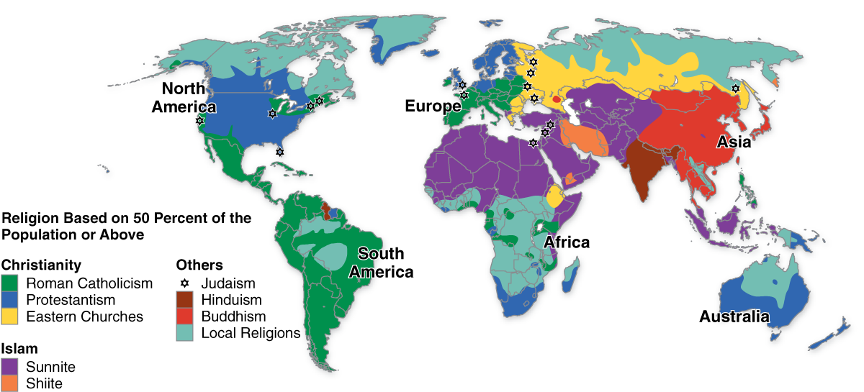
Religions of the World
Adapted from The State of Religion Atlas, New York: Simon & Schuster, 1993.

Slide 35
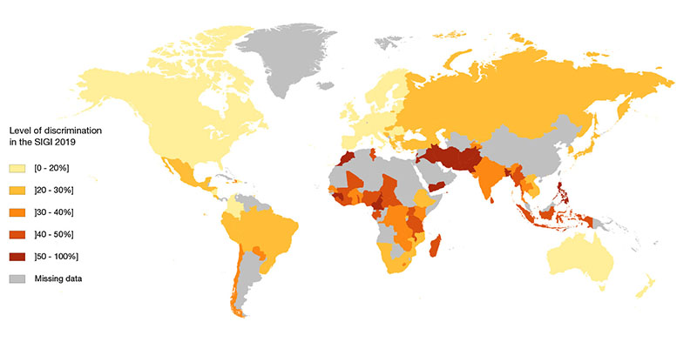
Gender Discrimination 2019

Slide 36
Other Religious Groups
Latter-Day Saints (LDS/Mormons)
Eastern Orthodoxy
Christian Science
Unitarian Universalists
Native American Religions
Jainism
Sikhism
Baha’ism
New Age Spirituality
Wicca
Cults

Slide 37
Religion and Gender
Religion often profoundly influences the gender roles in religious organizations and in society in general.
For the more conservative religious groups, the role of women is clearly defined and limited.
Women cannot attain the highest leadership positions in the Roman Catholic church, Mormon church, Islamic groups, and some conservative Protestants churches.

Slide 38
Religion and Homosexuality
Homosexuality is one of the most controversial issues in religious institutions today.
Conservative Christians and other conservative religious groups view homosexuality as a matter of choice, a sin, and curable through faith.
Liberal religious groups contend that the only choice is whether or not the individual engages in homosexual behavior, believing that the individual is born homosexual or predisposed to that life.
Views toward homosexuality vary considerably in other religious groups. There are intra-, as well as inter-group, differences in beliefs.

Slide 39
In the Schools
With opinions and emotions often running very high on homosexuality, it may be difficult for educators with strong religious views to deal objectively with those issues in the schools.
It is the responsibility of every educator to provide a safe and accepting environment in the school for every student, regardless of his or her sexual orientation.

Slide 40
Religion and Race
Religion has had a profound impact on issues of race and ethnic diversity.
In 1995, the Southern Baptist Convention apologized for its role in slavery and maintenance of a culture of racism in the United States.
Historically, many religious groups have found justification for slavery and discrimination against other religious groups in the Bible.

Slide 41
Black Religious Groups
Historically, African Americans organized their own religious institutions due to racism.
Black churches and religious institutions serve their people in practical, as well as spiritual ways.
The Civil Rights Movement was centered in Southern African American churches.
African American churches deserve much credit for many civil rights gains of the past fifty years.
.

Slide 42
Religion and Education
There is a clear history of the U.S. Supreme Court ruling against actions promoting specific religious intentions in schools.
Adherence to the First Amendment is complicated in schools and in society, where religious practices and statements have become commonplace.
Although schools should be secular, they are greatly influenced by the predominant values of the community.

Slide 43
Controversial Issues in Education and Religion
School Prayer
School Vouchers
Censorship
Secular Humanism

Slide 44
Guidelines for Teaching about Religion
The school should study what all people believe, but should not teach a student what to believe.
The school should strive for student awareness of all religions, but should not press for student acceptance of any one religion.
The school should seek to inform the student about various beliefs, but should not seek to conform him or her to any one belief.
The school may sponsor the study of religion, but may not sponsor the practice of religion.
The school may expose students to all religious views, but may not impose any particular view.
The school’s approach to religion is one of instruction, not one of indoctrination.
The function of the school is to educate about all religions, not to convert.

Slide 45
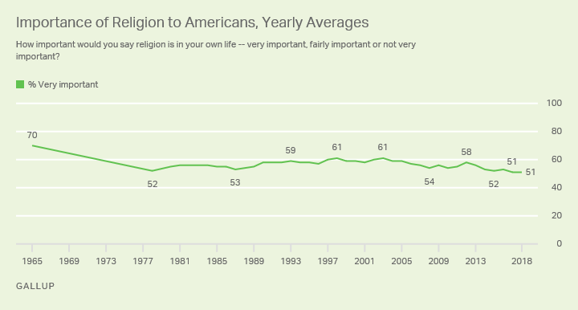
Percentage of Americans Saying Religion is Very Important in Their Lives: 1952–2018
Source: The Gallup Organization, Gallup polls on religion.
Notes:
The percentage of Americans saying religion is very important in their lives fell from 75% in 1952 to 58% in 1995.

Slide 46
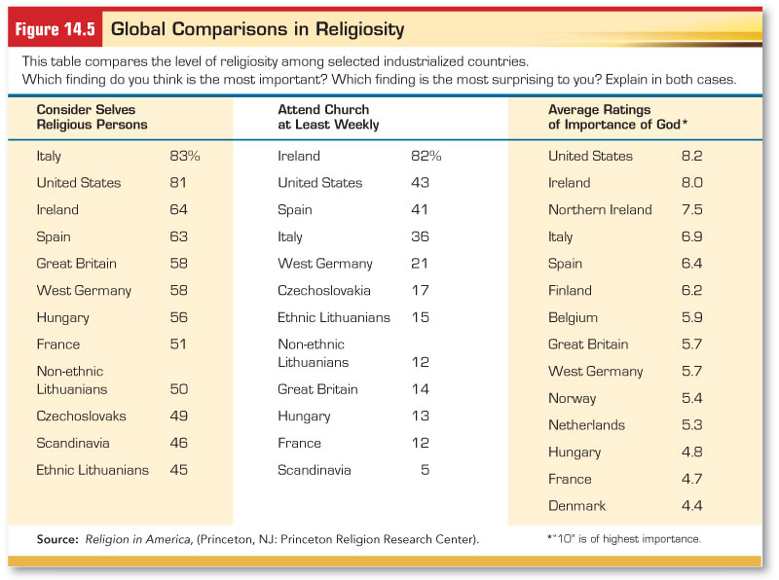
Notes:
America still appears to be a religious nation when compared with other industrial countries. Only 8% of the American population is without a religious preference.
About 7 in 10 Americans belong to some church and over ½ claim to be active.
Since 1939, weekly church or synagogue attendance in the U.S. has remained relatively stable
Americans also tend to support traditional religious beliefs. 96% of the American population believe in God or a universal spirit, 65% believe in life after death, 90% believe in heaven, and 73 percent believe in hell. 72% believe in the existence of angels.

Slide 47
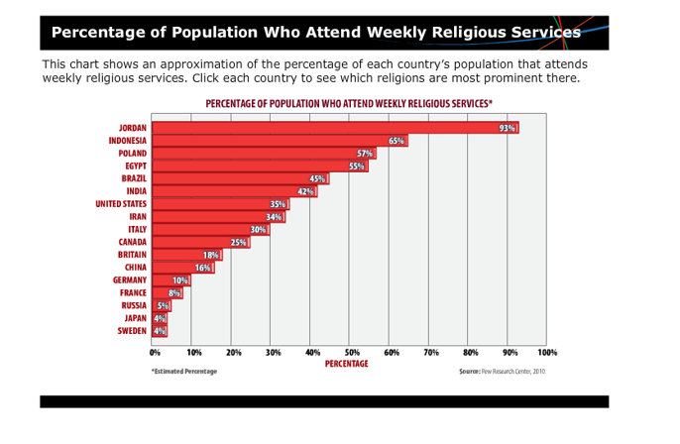
Notes:
This is the new one!
Have students conduct research on Jordan and Sweden to try to hypothesize about why there is such a large difference in the number of people who attend weekly religious services. Ask them to consider lifestyle, freedom, average income, poverty rates, and any other factors they think are relevant. Then ask the students to write a one-page essay that summarizes their findings and draws conclusions based on the research.
How does attendance in the U.S compare to that in European countries? (U.S. is higher than all European countries except Poland)
How does attendance in the U.S compare to other North American and South American countries? (Lower than Brazil, but higher than Canada)

Slide 48
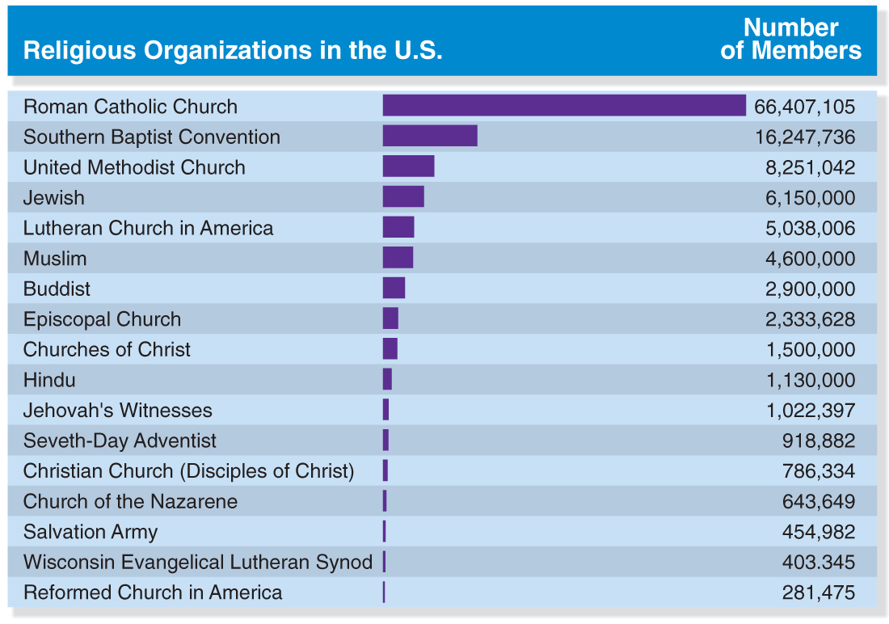
Membership in Selected Religious Organizations in the United States
Source: World Almanac and Book of Facts, 2005.

Slide 49
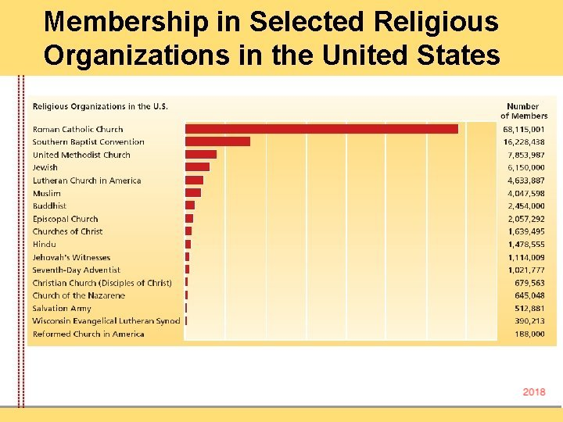
Notes:
New one

Slide 50
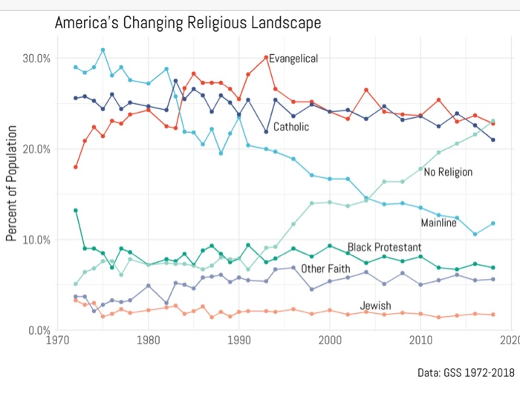

Slide 51
Fundamentalism in America
Fundamentalism is based on the desire to resist secularization and to adhere closely to traditional religious beliefs, rituals, and doctrines.

Slide 52
Fundamentalism in America (cont.)
Two issues disturbed the early fundamentalists:
The spread of secularism.
The movement away from emphasis on the traditional message of Christianity toward an emphasis on social service.
Notes:
Science was challenging the Bible as a source of truth and Marxism was portraying religion as an opiate for the masses.
Darwinism was challenging the idea of creation, and religion in general was losing its traditional strong influence.

Slide 53
Fundamentalism in America (cont.)
Christian fundamentalists believe in:
the literal truth of the Scriptures.
being “born again.”
Notes:
Fundamentalism is predominately found in Mormons, the Assemblies of God, the Seventh-Day Adventists, the Baptists, and Jehovah Witness.

Slide 54
Fundamentalism in America (cont.)
the responsibility of believers to give witness for God.
the presence of Satan.
the destruction of the world before the Messiah’s return.

Slide 55
Fundamentalism in America (cont.)
Fundamentalism is strong today because:
many Americans feel their world is out of control.
the fundamentalist churches provide solace to people who don’t feel connected elsewhere.
https://www.usatoday.com/story/news/politics/2018/05/01/loneliness-poor-health-reported-far-more-among-young-people-than-even-those-over-72/559961002/
Notes:
The social order of the 1950’s was shattered by a string of traumatic events beginning with the civil rights movement and progressing through campus violence, political assassinations, the Vietnam War, Watergate, increases in substance abuse, illegitimate births, divorce, and crime, are taken as signs of moral decline.

Slide 56
Fundamentalism in America (cont.)
they offer a more purely sacred environment.
they can use the mass media to reach people.

Slide 57
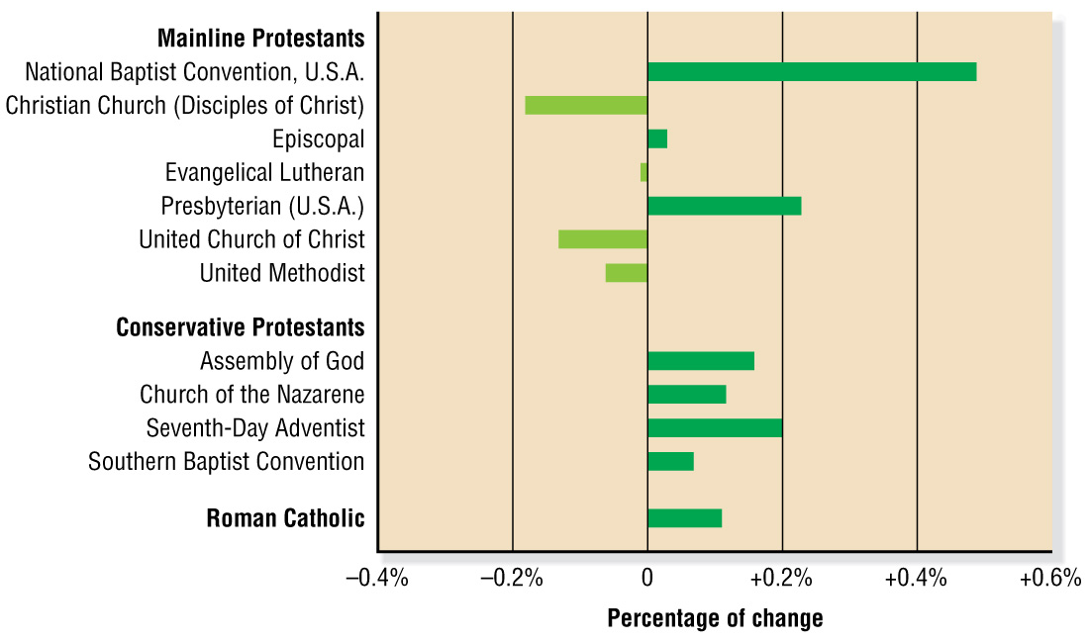
American Church Membership Trends: 1990–1999
Source: Yearbook of American and Canadian Churches, 1999.

Slide 58
Religion, Class and Politics
Religious affiliation is related to:
social class
upper versus lower class
political beliefs
Notes:
Presbyterians, Episcopalians, and Jews are at the top of the stratification structure.
Lutherans, Catholics, and Methodists are next
Baptists
Upper classes display their religiosity through church membership, church attendance, and observance of ritual, whereas people in the lower classes more often pray privately and have emotional religious experiences.
Jewish tend to be Democratic followed by Catholics and Protestants.
With exception of African Americans and Latinos, why do people who classify themselves as highly religious lean toward the Republican Party while those who classify themselves as less religious identify with the Democratic Party?(Democrats tend to be more liberal about social issues than are Republicans.) Remind students that while this is a very broad generalization it has held to be statistically true
Republicans tend to be Episcopalians and Presyterian. Not unlikely since the upper classes tend to be Republican
Baptists are the strongest supporters of the Democratic party, especially in the South.

Slide 59
Religion, Science, and Society
Religion involves matters beyond human observation, while science is all about observation.
Depending on the values and norms of the culture, society may favor religious or scientific explanations.

Slide 60
Religion, Science, and Society (cont.)
Many debates have involved the school system.
Today, some topics in science are closely tied to ethics, so the interface between science and religion is increasing.
Notes:
As part of separation of church and state, is common to keep religion apart from government sponsored institutions.
Strict fundamentalists do not believe in the theory of evolution or the Big Bang Theory should be presented in schools.
In 1999, fundamentalists used their influence in the Kansas Board of Education to remove any questions about evolution from the state high school exit examination.
Now use term “intelligent design”
In 2005, a district court in Pennsylvania ruled in favor of Tammy Kitzmiller and ten other parents and against the Dover Area School District, ruling that intelligent design was not distinct from creationism and thus could not be taught in schools, based on earlier court rulings. The court ruled that teaching intelligent design violated the establishment clause of the First Amendment. (“Congress shall make no law respecting an establishment of religion.”) The court stated in its ruling that the vast majority of the evidence at the trial showed that intelligent design was a different name for creationism and not a scientific theory. As part of the court decision in this case, the Dover school board was ordered to pay legal fees and damages or approximately $1 million.
There is a two-hour NOVA program, Judgment Day: Intelligent Design on Trial, about the Kitzmiller case and the resulting turmoil in Dover, Pennsylvania. Transcripts and an overview of the film are available at www.pbs.org. Interested students can find a wealth of information about the legal case online. They will also find information about the book, Of Pandas and People, which was the focus of the litigation and ensuing controversy.
What about teaching about cloning and gene therapy? The interference between between science and religion is sure to increase.
Today, many people are questioning whether “pure science” can remain independent of cultural or social norms, particularly because scientific processes are moving into ethically debatable areas

Slide 61

Secularization (process through which the sacred loses influence over society)
Fundamentalism (the resistance of secularization and the rigid adherence to traditional religious beliefs, rituals, and doctrines)

Slide 62
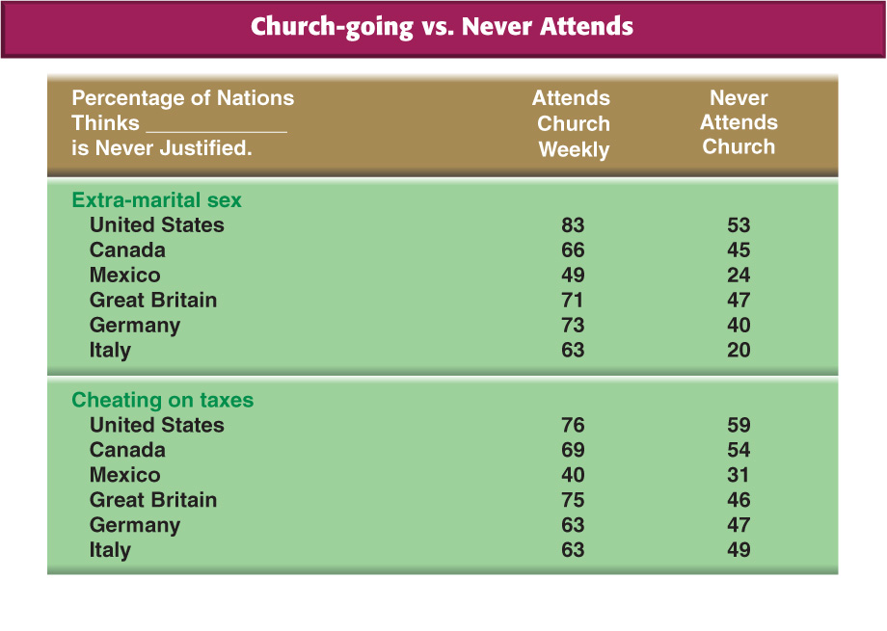


Slide 63
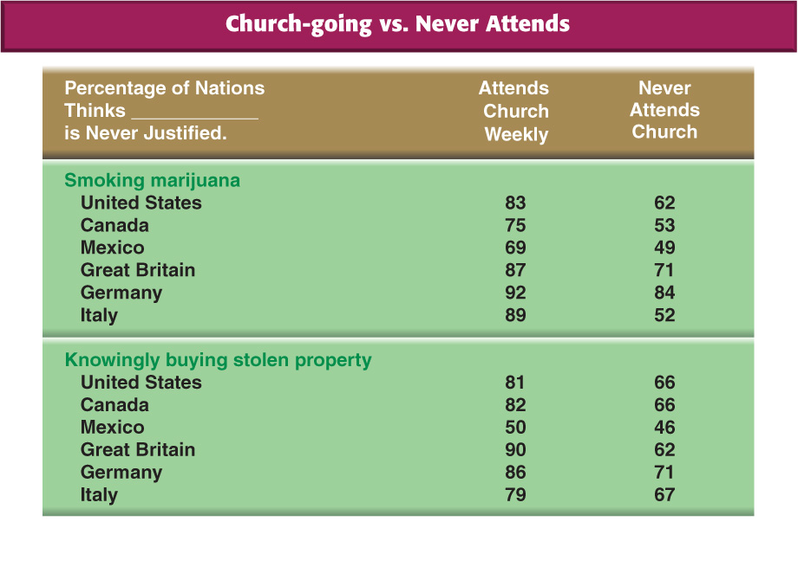


Slide 64
What are the Establishment Restrictions that Apply to Schools with Limited Open Forums?
The United States government nor any State or political subdivision thereof may
(1) influence the form or content of any prayer or other
religious activity;
(2) require any person to participate in prayer or other
religious activity;
(3) expend public funds beyond the incidental cost of
providing the space for student-initiated meetings;
(4) compel any school agent or employee to attend a school
meeting if the content of the speech at the meeting is contrary to
the beliefs of the agent or employee;
(5) sanction meetings that are otherwise unlawful;
(6) limit the rights of groups of students which are not of a
specified numerical size; or
(7) abridge the constitutional rights of any person.
Source: Equal Access Act, 1984 Section 4071

Slide 65
What Religious Liberty Opportunities Must Schools Offer when they are Limited Open Forums?
Schools are deemed to offer a fair opportunity to students who
wish to conduct a meeting within its limited open forum if such school
uniformly provides that--
(1) the meeting is voluntary and student-initiated;
(2) there is no sponsorship of the meeting by the school, the
government, or its agents or employees;
(3) employees or agents of the school or government are present
at religious meetings only in a non-participatory capacity;
(4) the meeting does not materially and substantially interfere
with the orderly conduct of educational activities within the
school; and
(5) nonschool persons do not direct, conduct, control, or
regularly attend activities of student groups.
Source: Equal Access Act, 1984 Section 4071

Slide 66
Religious Activities on Non Public Forum Government Property (prisons, military bases, polling places, etc.)
Government is free to limit access to these sites if such speech is restricted reasonably, not just because government officials disagree with the speaker’s point of view.
A Non Public Forum may be a public school that has not opened its campus for public expression in the form of non curriculum related clubs or outside groups. Use of the facility is limited to the core mission of instruction of students in the identified curriculum.
This area of equal access is much more contested in the courts.

Slide 67
Outside the holiday context, may the government post passages from sacred scripture or religious images, and may it erect monuments that feature such scripture or imagery?
It depends…
Courts examine the purpose and the primary effect of the display. They look at the context of its creation, and ask if a reasonable person would think it endorses or disparages religion.
If the display is mixed with religious and non religious elements, the chance of it looking like an endorsement are less likely.

Slide 68
What special rules regarding to religion apply to governmental workplaces [such as public schools]?
The rules for non-governmental employers apply
to government as well.
Employers have an obligation to reasonably accommodate the religious practices of their employees unless doing so would create undue hardship for the employer and minimal costs.
Employers must not treat employees more or less favorably because of their religious beliefs and practices.
Employers (especially supervisors) must ensure that employees are not subject to harassment or coercion in the workplace based on their religious affiliation and beliefs or lack thereof.

Slide 69
What special rules regarding to religion apply to governmental workplaces [such as public schools]?
Some rules for governmental employers apply as well.
Government employees (like teachers) do not enjoy free speech rights in situations related to their job duties.
  Government employers must ensure that government speech neither endorses nor disparages religion. On their own time, when one non-supervisor employee is simply talking to another about matters that are not part of work duties, the government generally must treat employees’ personal religious speech the same as other comparable forms of personal expression by employees.
  Non-establishment norms prohibit the government from preferring one religion over another, in speech or actions motivated by faith. For example, a governmental employer cannot create or implement a policy that says that workers are allowed to take a day off to attend Christian services but workers are not allowed to take a day off work to
  attend any other religion’s services.

Slide 70
What special rules regarding religion apply to governmental workplaces [such as public schools]? How do the Free Exercise Clause of the First Amendment and related laws apply in these situations?
Government employers must accommodate religious practices in ways that do not violate the constitutional prohibition against governmental establishments of religion.
The Free Exercise Clause of the First Amendment prohibits the government from targeting religious practice by selectively imposing burdens only on conduct motivated by religious belief, unless the government demonstrates a compelling justification for doing so.
  Such issues as Jewish employee time off, or breaks during the day for a Muslim employee to pray need to be considered.

Slide 71
What are some ways in which students may express their faith in public elementary and secondary schools?
Public schools may not promote or endorse religious expression, but students are free to…
  pray alone or in groups
  read their scriptures
  discuss their faith
Students are not free to…
  disrupt
  infringe upon the rights of others
Students must…
  comply with the same time, place and manner restrictions applicable to other nonschool-related student expression
In public secondary schools, students have the right to form religious clubs that meet on school property during non-instructional time if other extracurricular student clubs are permitted to do so.

Slide 72
May public schools teach about religion?
School officials may teach about religion if they are neutral in their treatment of faith, neither promoting nor denigrating religion.
Like other areas of instruction, such teaching should be fair, objective, and based on sound scholarship.

Slide 73
May public schools lead students in a voluntary recitation of the Pledge of Allegiance with the words “under God.”?
Schools must recognize that any student who objects to saying the pledge may abstain from reciting it.
The recitation of the “under God” portion of the pledge continues in the lower courts.

Slide 74
