Slide 1

Culture, Identity, & School Success
Is Assimilation a Good Idea?
BME 210 Week 2 Powerpoint
Jon Reyhner, Ed.D.
Professor of Education

Slide 2
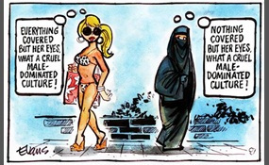

Slide 3
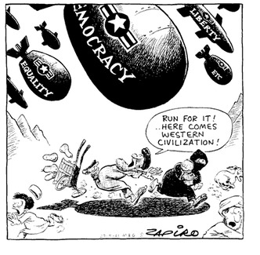

Slide 4
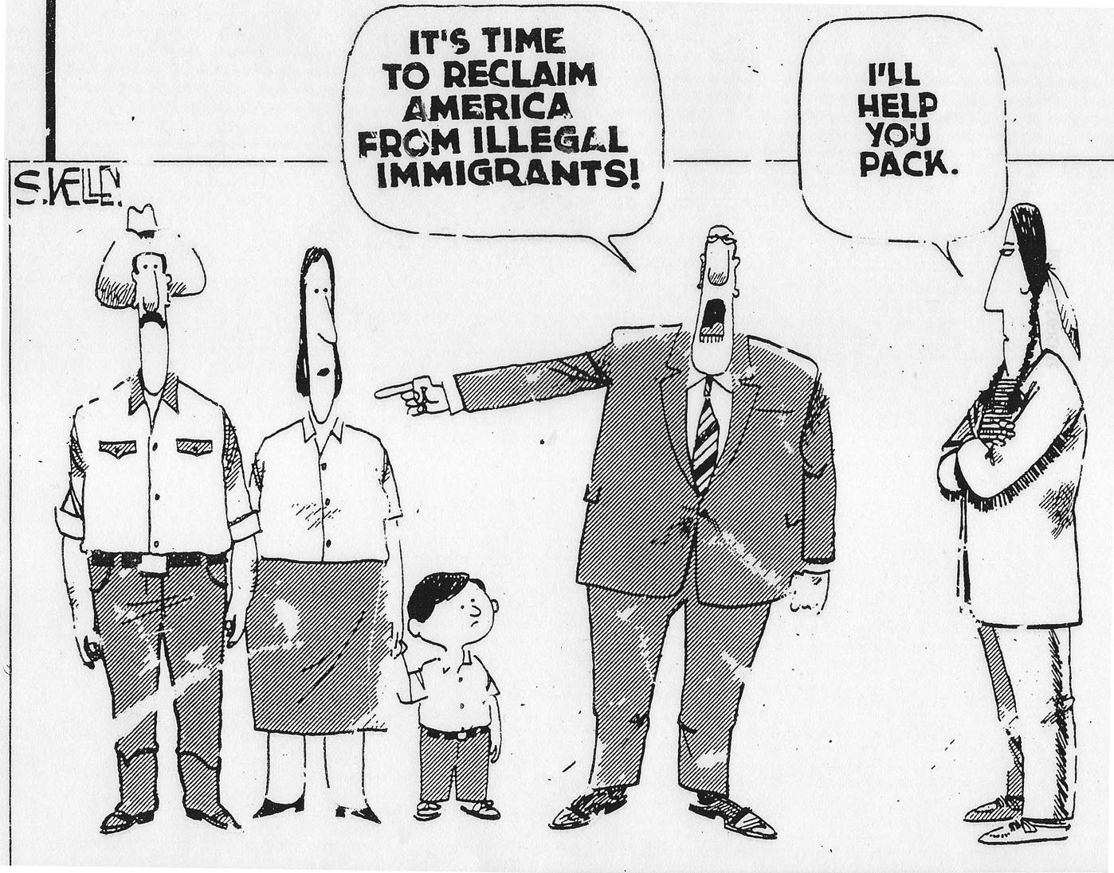

Slide 5
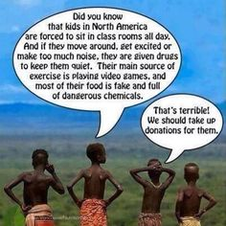

Slide 6
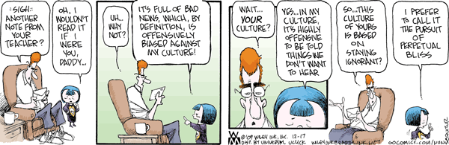

Slide 7
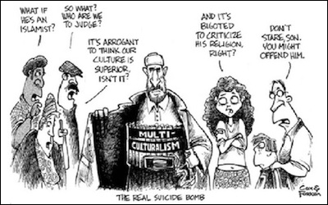

Slide 8
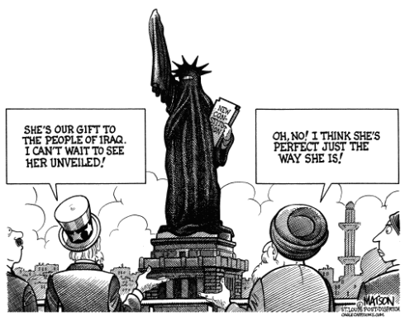

Slide 9
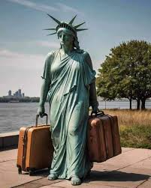

Slide 10
Unity
What Unites a Tribe?
What Unites a Country?
What does it mean to be an American?
What Can Unite the World?

Slide 11
What is the “Glue” that holds
the United States together?
U.S. Representative Tom Tancredo Republican candidate from Colorado for U.S. president said in 2007 that language is the “glue that keeps a country together” and in the U.S. that language is English.
He also said “bilingual countries don’t work…”
Newt Gingrich, another Republican U.S. presidential candidate and former Speaker of the House wrote on his website in 2007, “English is the language of American success and provides the basis for American cultural unity.”

Slide 12
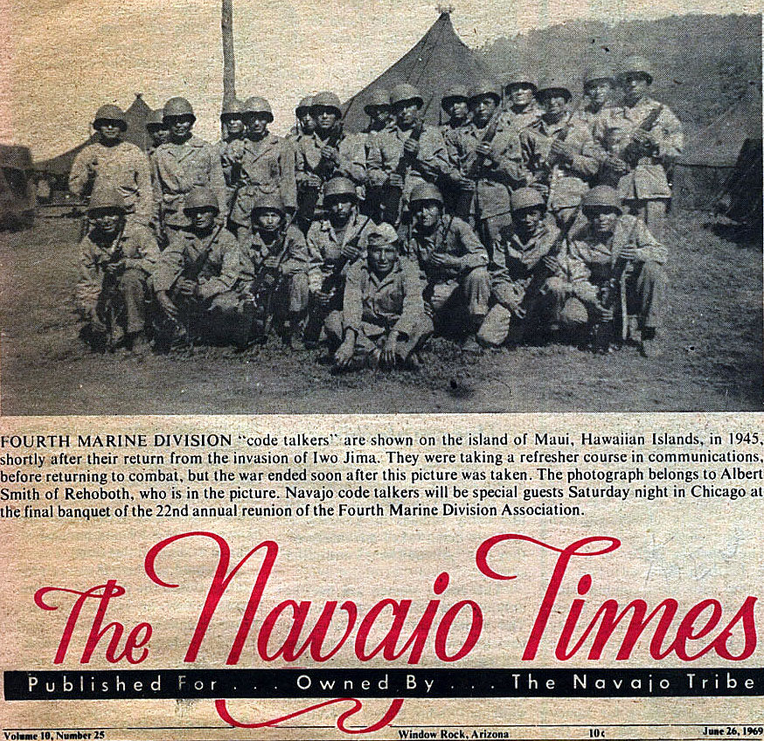

Slide 13
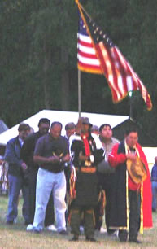
If you want to see a patriotic display in the United States, compare the playing of the national anthem at an athletic event to the grand entry at an Indian Pow Wow with its Flag Song and the honoring of veterans.

Slide 14
What is the “Glue” that holds a people together?
Is it the English language?
Or is it shared values of liberty and justice for all? Or is that just for “citizens”!
What about the respect for the human and other rights of others?

Slide 15

How Far Should Toleration Go?

Slide 16
Ethnocentrism
The belief that one’s own culture is superior to all others.
Ethnocentrism can be witnessed in schools across the world. Many experts agree that focusing a curriculum, say a world history curriculum, only on the history of the major developed countries and ignoring the developing and underdeveloped countries altogether, is an example of ethnocentrism in schools. Children are often taught only the greatness of their country, which might lead them to develop prejudices against other countries. The students belonging to minority communities/cultures can feel sidelined, targeted, or ignored.

Slide 17
Why Ethnocentrism?
•Most people are raised in a single culture and may never learn about other cultures.
•It is logical to them that their own way of life – their values, attitudes, ideas, and ways of behaving – seems to be the most natural and correct.
•Some say that it is a natural by-product of growing up in any society.
•May serve the positive societal function of enhancing group solidarity.

Slide 18
Ethnocentrism is dangerous, regretful, unhealthy, and serious
It is a major obstacle to the understanding of other cultures and to peaceful coexistence
It breeds contempt and hatred.
It inspires war.
It makes life strenuous and uncertain.
It creates emotional and physical distance between people.
It leaves barren our ability to witness and to appreciate the diversity of human beings.
We cannot eliminate ethnocentrism totally, but we can reduce it.

Slide 19
An Example of Ethnocentrism
J.D.C. Atkins, U.S. Commissioner of Indian Affairs from 1885 to 1888 wrote, “Every nation is jealous of its own language, and no nation ought to be more so than ours, which approaches nearer than any other nationality to the perfect protection of its people. True Americans all feel that the Constitution, laws, and institutions of the United States, in their adaptation to the wants and requirements of man, are superior to those of any other country; and they should understand that by the spread of the English language will these laws and institutions be more firmly established and widely disseminated.”

Slide 20
The Pervasiveness of Ethnocentrism
When he started teaching in 1899 on the Pine Ridge Reservation, Albert Kneale found the U.S. Government’s Indian Office “always went on the assumption that any Indian custom was, per se, objectionable, whereas the customs of whites were the ways of civilization.” Indian students “were taught to despise every custom of their forefathers, including religion, language, songs, dress, ideas, methods of living.”

Slide 21
However, as Civil War veteran, Grand Canyon explorer, and ethnologist John Wesley Powell noted in 1896, “so few Americans yet realize that of all the people on this continent, including even ourselves, the most profoundly religious, if by religion is meant fidelity to teachings and observations that are regard as sacred, are the American Indians, especially wherever still unchanged from their early condition, and this deeply religious feeling of theirs might, if properly appreciated, be made use of, not weakened or destroyed by premature opposition.”

Slide 22

Statement of Navajo President Joe Shirley
in 2005 after a high school shooting incident
We are all terribly saddened by the news
about our relatives on their land in Red Lake in Minnesota. Unfortunately, the sad truth is, I believe, these kinds of incidents are evidence of natives losing their cultural and traditional ways that have sustained us as a people for centuries.
Respect for our elders is a teaching shared by all native people. In the olden days we lived by that. When there was a problem, we would ask, “What does Grandpa say? What does Grandma say?”
On many native nations, that teaching is still intact, although we see it beginning to fade with incidents like this.

Slide 23
Even on the big Navajo Nation, we, as a people, are not immune to losing sight of our values and ways. Each day we see evidence of the chipping away of Navajo culture, language and traditions by so many outside forces.
Because we are losing our values as a people, it behooves native nations and governments that still have their ceremonies, their traditions and their medicine people, to do all they can to hang onto those precious pieces of culture. That is what will allow us to be true sovereign native nations. This is what will allow our people to stand on our own. The way to deal with problems like this one is contained in our teachings.

Slide 24
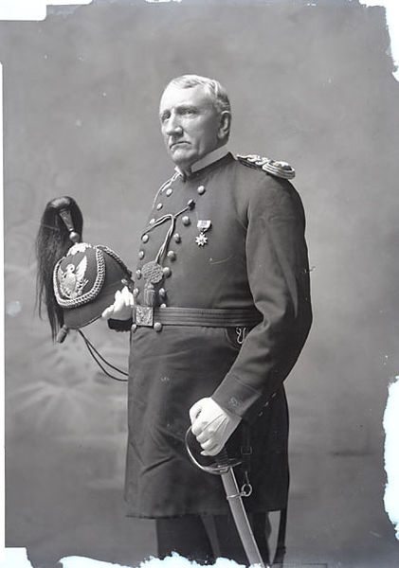
President Shirley’s views differ from those of Lt. Richard Henry Pratt who founded Carlisle Indian Industrial School in 1879 with the aim of “killing the Indian to save the man” through total cultural assimilation (now called cultural genocide). Pratt was an opponent of tribal segregation on Indian reservations. He believed that Indians could become civilized and even inter-marry with “whites.”

Slide 25
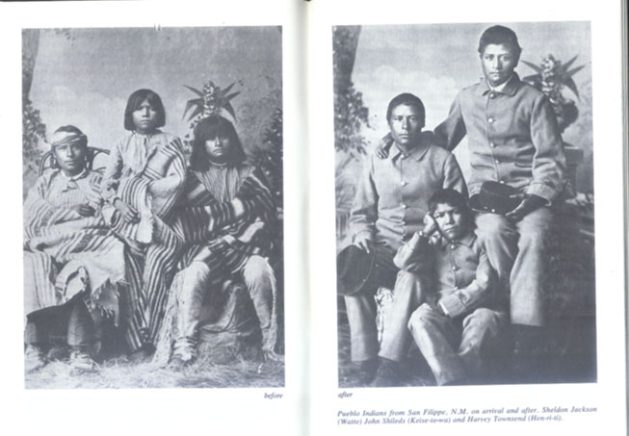
Pueblo Students at Carlisle

Slide 26
Civilization Versus Savagery
In 1869 after the Civil War (America’s bloodiest war where both the North and South spoke English), President Ulysses S. Grant’s Indian Peace Commissioners concluded that language differences led to misunderstandings and that “by educating the children of these tribes in the English language these differences would have disappeared, and civilization would have followed at once . . .”

Slide 27
The Peace Commission went on to declare that “through sameness of language is produced sameness of sentiment and thought; customs and habits are molded and assimilated in the same way, and thus in process of time the differences producing trouble would have been gradually obliterated…. In the difference of language to-day lies two-thirds of our trouble. . . . Schools should be established, which children should be required to attend; their barbarous dialect should be blotted out and the English language substituted.”

Slide 28
What Is a “Good Teacher”?
The best teachers “demonstrate their belief in the move toward Indian self-determination, while the worst are full of the passionate intensity of the old assimilationists. The best go about learning as much as they can about the tribe they work for and attempt to become culturally sensitive, respecting tribal customs and beliefs. The worst fiercely adhere to the paternal idea that Indians must be “civilized.” They approach education as though it embodied their own personal mission to convert Indians to thinking that the only way to happiness is the “White Way.”
--Mick Fedullo, Light of the Feather, 1992

Slide 29
Fort Macleod School Walkout
6/16/07, Sherri Gallant
About 50 First Nations high school students here staged a walkout from classes Friday, hoping to draw attention to the scarcity of aboriginal content in their school programming.
In early June, some of the students, who attend F. P. Walsh School, went to the Wasase Gathering in Victoria, a symposium for all ages on indigenous governance. Empowered with new information about their heritage, they returned to southern Alberta determined to make change.

Slide 30
“In Aboriginal class, they’re teaching us about beading and crafts,” said Grade 11 student Ellie Warrior. “We make dream-catchers. We’re not learning anything about our history at all.”

Slide 31
After returning from Wasase, Tiffany Bastien and Crystal English, Grade 12 students, circulated a letter to other First Nations students…this week, inviting them to take part in a peaceful walkout.
The goal, the letter said, was to ask principal Don O’Neill to offer Blackfoot Language 10, 20 and 30 with full credits, to recognize Aboriginal Day June 21 in an official day at the school, to implement First Nations culture and heritage in the curriculum, and to ensure aboriginal classes are taught by someone with experience in aboriginal studies, whether they’re native or non-native.”

Slide 32
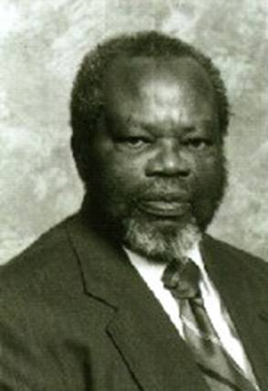
John Ogbu's
Recommendations for Minority Communities
Teach children to separate attitudes and behaviors that lead to academic success from attitudes and behaviors that lead to a loss of ethnic identity and culture or language.
Provide children with concrete evidence that its members appreciate and value academic success as much as they appreciate achievements in sports, athletics, and entertainment.

Slide 33
Teach each child to recognize and accept the responsibility for their school adjustment and academic performance.
Praise effort not smartness—Asian idea of school success resulting from effort versus being smart.
The middle class minority community must keep its ties with their ethnic community versus seeing their success as “a ticket” out. If they return, it should not be as representatives of white society.

Slide 34
Recommendations for Educators --John Ogbu
Minority students are not just culturally different; they may have ‘oppositional identities’that reject schooing.
Study the history of your students’ ethnic groups.
Provide special counseling to separate school success from ‘acting white.’
Facilitate ‘accommodation without assimilation.’
Society needs to provide more job opportunities for minority youth

Slide 35
Assimilation
A person or group assimilates when that person or group loses/forgets their home culture and adopts a new culture. Assimilation can be voluntary or involuntary.
Part of the logic of assimilation is that cultures are evolving (Social Darwinism), and “our” culture, whatever that is, is at the top of the evolutionary ladder.
https://www.pbs.org/video/italian-americans-assimilation/

Slide 36
Is Assimilation a Good Idea?
University of Utah Professor Emeritus Donna Deyhle from 20 years of research found that Navajo and Ute Indian students with a strong sense of cultural identity could overcome the structural inequalities in American society and the discrimination they faced as American Indians.
In a study of students on three reservations in the upper mid-west, Whitbeck, Hoyt, Stubben and LaFromboise reported in the Journal of American Indian Education in 2001 that the traditional cultural values defined “a good way of life” typified by pro-social attitudes and expectations and that learning the Native culture is a resiliency factor.

Slide 37
Results of Assimilation on Immigrants
The National Research Council (1998) found that immigrant youth tend to be healthier than their counterparts from nonimmigrant families. It found that the longer immigrant youth are in the U.S., the poorer their overall physical and psychological health. Furthermore, the more Americanized they became the more likely they were to engage in risky behaviors such as substance abuse, unprotected sex, and delinquency.

Slide 38
Hallett, Chandler and LaLonde (2007) examined data from 150 First Nations (Indigenous/American Indian) communities in British Columbia and found that those with less conversational knowledge of their Native language had suicide rates six times greater than those with more knowledge.

Slide 39
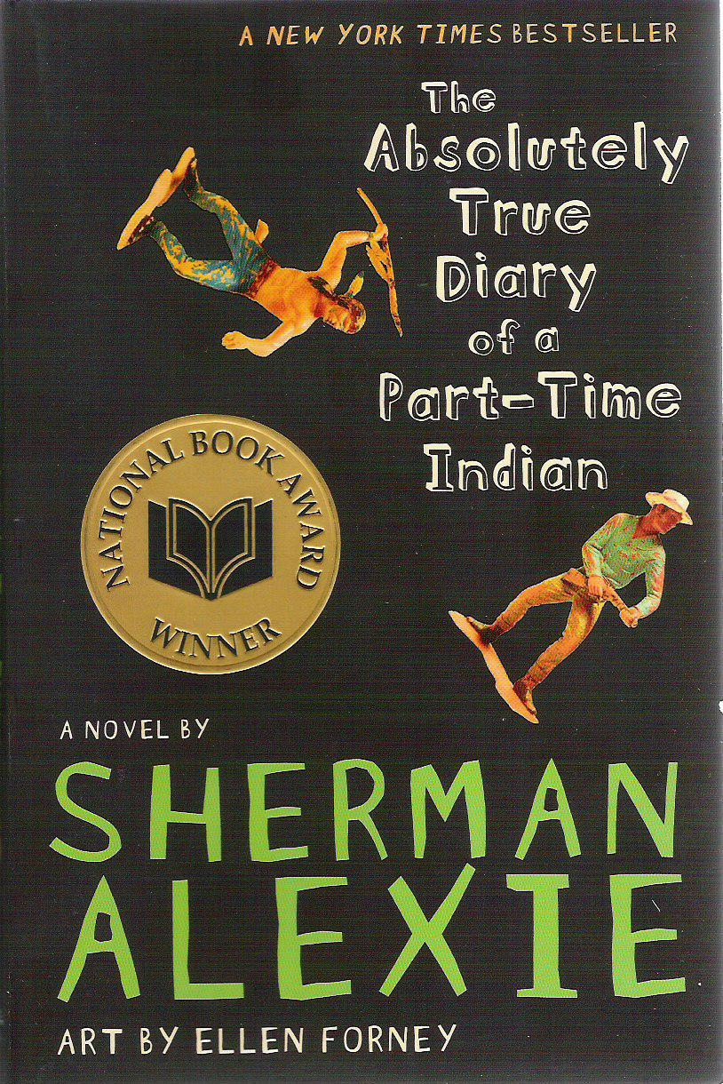
Assimilation is a controversial topic that intelligent, reasonable people can make strong arguments for and against.

Slide 40
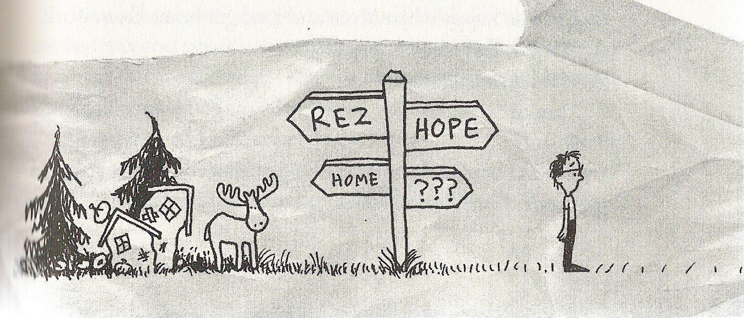
Mr. P (a teacher), “Son, you’re going to find more and more hope the farther and farther you walk away from this sad, sad, sad reservation.”

Slide 41
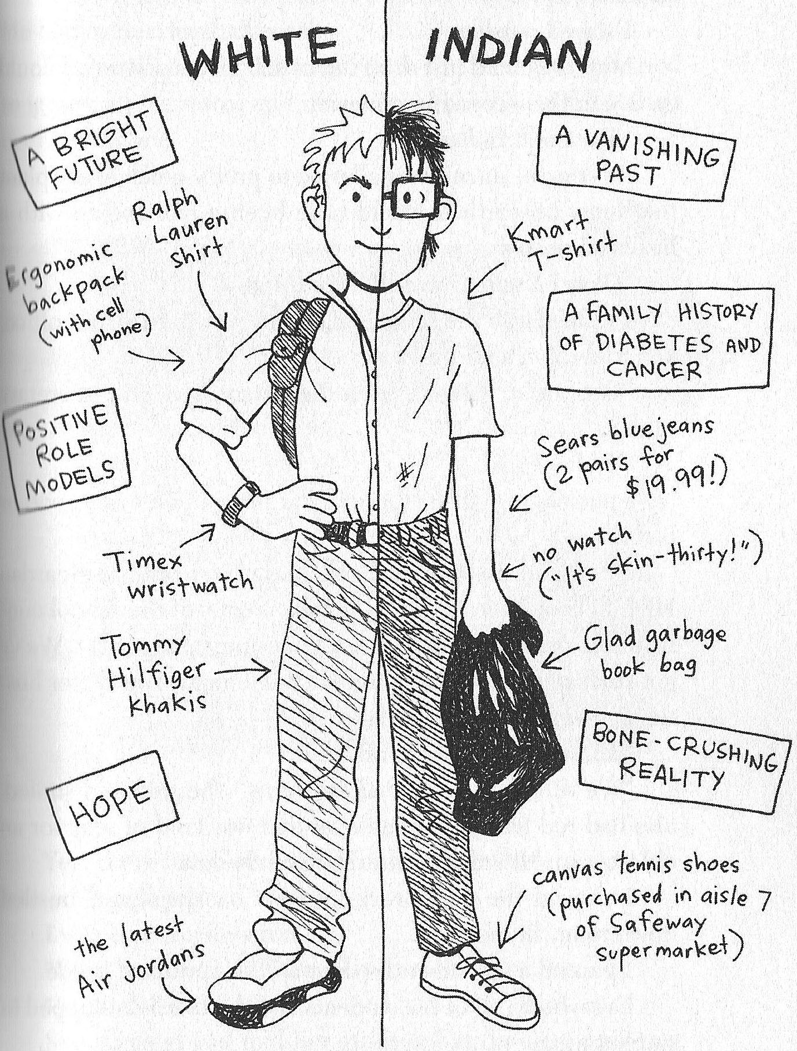
Assimilation can also mean different things to different people. It has its superficial and deep aspects.

Slide 42
“My school and my tribe are so poor and sad that we have to study from the same dang books our parents studied from. That is absolutely the saddest thing in the world.”
Mr. P. (a teacher) “That’s how we were taught to teach you. We were supposed to kill the Indian to save the child…. We were supposed to make you give up being Indian. Your songs and stories and language and dancing. Everything. We weren’t trying to kill Indian people. We were trying to kill Indian culture.”

Slide 43
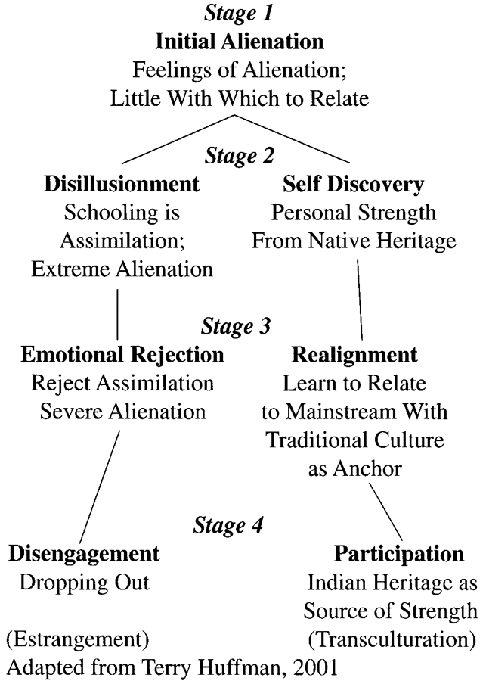
Stages that new American Indian college students can experience

Slide 44
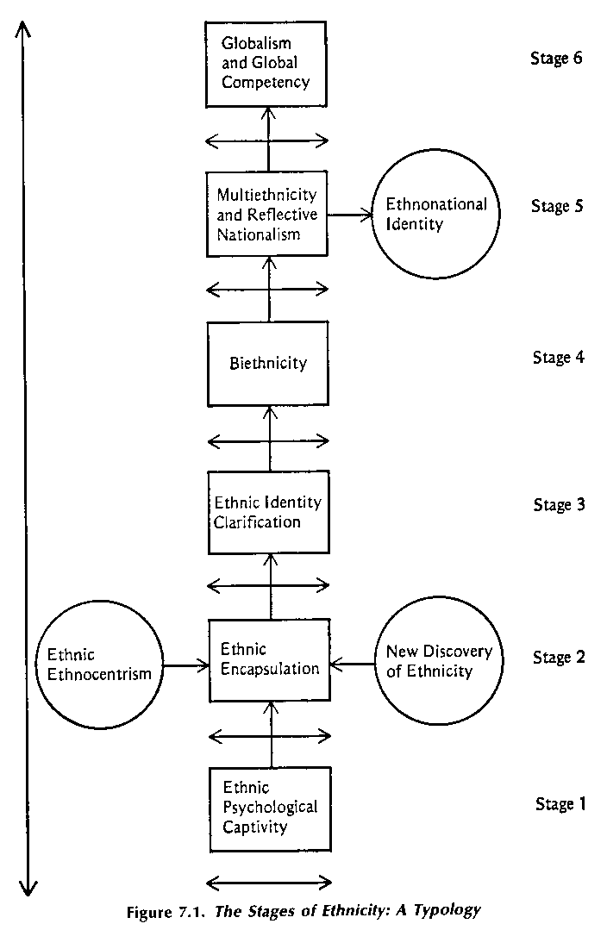
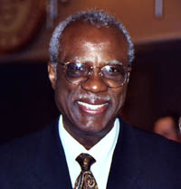
James Banks’ stages that an ethnic minority individual or group can experience as they adjust to living
alongside or among a dominant ethnic group.

Slide 45
Cultural Encapsulation
(Tribalism/Whiteman’s Shadow)
Deborah House who both took Navajo Studies classes and taught at Diné College in the 1990s found that “non-Navajo students (Anglo, Hispanic, and others) were encouraged to disparage their own upbringing and cultural experiences. Furthermore, their language, literature, religion, family life, and ethnic identities are routinely, and at times painfully, denigrated and devalued by Navajo and non-Navajo instructors, administrators, and other students.”

Slide 46
Minority Students With Complex Beliefs About Ethnic Identity Do Better in School
Daphna Oyserman, University of Michigan
Two helpful types of racial self-concept.
“Dual identity” is an optimistic, assimilationist position, in which students have positive beliefs both about their own ethnic group and about their membership in the larger society.
“Minority” identity combines positive beliefs about the student's ethnic group with skepticism toward the larger society. Students with "minority" identities vigilantly watch for instances of prejudice, but they remain pragmatically engaged with the larger society even as they criticize it.

Slide 47
Two unhelpful identities
1. “In-group-focused” students have positive beliefs about their in-group but express no sense of membership in the larger society, not even the skeptical engagement claimed by the “minority” students. These highly alienated students tend to reject norms of academic achievement and to embrace an “oppositional culture [identity]”

Slide 48
2. “Aschematic” ethnic identities—these students do not incorporate race or ethnicity into their self-concepts. When asked about what their ethnicity means to them, these students tend to answer, “Nothing. Groups don’t matter. Deep down we’re all human.” They say things that are very humanitarian and universalistic, but these students tended to disengage from academic tasks. They are especially vulnerable to “stereotype threat.” They “don’t have a preorganized framework for dealing with prejudice or buffering themselves from stereotyping. So it rattles them each time they encounter it.”

Slide 50
    “Your enemy doesn’t have to love you for you to learn something from him”—John Ogbu.
                Self-esteem is not important to one’s competence, happiness, or health—Identity is.

Slide 51
Have any of you experienced or observed something similar to Stereotype Threat or a student or students having an Oppositional Identity in regard to schooling?

Slide 52
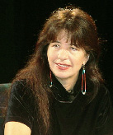
Healing and Language Revitalization
As Joy Harjo (Muscogee Creek) notes, “colonization teaches us to hate ourselves. We are told that we are nothing until we adopt the ways of the colonizer, till we become the colonizer.” But even then Native people are often not accepted—a brown [or black] skin can’t be washed off.

Slide 53
Racism is corrosive; it contaminates every part of our being, mind, body, and spirit. Racism comes in many forms, but my experiences in an integrated school in the mid-sixties were probably the most indelible and damaging for me. I was made to feel ashamed because of my race. I trace my feelings of inferiority and inadequacy to my early school experiences because of the manner in which my history, culture, and language were devalued and excluded from the curriculum. There was much to be angry about and that anger was directed inward.
—Angelina Weenie (Plains Cree), Post-colonial
Recovering and Healing in Learn in Beauty

Slide 54
Recognizing Red Rage
Faith Spotted Eagle
Red Rage is the emotional reaction or over reaction that Native people have as a response to generations of historical trauma/oppression.
It breeds a hateful tyrannical character who is often numb to the feelings of others, due to their own safety needs.
Red Rage creates rageful nations and systems. Healing hurts provides relief.

Slide 55
“The Elders tell us that it is alright to feel angry about stuff like this [e.g., the Sand Creek massacre] and it is good.
However, in the end you must go down to the river, offer a gift of tobacco to the Creator and simply let the anger go ....
Otherwise the anger will poison your spirit…”
—Heard at the 2000 Toronto International Pow-Wow

Slide 56
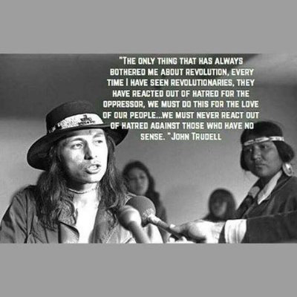
In Lak’ech
In Lak’ech Tú eres mi otro yo.
You are my other me.
Si te hago daño a ti,
If I do harm to you,
Me hago daño a mi mismo.
I do harm to myself.
Si te amo y respeto,
If I love and respect you,
Me amo y respeto yo.
I love and respect myself.
--Luis Valdez

Slide 57
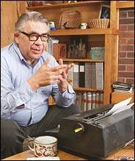
Students who are not embedded in their traditional values are only too likely in modern America to pick up a hedonistic culture of consumerism, consumption, competition, comparison, and conformity.
As Vine Deloria, Jr. (Standing Rock Sioux) wrote, “A society that cannot remember and honor its past is in peril of losing its soul.”

Slide 58
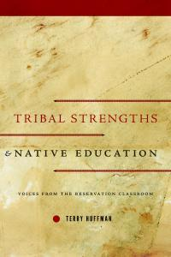
Researchers like Terry Huffman
who have spent decades studying
American Indian classroom teachers and
school administrators point to the
importance of American Indian student
identity and tribal strengths, which are too
often ignored or even devalued by teachers. A principal Huffman interviewed lamented “NCLB has changed teaching so much. I mean, assessment is the drive and it’s like we are forgetting the child…. We are leaving the child behind because we have forgotten teaching styles and, like I said, the language and the culture. That has all been put on the back burner when they should actually be up front” (Huffman, 2013, p. 95).

Slide 59
Terry Huffman (2010), among others, has marshaled evidence that “rejects the notion that American Indian students must undergo some form of assimilation to succeed academically.” Extensive interviews with experienced American Indian educators reveal how a “strong sense of cultural identity serves as an emotional and cultural anchor. Individuals gain self-assuredness, self-worth, even a sense of purpose from their ethnicity. By forging a strong cultural identity, individuals develop the confidence to explore a new culture and not be intimidated. They do not have to fear cultural loss through assimilation. They know who they are and why they are engaged in mainstream education.”

Slide 60
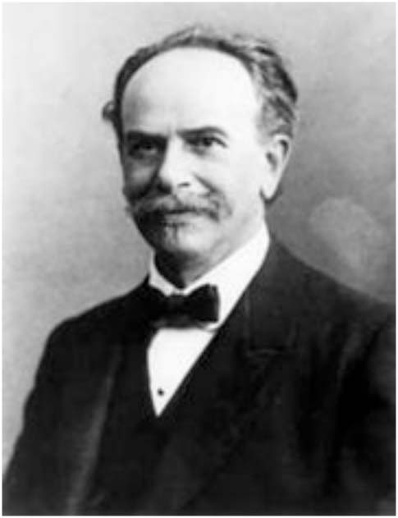
Cultural Relativism
Franz Boas (1858-1942), a
Jewish German immigrant to
the U.S. before World War I is
considered the father of
American Anthropology. He is noted for the concept of “Cultural Relativism,” which in contrast to the Social Darwinism of his day, maintained that cultures could not be hierarchically compared but were rather just different from one another.

Slide 61
US
People like me
Friends, allies, non-threatening
OTHERS/THEM
People different than us
Enemies, wicked, wrong unless they assimilate & become like us
Us versus Them

Slide 62
The flip side of the “American Dream” narrative—if you work hard and are talented you will succeed—is that if you are poor it means either you didn’t work hard or that you aren’t talented. You are not one of us. This is an example of “blame the victim.”

Slide 63
Cultural Relativism (Franz Boas): Any part of a culture (such as an idea, a thing, or a behavior pattern) must be viewed in its proper cultural context rather than from the viewpoint of the observer’s culture.
•Rejects the notion that any culture, including one’s own, possesses a set of absolute standards by which all other cultures can be judged.
•Cognitive tool that helps us understand why people think and act they way they do.
•The Cultural Relativist asks: “How does a cultural item fit into the rest of the cultural system of which it is a part?” and not, “how does this fit into my cultural perspective”?
•Does not require that you give up your own culture and practice another.

Slide 64
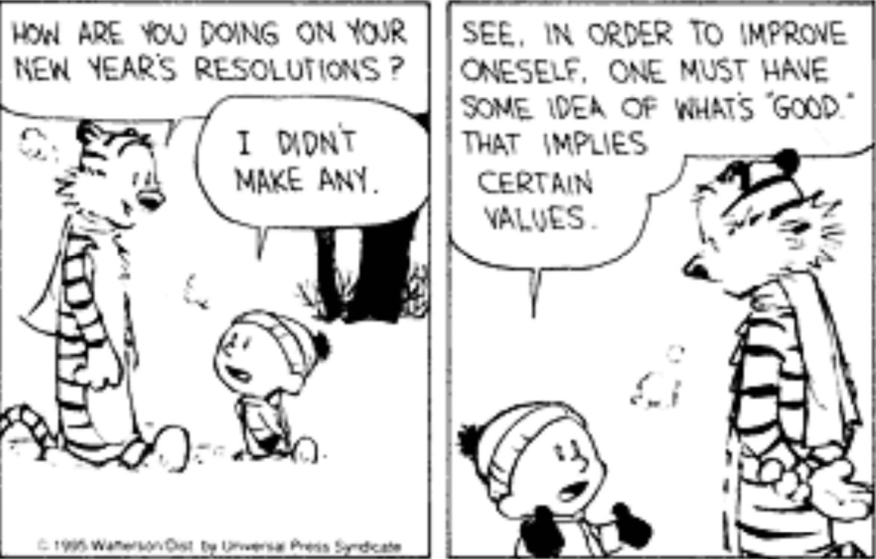
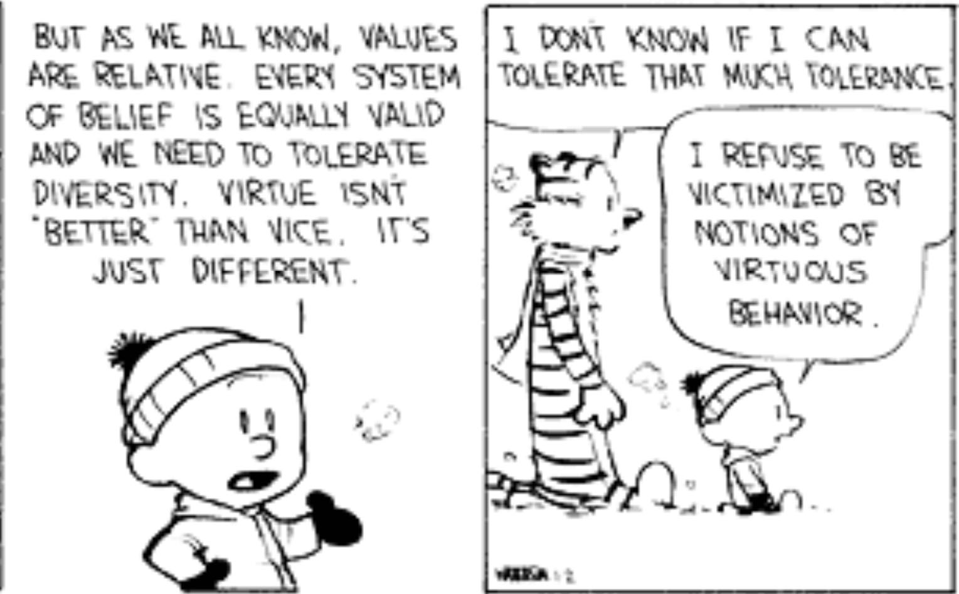
What are the limits of Cultural Relativism?

Slide 65
When is “Wrong” Really Wrong
No Matter What Culture?
If Cultural Relativism is taken to its logical extreme, then we would conclude that absolutely no behavior found in the world is immoral – wrong – provided that the people who practice it concur that it is morally acceptable and that it performs a function in the interest of the society.
Practicing Cultural Relativism does not require that we view all cultural practices as morally equivalent; that is, not all cultural practices are equally worthy of tolerance and respect.
Some cultural practices are morally indefensible in any cultural context because it is believed that all humans have rights – entitlements to a certain level of treatment (that may be formalized in laws or socially-acceptable and expected).

Slide 66
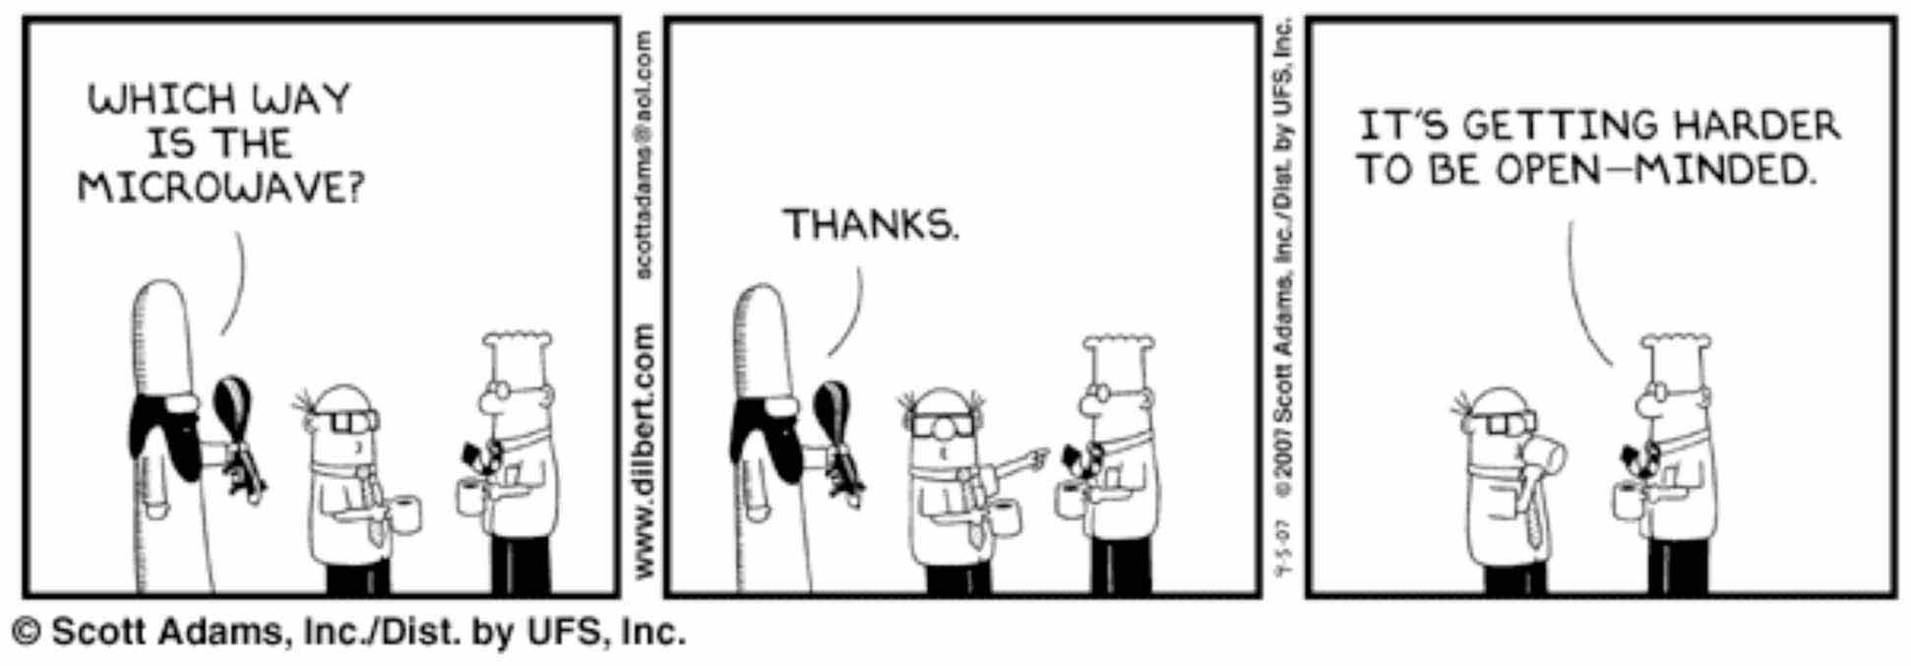
What are the limits of cultural relativism
and tolerance?
The highest result of education is tolerance.
--Hellen Keller

Slide 67
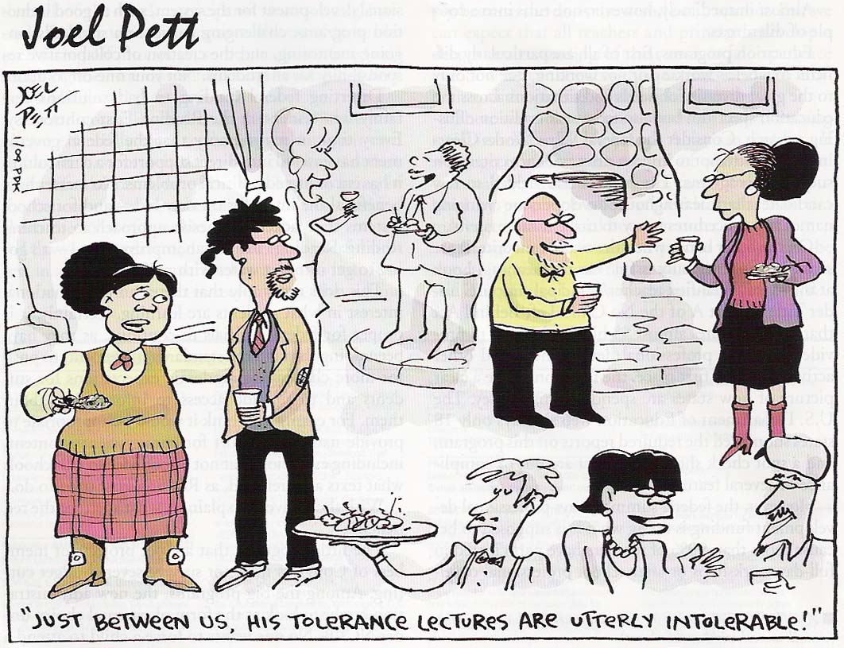

Slide 68
What Is It Okay to Eat/Drink?
Carrots
Beef
Mutton
Rabbit Meat
Fish
Ham/Pork
Horse Meat
Dog Meat
Snakes
Snails
Grasshoppers
Beer/Wine

Slide 69
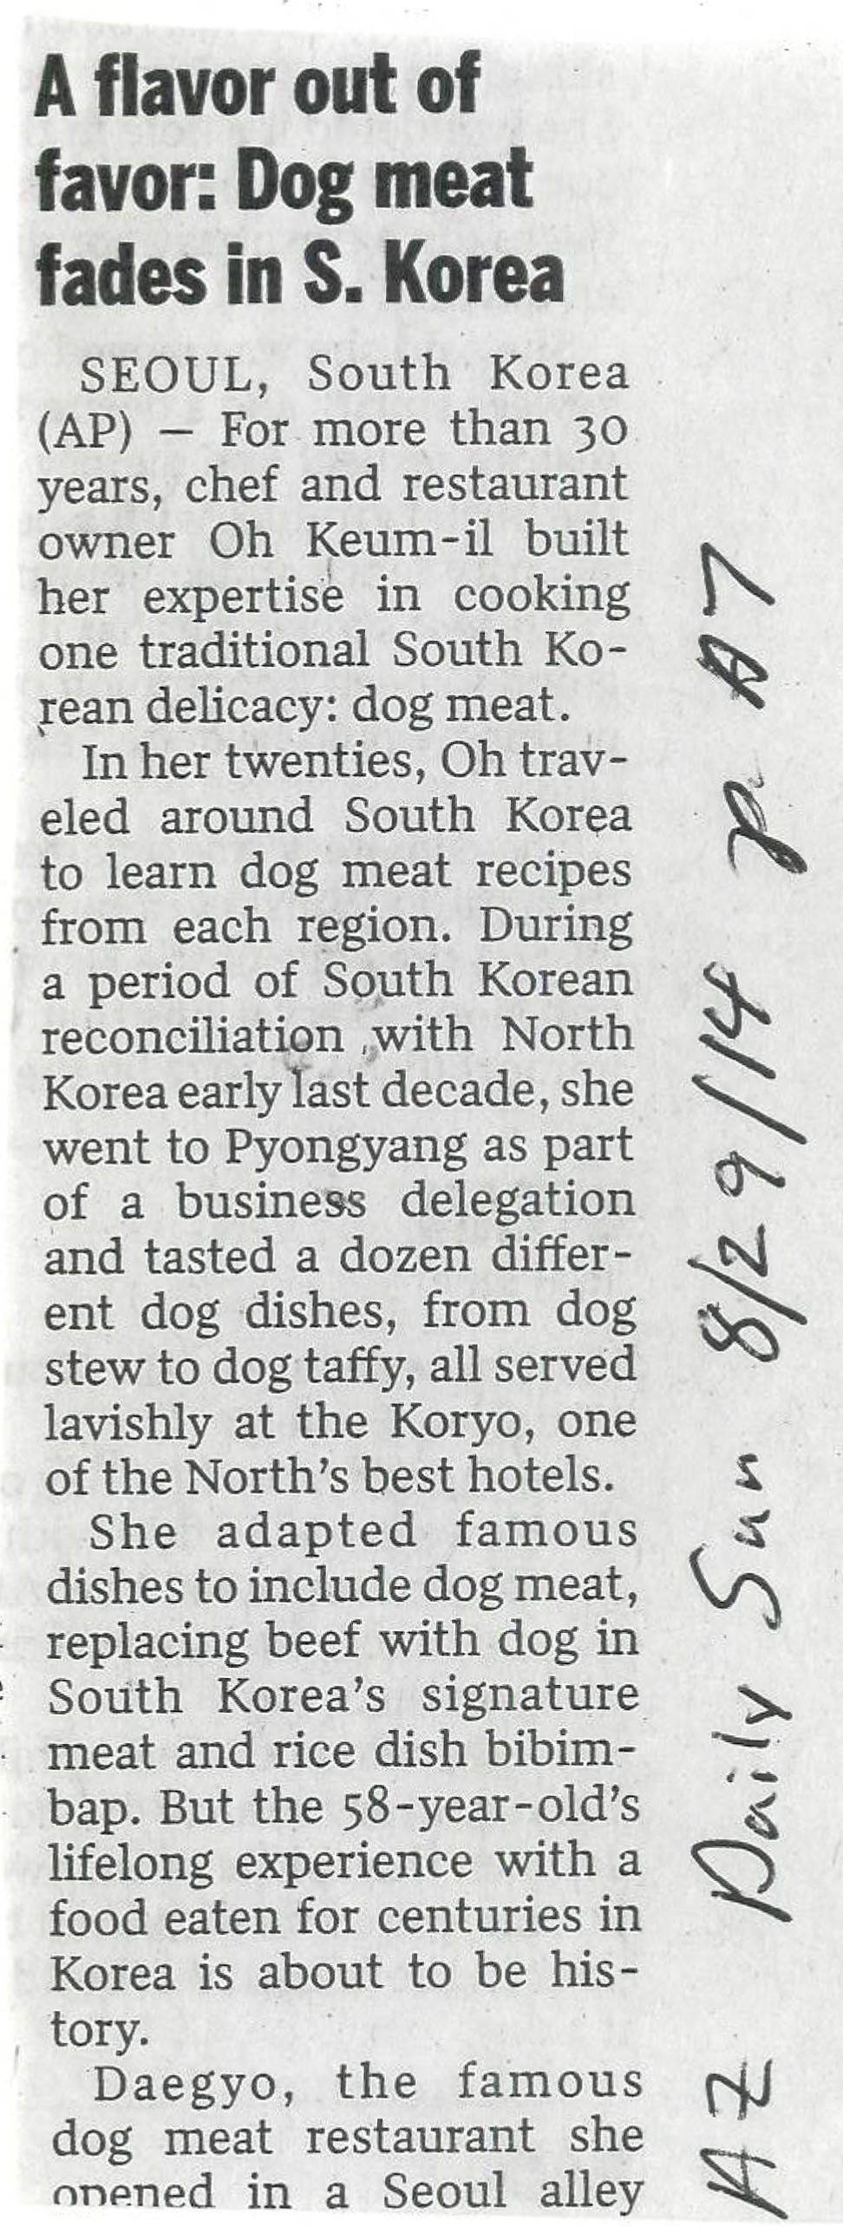

Slide 70
Multiculturalism: Fact or Threat?
Dinesh D’Souza
“Multiculturalists insist that we change how we teach our children, in order to reshape how they think. Specifically, they must stop thinking of Western and American civilization as superior to other civilizations. The doctrine underlying this position is cultural relativism — the denial that any culture can be said to be better or worse than any other. Cultural relativists take the principle of equality, which in the American political tradition is applied to individuals in terms of rights, and apply it instead to cultures in terms of their value” —in other words Franz Boas’s “cultural relativism.”

Slide 71
The Search for Panaceas
In 1885 U.S. Superintendent of Indian Schools John H. Oberly predicted, “if there were a sufficient number of reservation boarding-school-buildings to accommodate all the Indian children of school age, and these building could be filled and kept filled with Indian pupils, the Indian problem would be solved within the school age of the Indian child now six years old.”

Slide 72
However, in an 1891 Educational Review article, Elaine Goodale, soon to be the wife of Charles Eastman (Sioux), criticized education in Indian schools declaring that “Four fifths, if not nine tenths, of the work done is purely mechanical drill.... The child reads by rote, he memorizes the combinations in arithmetic, he copies letters and forms, he imitates the actions of his teacher.”

Slide 73
Oberly complained that Indian agents were selecting inappropriate textbooks and called for the publication of a “series of uniform Indian school textbooks” to be printed by the Government Printing Office. These textbooks would not “on one page represent the Indian as a monster, and on the next page represent him as a hero of romance.” Such a textbook series has still not been published in 2024.

Slide 74
The real job is not to understand foreign culture but to understand our own. —Edward T. Hall
It is only in our attempts to understand the culture of others that we come to understand our own culture. —Henry T. Trueba
Culture is “everything that we take for granted.” —Louis Wirth

Slide 75
Unfortunately, the very dreams that bring immigrants and refugees to America are shattered in the first years of their children's experience in schools. —Henry T. Trueba
An important issue…is to socialize newcomers into the core values of American society. —Henry T. Trueba

Slide 76
Culture is continuously reshaped and reinterpreted.
—Henry T. Trueba
We tend to consider the way we do things in our own culture as normal and right and the way other people from other cultures do things as abnormal and wrong.
—Jon Reyhner

Slide 77
Three Metaphors for Culture
Software
Blueprint
Script

Slide 78
What are some attributes of American Culture?
We want to be number one, most Olympic gold medals, highest test scores, etc., etc.
Individualism
Does anyone care to suggest other traits of American culture?

Slide 79
Is Our Obsession with Testing Students Wrong?
In an opinion piece in Education Week, Iris Rotberg writes that no research finding has influenced education policy more, or been more misinterpreted, than our ranking on international mathematics and science tests [and our focus in schools on STEM]. For decades, our rhetoric and policies have been based on the premise that a lower ranking on international tests will lead to a decline in our nation's economic competitiveness and a shortage of American scientists and engineers. The data for industrialized countries consistently show that test-score rankings are not linked to a country’s economic competitiveness

Slide 80
The World Economic Forum's 2010-2011 global-competitiveness report ranks the United States fourth, exceeded only by Switzerland, Sweden, and Singapore. Moreover, American students’ performance on math and science tests is not reflected in a shortage of scientists, engineers, and mathematicians. Rotberg finds it ironic, therefore, that given national rhetoric, so little attention is paid to two powerful findings that impact competitiveness: the strong negative effects on student performance of both family poverty and concentrations of poverty in schools. Poverty, not international test-score comparisons, is the most critical problem that must be addressed. Unfortunately, our recent political polarization over budgetary priorities leaves Iris Rotberg little room for optimism.

Slide 81
Does the current U.S. emphasis on testing help students to learn how to think for themselves at home and in school?
Is education about memorizing facts?
Is education indoctrination or is it liberating? (faith vs. nihilism?)
Are you other-directed (peer group, etc.) or inner-directed?
What is the source of inner-direction?

Slide 82
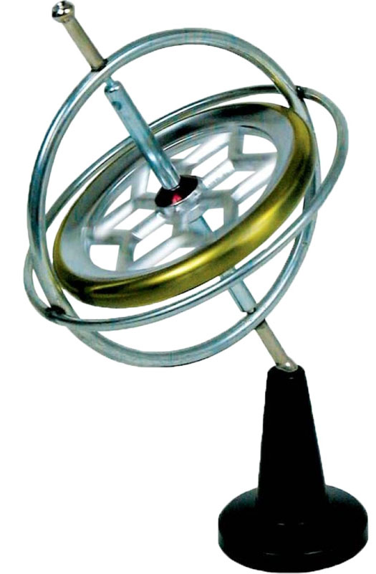
Some people have developed an internal gyroscope that gives them direction (goals and ways of behaving in life) and helps keep them from being swayed by peer groups, propaganda, and fake news. https://en.wikipedia.org/wiki/Gyroscope
Where does this sense of direction come from?

