Slide 1
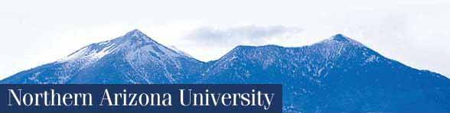
American Exceptionalism Ethnocentrism or Reality? What’s Does the Evidence Say?
BME 210 Week 3 Powerpoint
Jon Reyhner, Ed.D.
Professor of Education

Slide 2
What makes America Exceptional?
Democracy?
Strongest Military?
World’s Largest Economy?
Ethnocentrism?
Where Are We Headed?

Slide 3
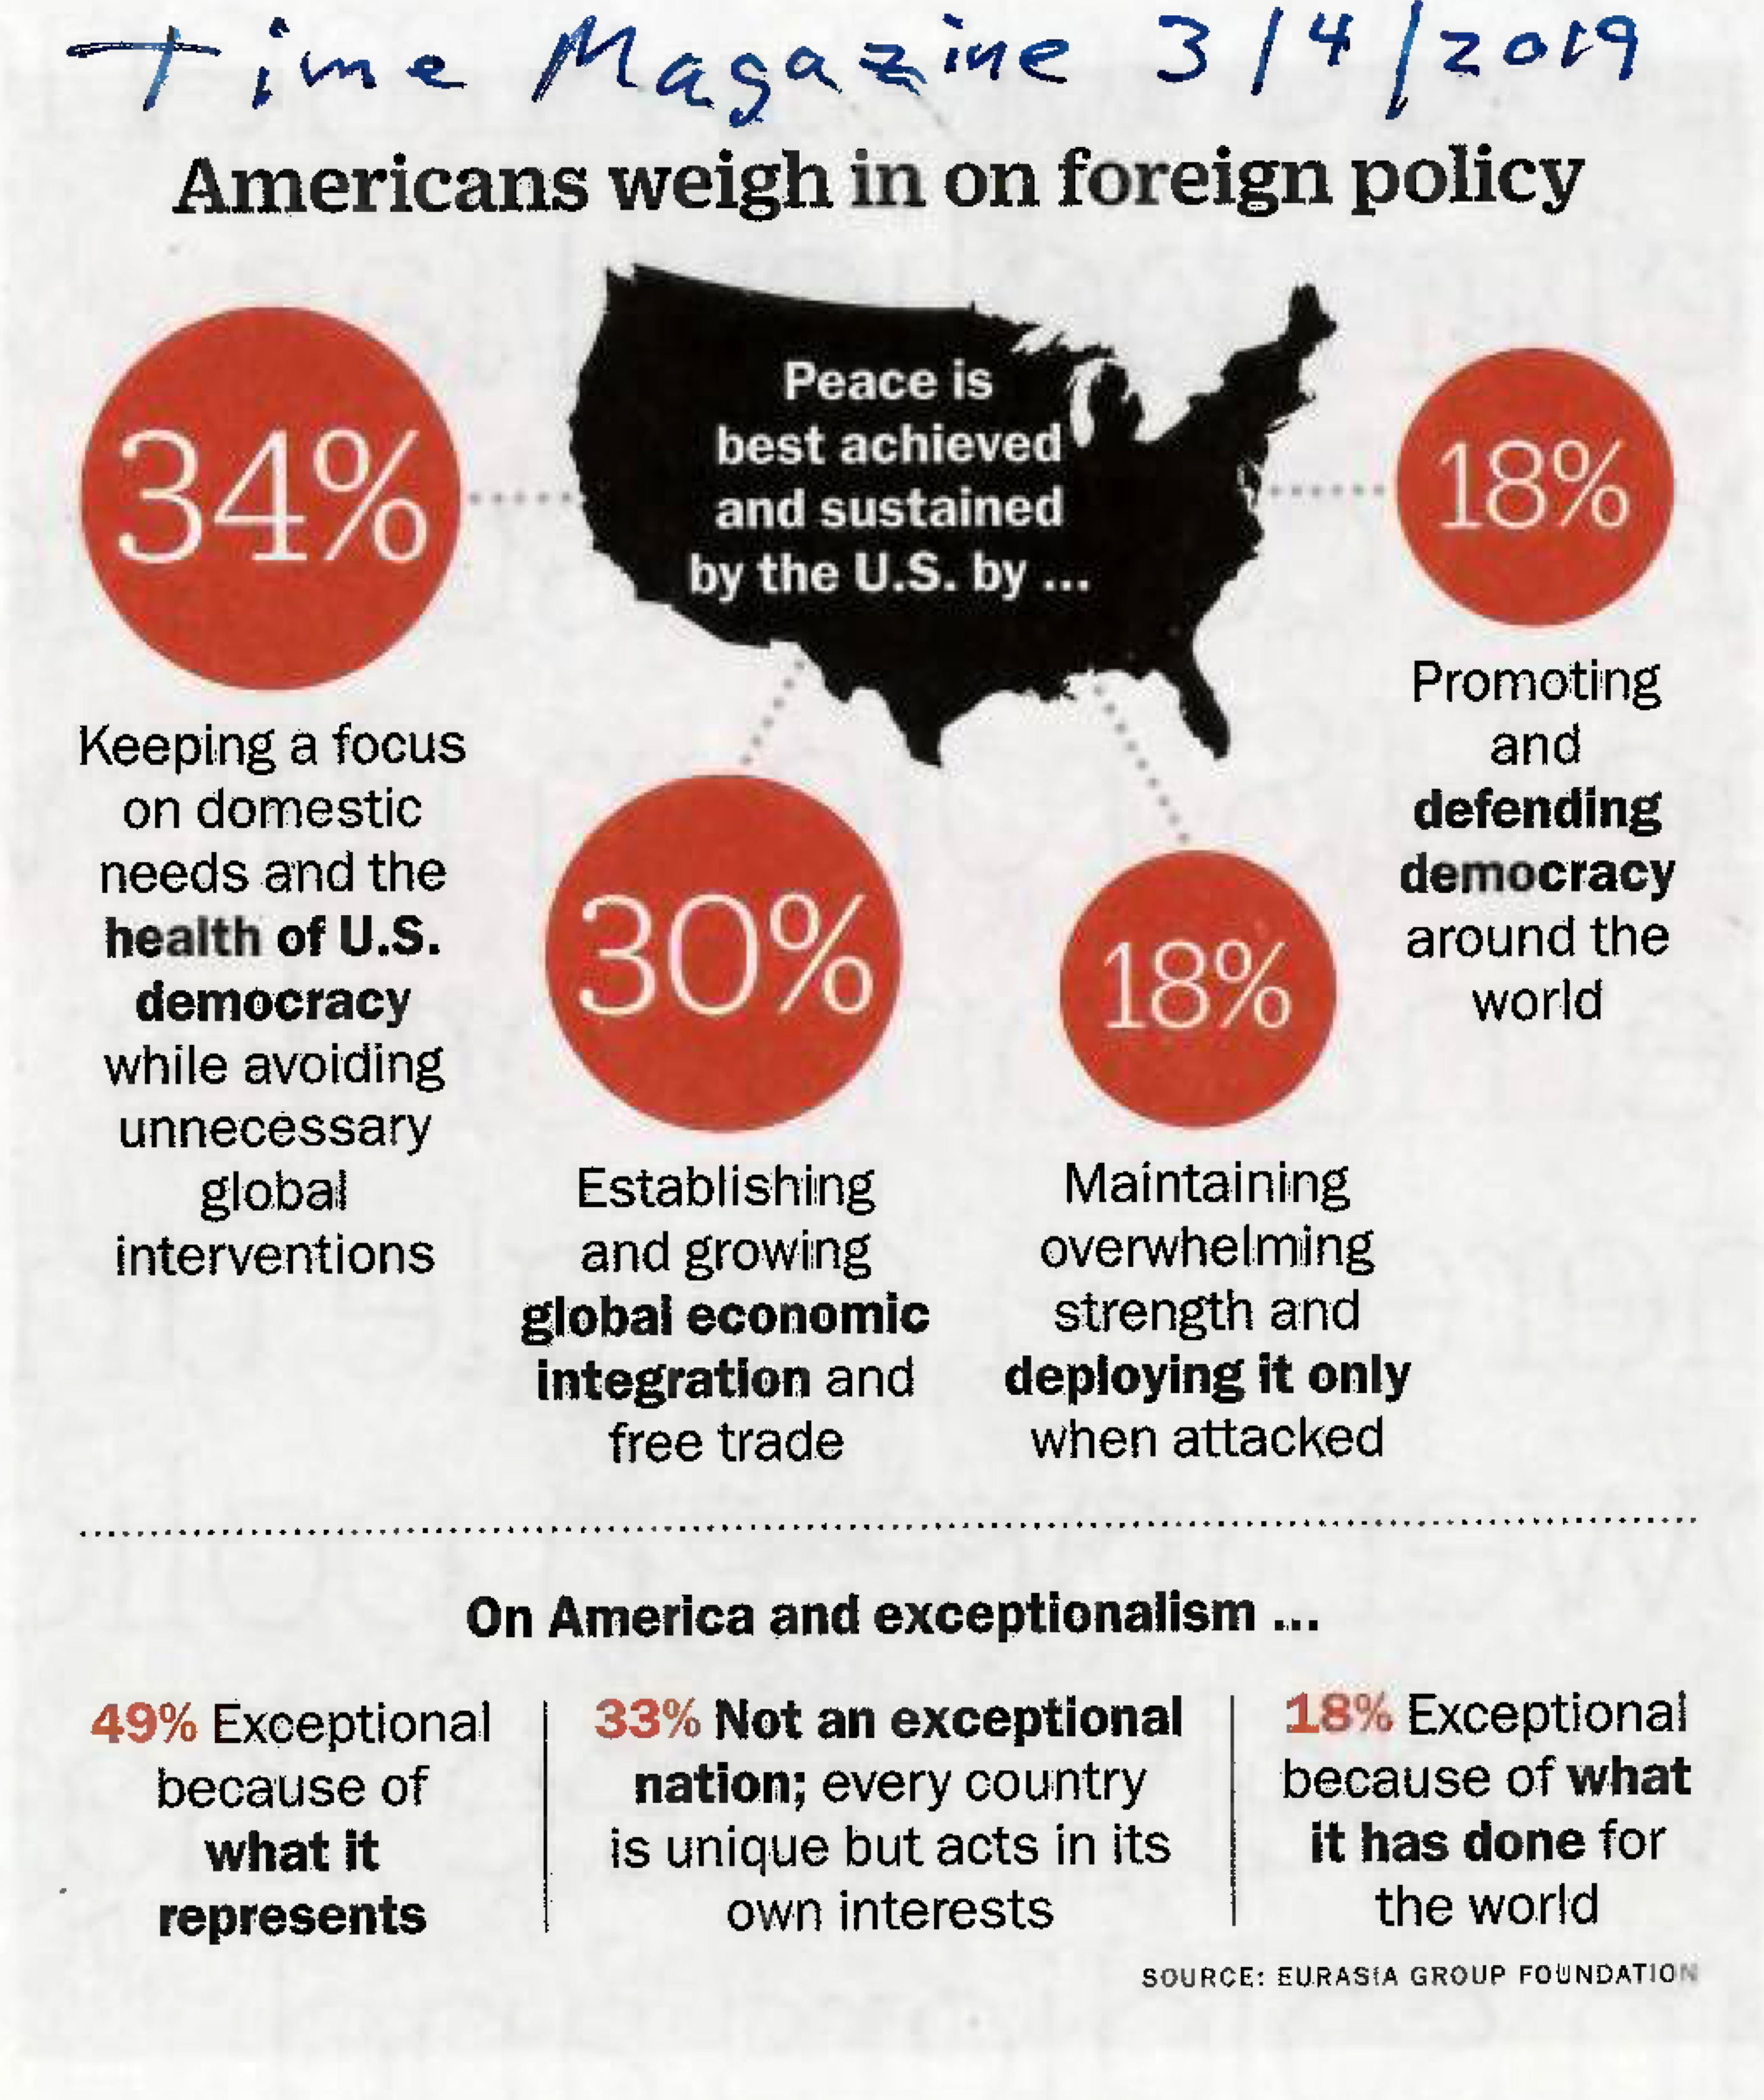

Slide 4
What Is American Exceptionalism?
A belief that America has had a unique historical experience –set “apart from history”?
A belief that American values are superior to all others?
A belief that America has a unique role to play in the world?
“The belief in their own uniqueness –and superiority—is especially deeply rooted among Americans”? ~ Carl Guarneri, America in the World (2007), p. 12.

Slide 5
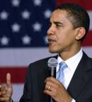
Barack Obama, 4/4/09
"I believe in American exceptionalism … just as the Brits believe in British exceptionalism, and the Greeks in Greek exceptionalism.”
" I'm enormously proud of my country and its role and history in the world… And so I see no contradiction between believing that America has a continued extraordinary role in leading the world towards peace and prosperity and recognizing that that leadership is incumbent, depends on, our ability to create partnerships because we create partnerships because we can't solve these problems alone."

Slide 6
The SOLE WORLD POWER?
Oldest republic
Oldest democracy
Oldest written constitution
Highest Gross National Product (GNP)
3rd wealthiest per capita
Strongest military in human history

Slide 7
Are Americans “WEIRD”? WEIRD= Western , Educated, Industrialized, Richy, & Democratic
“Americans are, on average, the most individualistic people in the world…. American parents, for example, were the only ones in a survey of 100 societies who created a separate room for their baby to sleep…. [C]ompared with other Western industrialized societies, Americans were found to be the most patriotic, litigious, philanthropic, and populist (they have the most positions for elections and the most frequent elections, although they have among the lowest voter turnout rates). They were also among the most optimistic, and the least class-conscious.”

Slide 8
“Americans are the most churchgoing in Protestantism, and the most fundamentalist in Christendom, and more likely than others from Western industrialized countries to see the world in absolute moral terms. In contrast to other large Western industrialized societies, the United States had the highest crime rate, the longest working hours, the highest divorce rate, the highest rate of volunteerism, the highest percentage of citizens with a post-secondary education, the highest productivity rate, the highest GDP, the highest poverty rate, and the highest income-inequality rate; and Americans were the least supportive of various governmental interventions.”

Slide 9
“The United States is the only industrialized society that never had a viable socialist movement; it was the last country to get a national pension plan, unemployment insurance, and accident insurance; and, at the time of writing, remain the only industrialized nation that does not have a general allowance for families or a national health insurance plan.”
—Joseph Henrich et al. 2010. The Weirdest People in the World? Behavioral and Brain Sciences Journal. https://www.cambridge.org/core/journals/behavioral-and-brain-sciences/article/weirdest-people-in-the-world/BF84F7517D56AFF7B7EB58411A554C17

Slide 10
Super Power as Role Model…?
Withdrew from the 1997 Kyoto Treaty on global warming, signed by 186 nations.
Refused to sign the 1997 Land Mines Ban Treaty, signed by 137 nations.
Unilaterally withdrew from the Anti-Ballistic Missile (ABM) Treaty of 1973.
Refused to join the International Criminal Court.

Slide 11
Abstained from the renewal of the 1967 Outer Space Treaty.
Refused to ratify the 1994 Law of the Sea Treaty, accepted by 120 nations.
Rejected an agreement to enforce the 1972 International Biological Weapons Convention, ratified by 413 countries.
Withdrew in 2020 from Paris Climate Accord

Slide 12
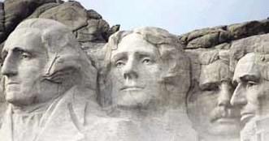
John Dewey reminded us…
The trouble…is that we have taken our democracy for granted; we have thought and acted as if our forefathers had founded it once and for all. We have forgotten that it has to be enacted anew in every generation.

Slide 13
Is there too much concern for social justice today in Northern Arizona University classrooms, such as Indigenous land acknowledgements?
Are universities hotbeds of liberalism today as some conservatives claim?
Can people of all political persuasions speak their mind freely at NAU and elsewhere?
How can we identify “fake news”?
I give extra credit to students who can identify and give evidence of factual errors in my class materials.

Slide 14
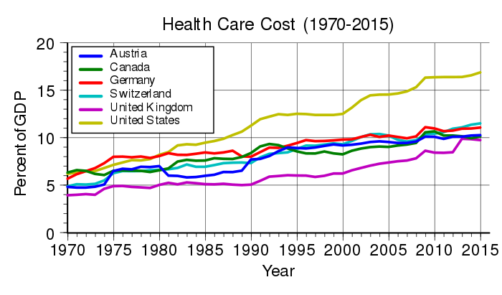

Slide 15
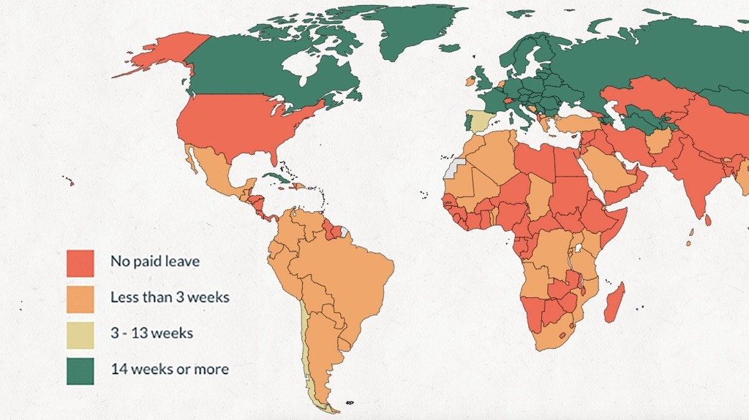
Paid Paternity Leave Around the World
Source: World Policy Center/NPR https://www.npr.org/sections/goatsandsoda/2018/06/14/619604235/
which-countries-guarantee-that-new-dads-get-paid-paternity-leave

Slide 16
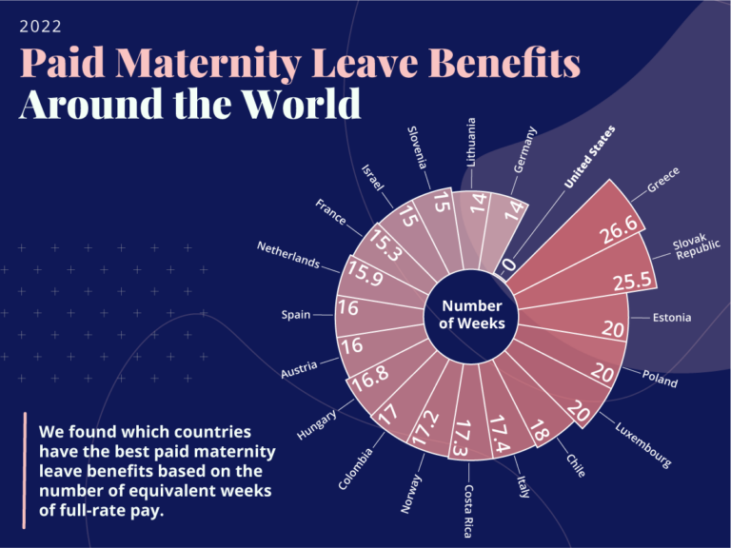

Slide 17
The reasons for the increased death rate are not the usual things that kill Americans, like diabetes and heart disease. Rather, it’s suicide, alcohol and drug poisonings, and alcohol-related liver disease [called by some “despair deaths”]. The least-educated are worst off: All-cause mortality among middle-aged Americans with a high-school degree or less increased by 134 deaths per100,000 people between 1999 and 2013, but there was little change in mortality for people with some college. The death rate for the college-educated fell slightly.
The Atlantic 11/4/15

Slide 18
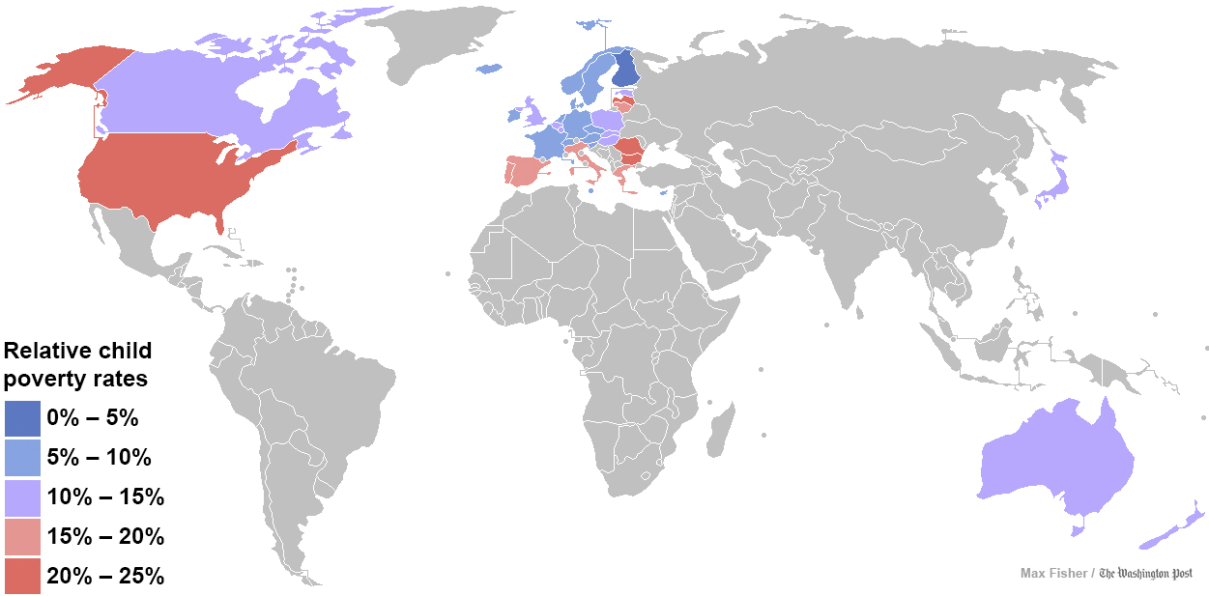

Slide 19
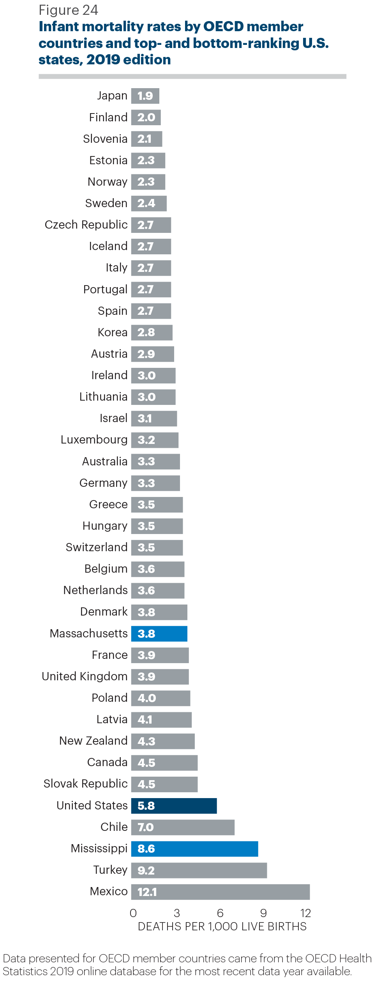

Slide 20
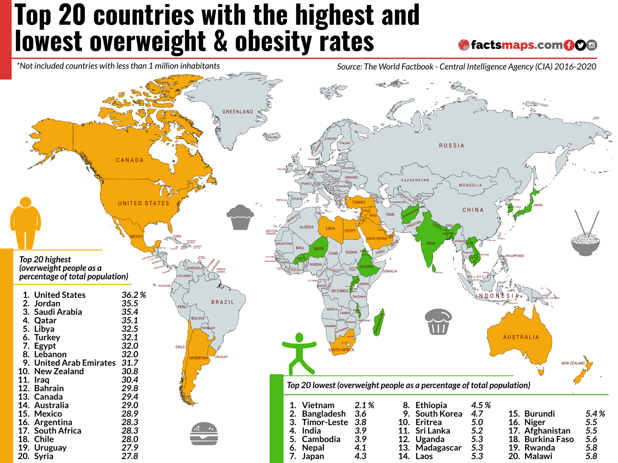

Slide 21
The Atlantic, Dec. 13, 2016

Slide 22
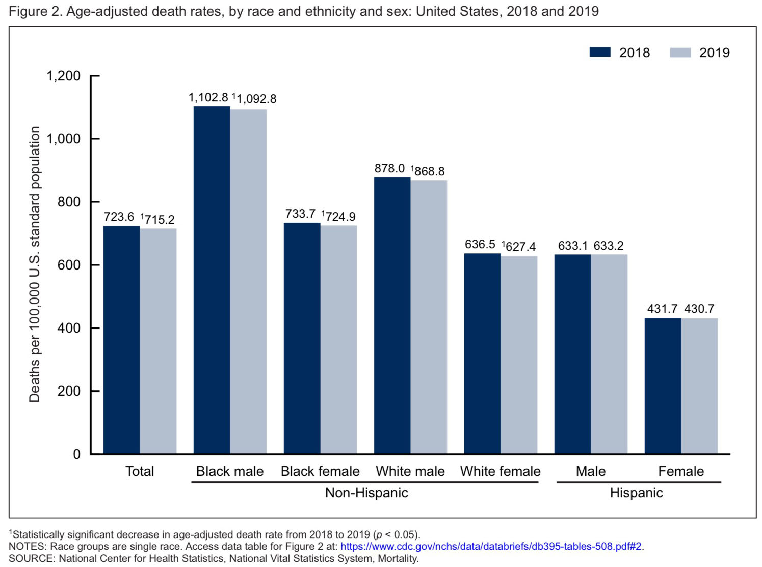

Slide 23
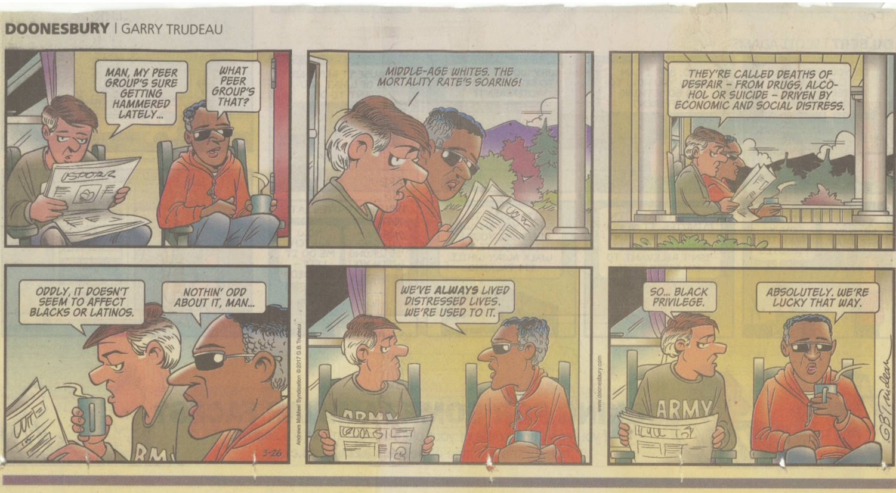

Slide 24
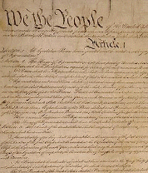
So How Are We Doing As A Democracy?
Here’s a 6 part test.
“We the People of the United States, in order to:
…do ordain and establish this Constitution for the United States of America.”
Form a more perfect union
2. Insure domestic tranquility
3. Establish justice
4. Provide for the common defense
5. Promote the general welfare
Secure the blessings of liberty to
ourselves and our posterity

Slide 25
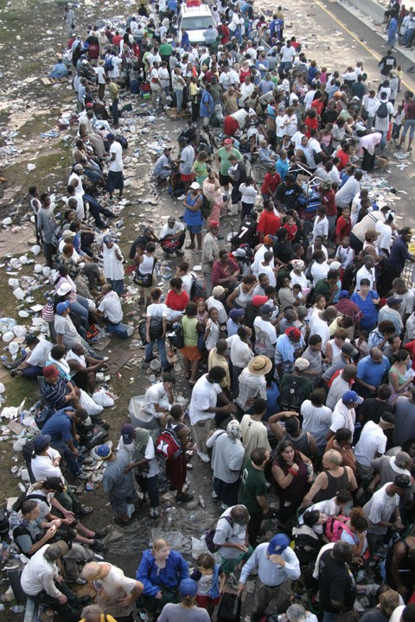
The bad news…
Hurricane Katrina demonstrated what happens when govern-ment does not work… when we are not all in the same boat.
Is this the case with the COVID pandemic today?

Slide 26
Janadas Devan, Straits Times columnist:
[But] it is not only government that doesn't show up when government is starved of resources and leached of all its meaning. Community doesn't show up either, sacrifice doesn't show up, pulling together doesn't show up, 'we're all in this together' doesn't show up.”
Taxes are the price we pay for civilization.

Slide 27
Concern About Declining Levels of Citizenship
The global problems we confront are more ominous: global pandemics, global warming, terrorism, the viability of the nation-state
The national problems we confront are more insistent: role of science v. religion, political polarization, capitalism v. democracy, health care, growing divide between rich and poor
We must have an educated and engaged citizenry!

Slide 28
Threats to American Democracy
Decline in social capital
Increasing inequality
Atomization of interests, news sources and the pervasive focus on entertainment
Money and politics
Lack of civic understanding and civics education in K-12 grades
Decline in political participation, esp. among the youngest adults
Notes:
Political—more than voting, variety of engagement in civic life
Inequality– wealth and poor “top 1% …..”
Politics about different perspectives looking for common grounds, now just about he said she said
K-12 NCLB, civics is not tested, math and science up
Encouraging abroad but don’t know what it is here

Slide 29
Threats to American Democracy?
On April 28, 2006 President Bush stated that the National Anthem should not be sung in translation: "One of the important things here is that we not lose our national soul," the president exclaimed. Sen. Lamar Alexander Introduces Senate Resolution on National Anthem on May 1, 2006: “I am introducing a resolution that affirms that statements of national unity, especially the Pledge of Allegiance and the national anthem, ought to be recited or sung in English.
“We wouldn’t recite the Pledge in French, or German, or Russian, or Hindi, or even Chinese (which, after Spanish, is the second most spoken foreign language in the United States). And we shouldn’t sing the national anthem in Spanish, or any other foreign language.
“So, in this land of immigrants, let’s all sing it together, as one American nation, in our common language: English.
Notes:
Political—more than voting, variety of engagement in civic life
Inequality– wealth and poor “top 1% …..”
Politics about different perspectives looking for common grounds, now just about he said she said
K-12 NCLB, civics is not tested, math and science up
Encouraging abroad but don’t know what it is here

Slide 30
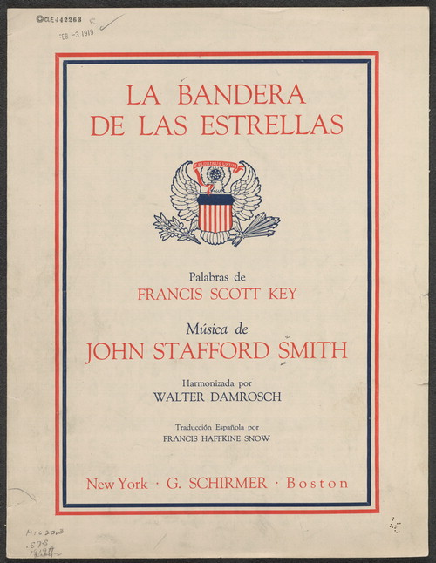
Threats to American Democracy?
U.S.Government Commissioned Translation of Our National Anthem—1919!
http://time.com/3773/coca-colas-its-beautiful-super-bowl-ad-brings-out-some-ugly-americans/
Notes:
Political—more than voting, variety of engagement in civic life
Inequality– wealth and poor “top 1% …..”
Politics about different perspectives looking for common grounds, now just about he said she said
K-12 NCLB, civics is not tested, math and science up
Encouraging abroad but don’t know what it is here

Slide 31
Threats to American Democracy?
According to U.S. Representative J.D. Hayworth in the January 29, 2006 issue of the Arizona Republic, “Assimilation is the key to any successful immigration policy…. Sadly, Americanization has given way to an insidious multiculturalism.” Hispanic immigrants “are force-fed a steady diet of multiculturalism and told by their own community leaders and our own anti-American elites that America is racist, sexist, intolerant and genocidal.” These sentiments are echoed in his 2006 book Whatever It Takes: Illegal Immigration, Border Security, and the War on Terror.
Notes:
Political—more than voting, variety of engagement in civic life
Inequality– wealth and poor “top 1% …..”
Politics about different perspectives looking for common grounds, now just about he said she said
K-12 NCLB, civics is not tested, math and science up
Encouraging abroad but don’t know what it is here

Slide 32
Threats to American Democracy?
However, on March 2, 2006, the Arizona Republic reported that, “The longer Hispanics are here [in the United States], the more likely they are to become obese, to develop diabetes, high blood pressure and heart disease. And Hispanics born here have even higher rates of those illnesses, a new government report [by the U.S. Centers for Disease Control and Prevention] shows.” This new study confirms the 1998 findings issued by the National Research Council that immigrant youth tend to be healthier than their counterparts from nonimmigrant families. That study found that the longer immigrant youth are in the U.S., the poorer their overall physical and psychological health. Furthermore, the more Americanized they became the more likely they were to engage in risky behaviors such as substance abuse, unprotected sex, and delinquency.
Notes:
Political—more than voting, variety of engagement in civic life
Inequality– wealth and poor “top 1% …..”
Politics about different perspectives looking for common grounds, now just about he said she said
K-12 NCLB, civics is not tested, math and science up
Encouraging abroad but don’t know what it is here

Slide 33
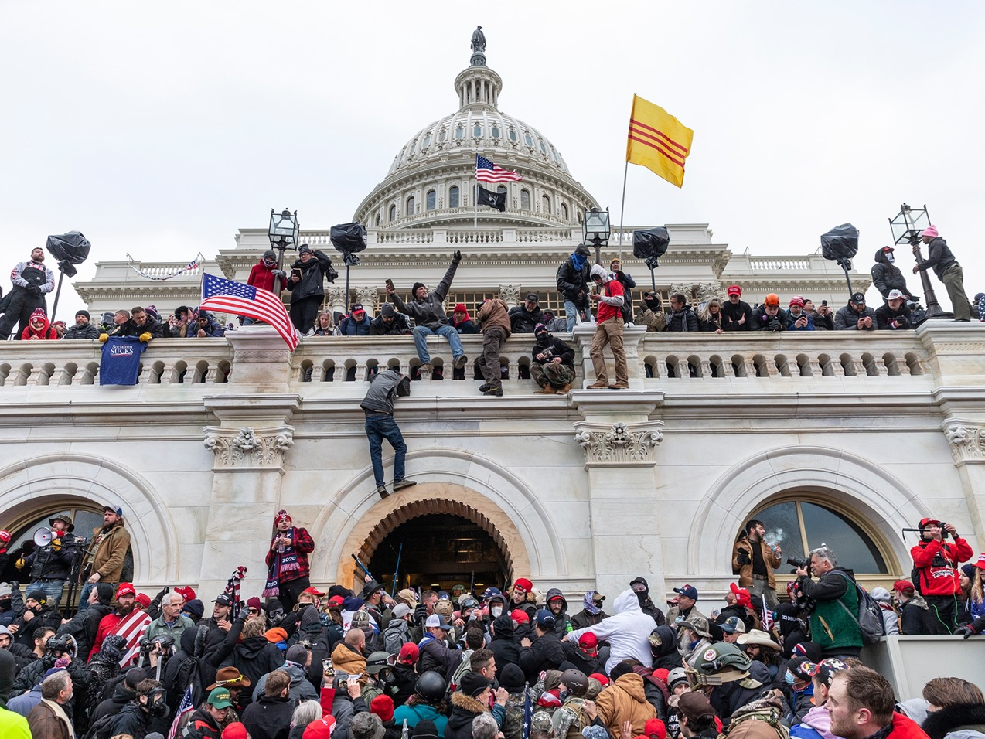
How much of a threat to our democracy was the January 6, 2021 attack on the nation’s capital building?

Slide 34
A Decline in Social Capital
Declining Social Capital: Trends over the last 25 years
Attending Club Meetings Down by 58%
Family dinners Down by 33%
Having friends over Down by 45%
Factors Contributing to Declining Social Capital
Commuting (Each 10 minutes = 10% reduced participation)
Television
Two parents working
Less Social Capital (esp. bridging social capital) =
Less Democracy
Studies in the United States and Italy
Robert Putnam Bowling Alone

Slide 35
Increasing Inequality
Are We A Plutocracy Today?
Disparities of income, wealth, and access to opportunity are growing more sharply in the U. S. than in many other nations
People with wealth are “roaring with a clarity and consistency that public officials readily hear and routinely follow.” Citizens “with lower or moderate incomes are speaking with a whisper.”
Progress toward American ideals of democracy may have stalled, and in some arenas reversed.
American Democracy in an Age of Rising Inequality, Task Force on Inequality and American Democracy, American Political Science Association, 2004, www.apsanet.org

Slide 36
A delegate from Indian Territory to Washington, D.C., in an 1886 article in The Indian reprinted from the Cherokee Advocate, protested the efforts of the U.S. government to allot Indian lands:
“We were sent to the wilderness because the whites wanted our country in the States. Now we have developed the new country and built for ourselves homes in it, and the whites want that. We are doing well. We are happy and prosperous. We are working out the problem of civilization. We have schools and churches and governments patterned after your own. Our lands are patented to tribes, and our people hold it in common. We all have names. There are no paupers among us. We never see anybody begging for pennies in our country as we do here [in Washington, D.C.]. Let us alone. Don’t break us up.” (Indian, 1886, p. 25)

Slide 37
The Economist 2005
Corporate Compensation
30 years ago: Average compensation of top 100
CEOs was 30 times the pay of average workers
Today: 1,000 times the pay of the average worker
School Systems
Increasingly stratified by social class in which
poor children attend school with fewer resources
Universities
Increasingly reinforcing rather than reducing educational inequalities
Does the United States risks calcifying into a European-style,
class-based society?

Slide 38
Atomization of Interests, News Sources and the Pervasive Focus on Entertainment
The number of registered lobbyists in Washington has more than doubled since 2000, from 16,342 to 34,750
More television channels, more talk radio, internet, blogs, etc.
40 million watched American Idol finale; 37 million watched 2nd Bush/Gore debate. Average age of viewer of network news: 60

Slide 39
Money and Politics
2000: Bush $ 193; Gore $ 134 million.
Total 2000 = $ 327 million
2004: Bush $ 293: Kerry $ 252 million
Total 2004 = $ 545 Million
60 % increase in 4 years
.09 % of population gives at least $ 1,000 to political campaigns, 55% of funds raised
¼ of Congress are millionaires; 1% of U.S.
Is the United States a plutocracy today?

Slide 40
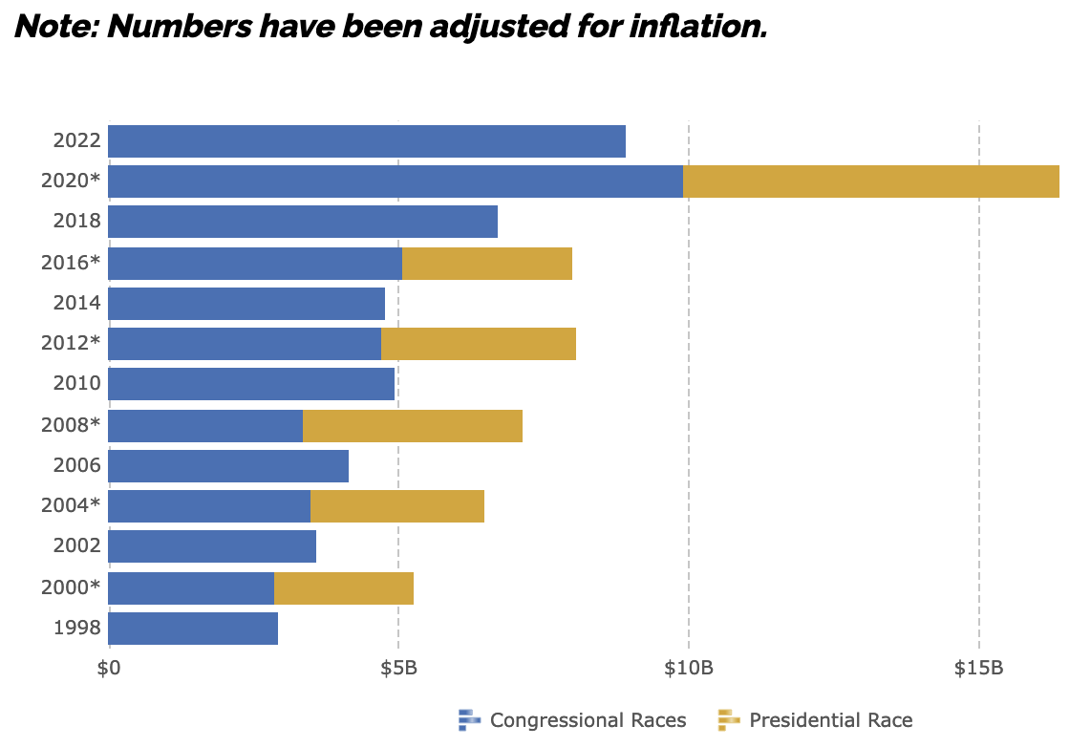
Total Cost of Elections (1998-2022)
Source: Open Secrets https://www.opensecrets.org/elections-overview/cost-of-election?display=T

Slide 41
91% of 2004 congressional primary candidates who raised the most money won their races.
Winning Congressional candidates raised 50% more in 2004 than in 2002.
63% of primary candidates’ money came from .08% of the voting age population.
“The sad thing is that in America today if it’s going to take $ 2 million to win, then normal people can’t run anymore. You either have to be very, very wealthy or very, very bought.”
Janice Bowling, Republican Nominee
for Tennessee’s 4th District

Slide 42
Frederick Webber, 30+ years as lobbyist in Washington, President of Alliance of Automobile Manufacturers
“Political fundraising in this town has gotten
out of control. What are the priorities here? This thing has gotten away from us”
Washington Post, September 12, 2005
- - - - - - - - - - - - - - - - - - - - - - - - - - - - - - - - - - - - - - - - - -
Ernest Hollings, 38 years in the U.S. Senate
“There is a cancer on the body politic: money. The result of this nonsense is that almost one-third of a senator's time is spent fundraising.”
Washington Post, February 19, 2006

Slide 43
Lack of Civic Understanding
John S. and James L. Knight Foundation Survey 112,003 high school students in 2004: 36% believe that newspapers should get “government approval” of stories before publishing
Fewer than half of persons 15-26 years old think that communicating with elected officials, volunteering, or donating money to help others are qualities of a good citizen
On NAEP 1998 Civics, 23% of 4th graders, 23% of 8th graders, and 26% of 12th graders scored at or above proficient

Slide 44
75.2% know what city zip code 90210 is. Only 25.5% know that Philadelphia is the city where the Constitution was written.
81.2% know how many members in the music group “Hanson.” Only 21.2% know how many senators serve in the U.S. Senate.
87% know the name of the football player found not guilty of murdering his wife. Only 9% know the landmark case Brown v. Board of Education.
63.7% know that “The Club” protects against car theft. Only 25% of respondents know that the Fifth Amendment protects against double jeopardy/self incrimination, etc.
59.2% know the names of the three stooges. Only 41.2% know the names of the three branches of government;
89% know the father in Home Improvement. Only 32% know the Speaker of the House;
Survey of 600 students age 13-17, National Constitution Center, 1998

Slide 45

Decline in Political Participation
The youngest generation of voters has the greatest distrust of others
80%
70%
70%
60%
56%
59%
50%
49%
41%
40%
40%
36%
30%
29%
20%
10%
0%
DotNets
GenX
Boomers
Matures
Most people look out for themselves
Most people would take advantage of you
Source: The Civic and Political Health of the Nation, A Generational Portrait, 2002.
Notes:
Relate this to Norway, Brazil

Slide 46
The youngest voters have the lowest participation in presidential elections
Source: Current Population Survey (CPS), November Supplement, calculated using CIRCLE method.

Slide 47
But do we really want them involved?
Do we really want them to vote?
Recent AIR/Pew Study (January 2006)
More than 50% of students at 4 yr colleges
do not score at the “proficient level of literacy.”
That means that they cannot compare credit card offers with different interest rates or summarize the arguments in newspaper editorials.
Good News
Literacy level higher among students who say their coursework requires applying theories and concepts to practical problems.

Slide 48
The Stewardship of Public Lands
Issue: How are controversies over public lands resolved in a democracy?
Partner: Yellowstone Association
Activities:
2005 Wolf Reintroduction Presidents/CAOs, Faculty Seminars.
2006 Politics and the Yellowstone Ecosystem
Faculty Seminar, National Program Spring 2007 with The New York Times

Slide 49
Knowledge
History of the United States
What is the history of the U.S. that all undergraduates need to know? What are the themes and issues?
Do U.S. history textbooks view the past through rose-colored glasses?
Principles of Democracy
What are the core principles of democracy that all undergraduates must understand? What is the irreducible list of books that must be read? What could you use as a test of democratic principles?

Slide 50
O wad some Power the giftie gie us,
To see oursels as ithers see us!
From “To a Louse,” by Robert Burns
Collegiality means responsible citizenship within our institutions,embracing the same qualities that one would hope for in responsible citizens of the nation and globe: thoughtfulness, attentiveness to the needs of others, a willingness to listen carefully and engage in meaningful communication across and in spite of differences, an ability to work collaboratively to solve problems and set priorities, and, finally, a commitment to ethical treatment of others, and especially those in disempowered positions (which in the context of an academic department means students, untenured professors, and support staff…)
Donald Hall Inside Higher Ed, January 4, 2006

Slide 51
SUMMARY
Focusing on preparing citizens is good pedagogy
Active
Engaged
Meaningful
Focusing on preparing citizens helps prepare students for the world of work
Focusing on preparing citizens is good practice
It gives focus to the curriculum
It holds the institution collectively accountable
It offers a public purpose for public institutions
Focusing on preparing citizens strengthens democracy

Slide 52
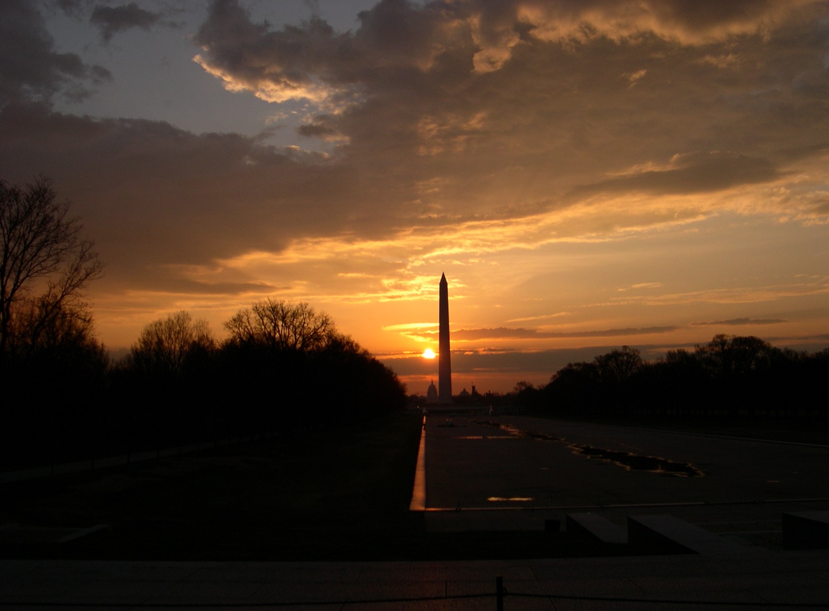

Slide 53
Photos from the January 6, 2021 Assault on the Capital:
https://www.theatlantic.com/politics/archive/2021/01/photos-trump-supporters-storm-capitol/617577/
Just How Stable Is Our Democracy?

Slide 54
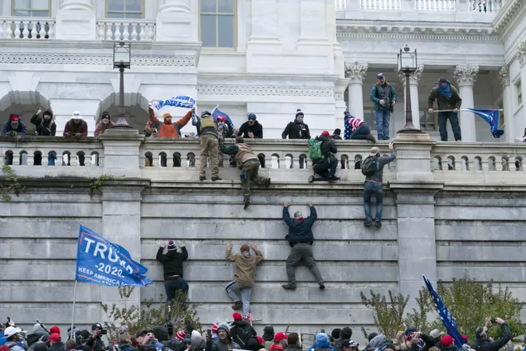

Slide 55
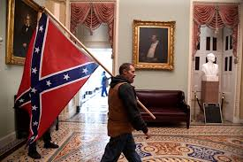

Slide 56
The death of democracy is not likely to be an assassination from ambush. It will be a slow extinction from apathy, indifference and undernourishment
Robert Hutchins

Slide 57
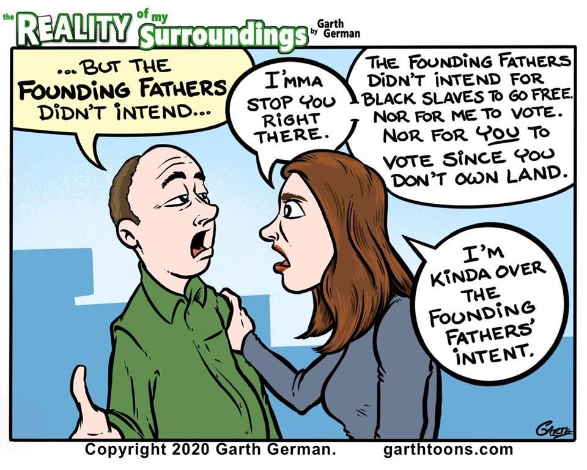

Slide 58
What makes the United States different from and/or better than other countries?
A previous BME 210 classes answers: Mentions
First & Second Amendments 8
Democracy 6
Capitalism/Free Enterprise/Economic Freedom 4
Diversity/Melting Pot 4
Public Education (Free) 3
Patriotism 3
Fosters Innovation/Technology 2
As of the end of 2016, 97 out of 167 countries (58%) with populations of at least 500,000 were democracies, and only 21 (13%) were autocracies, both post-World War II records. (2021 Internet Search)

Slide 59
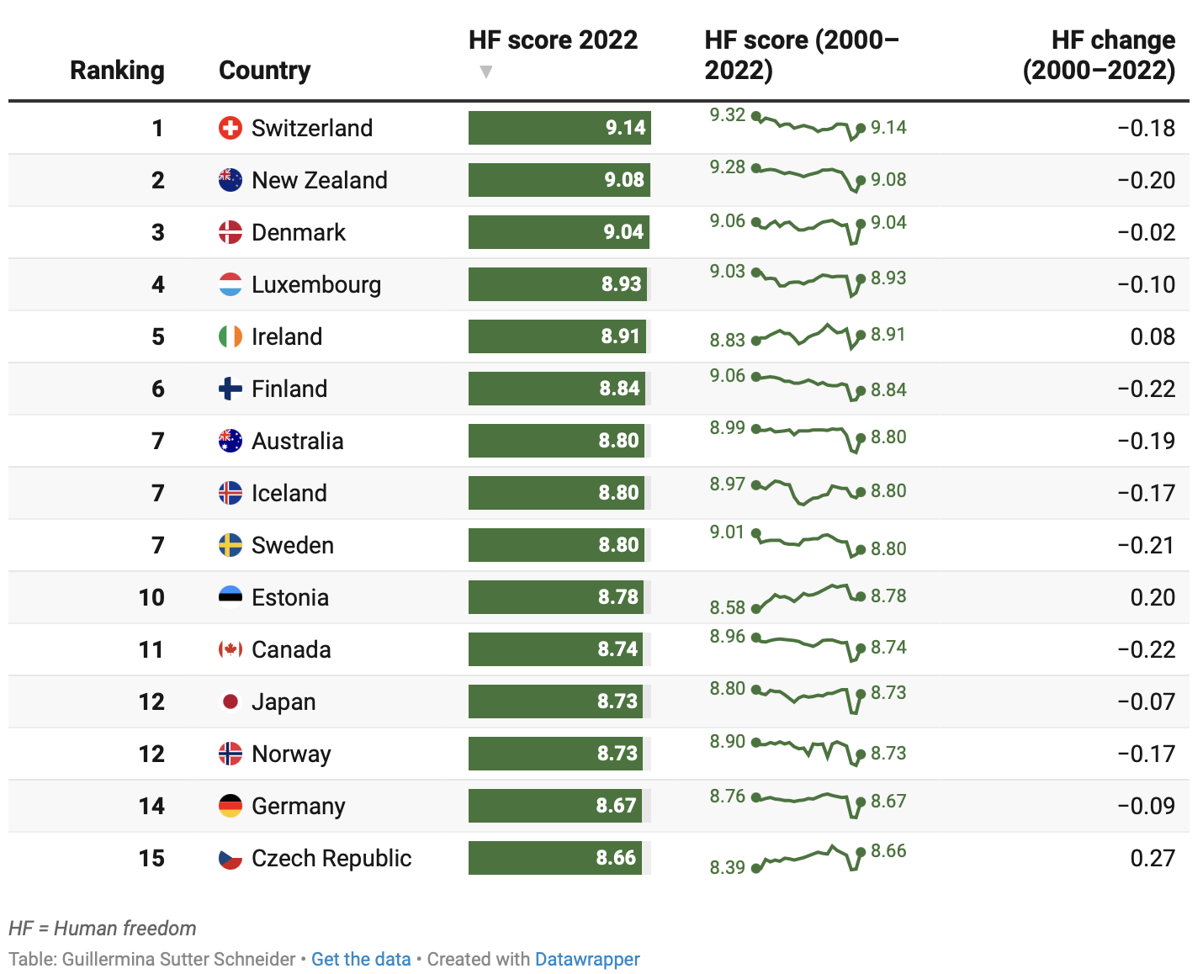
Human Freedom Index, Cato Institute 2024
https://www.cato.org/human-freedom-index/2024

Slide 60
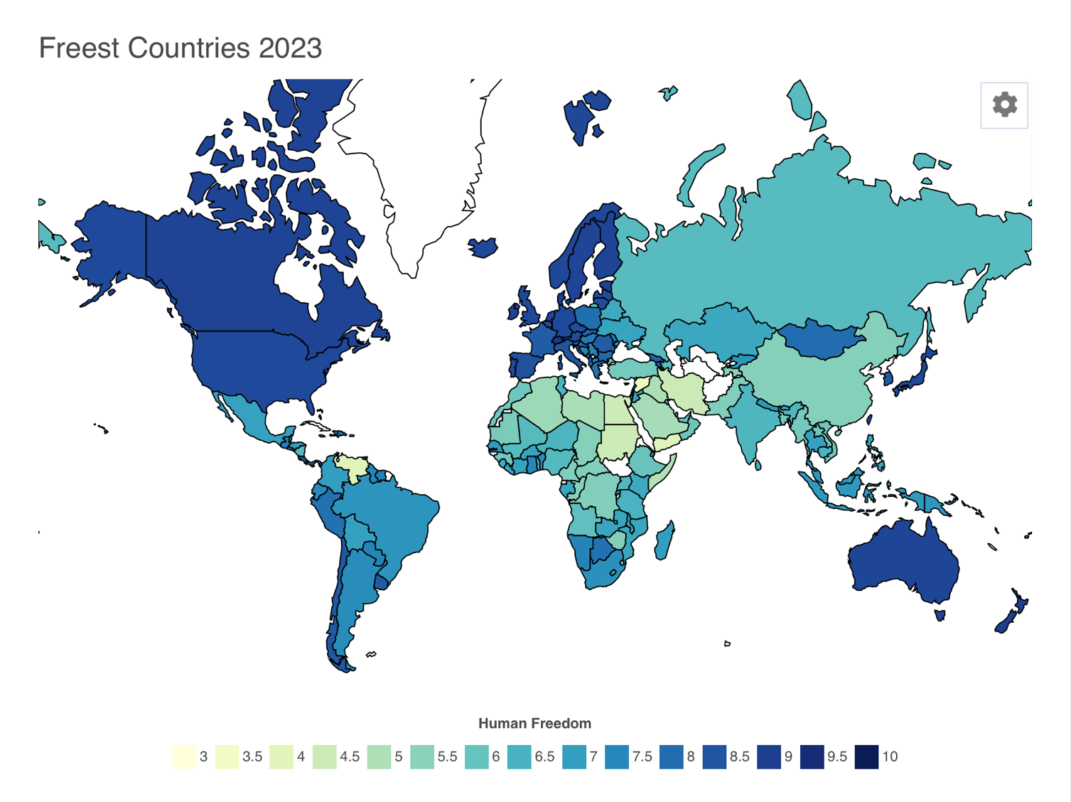

Slide 61
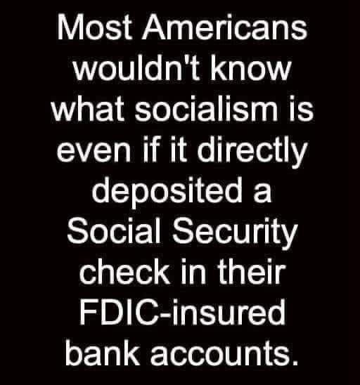

Slide 62
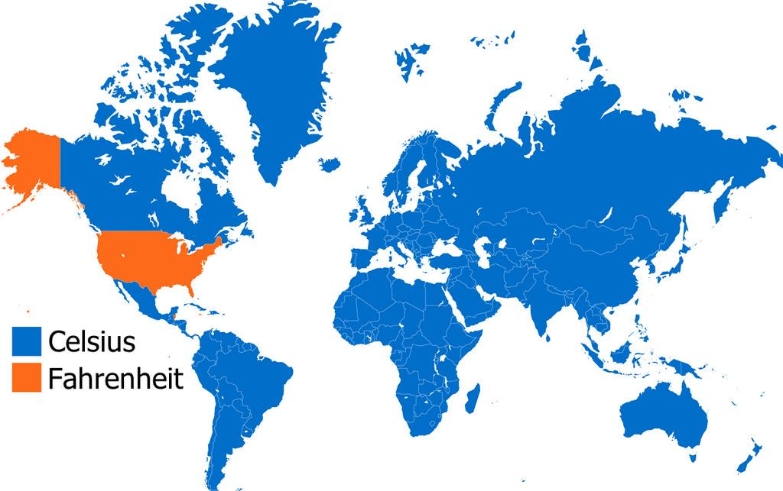
Only two countries, the United States and New Zealand, allow the
Advertising of prescription drugs.

Slide 63
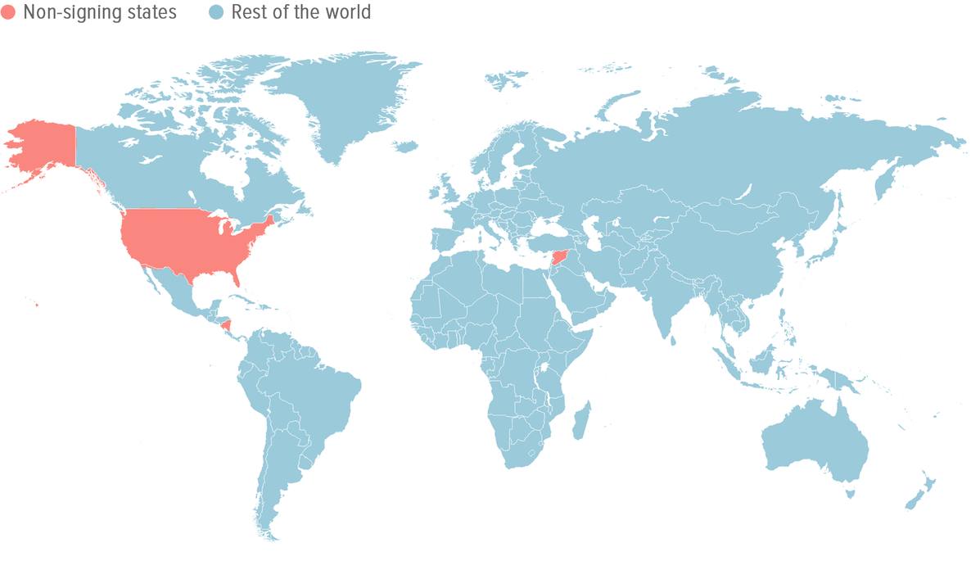
Paris Climate Accord President Biden Rejoined the Accord 1/20/2021

Slide 64
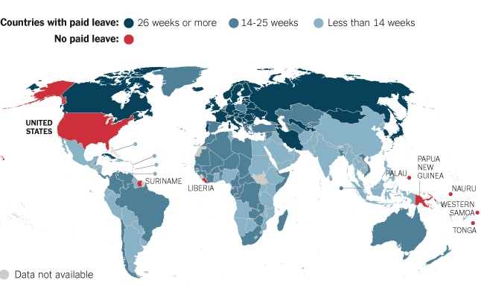

Slide 65
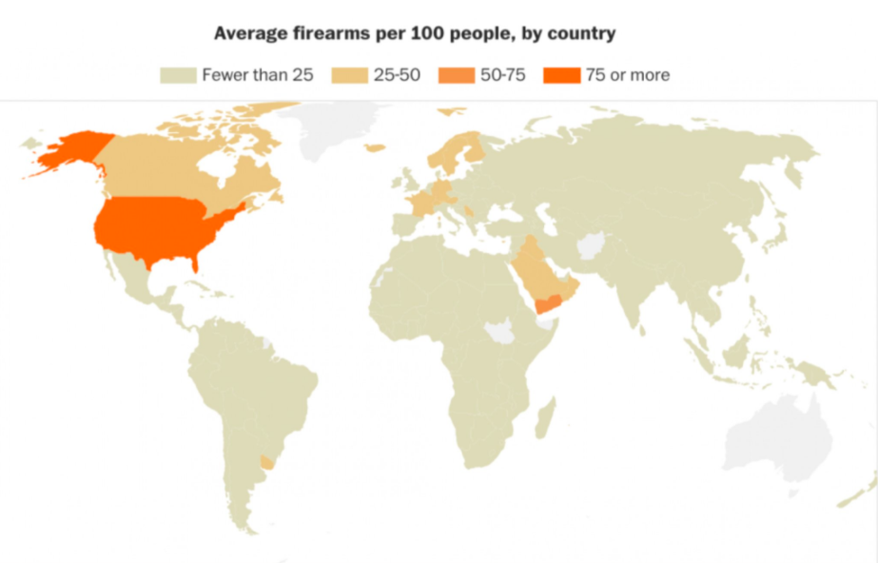

Slide 66
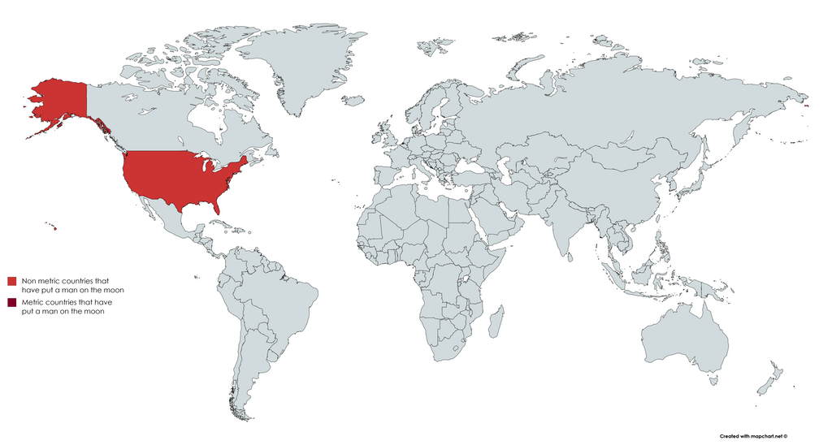
Countries That Have Put A Man On The Moon

Slide 67
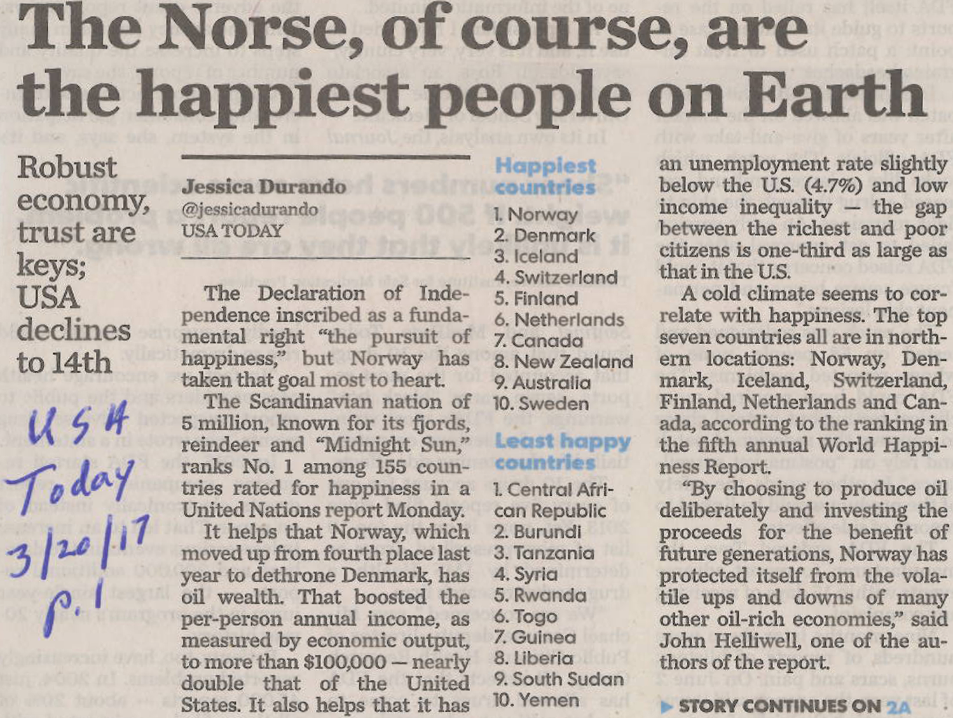

Slide 68
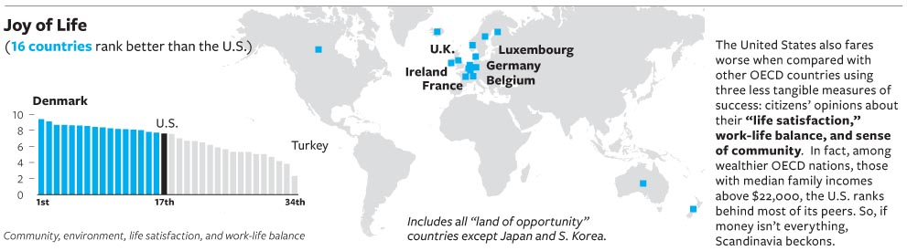

Slide 69
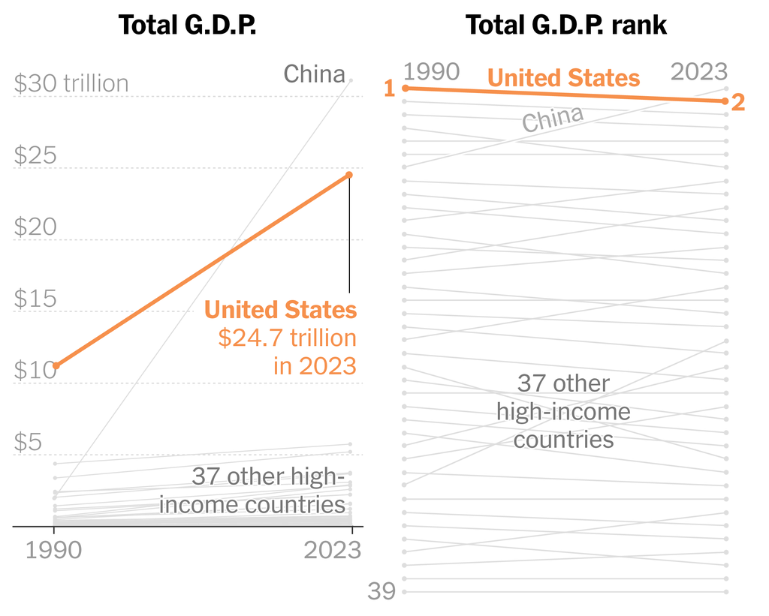
Sources: State of the Nation report, World Bank: New York Times 2/4/25

Slide 70
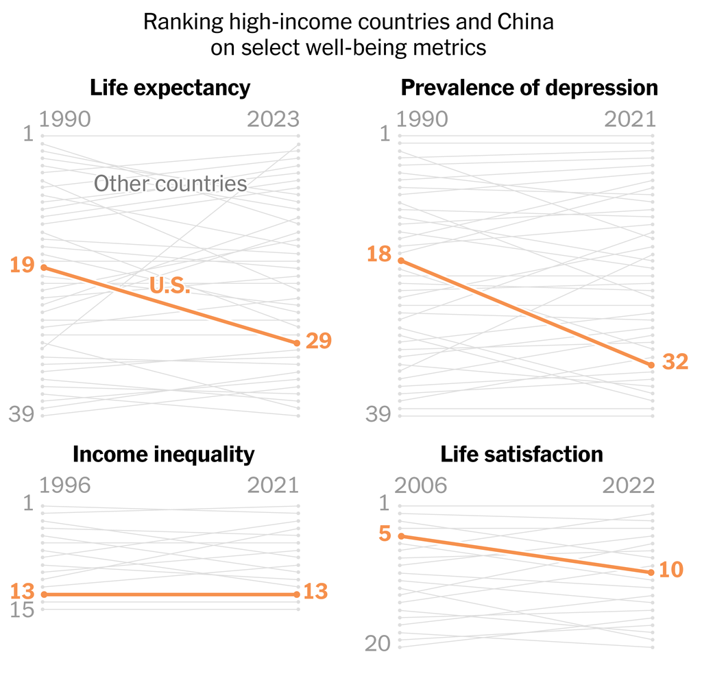
Source: State of the Nation report, UNICEF, Institute for Health Metrics and Evaluation, World Bank, Gallup World Poll: New York Times 2/4/

Slide 71
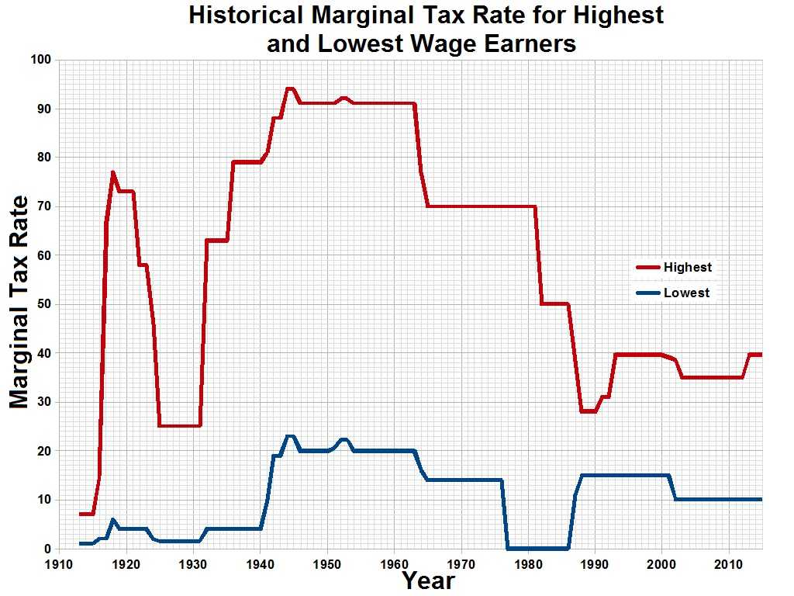

Slide 72
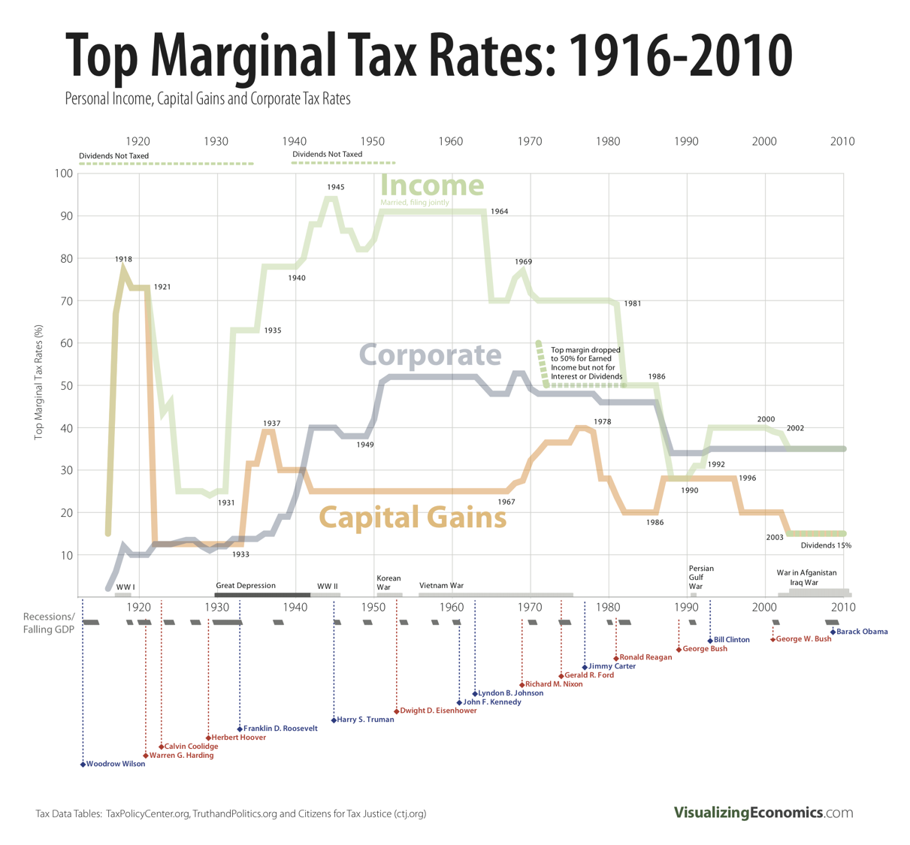

Slide 73
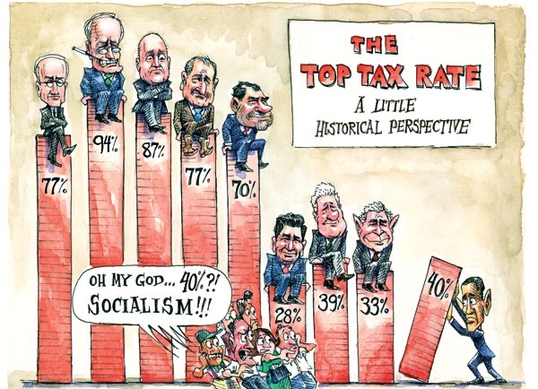

Slide 74
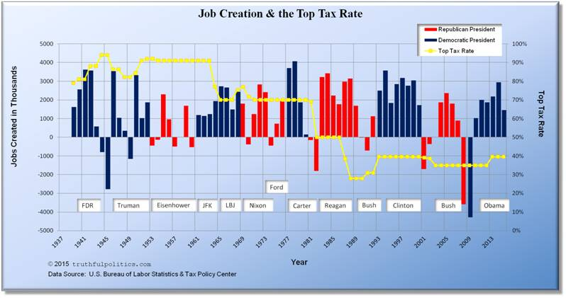

Slide 75
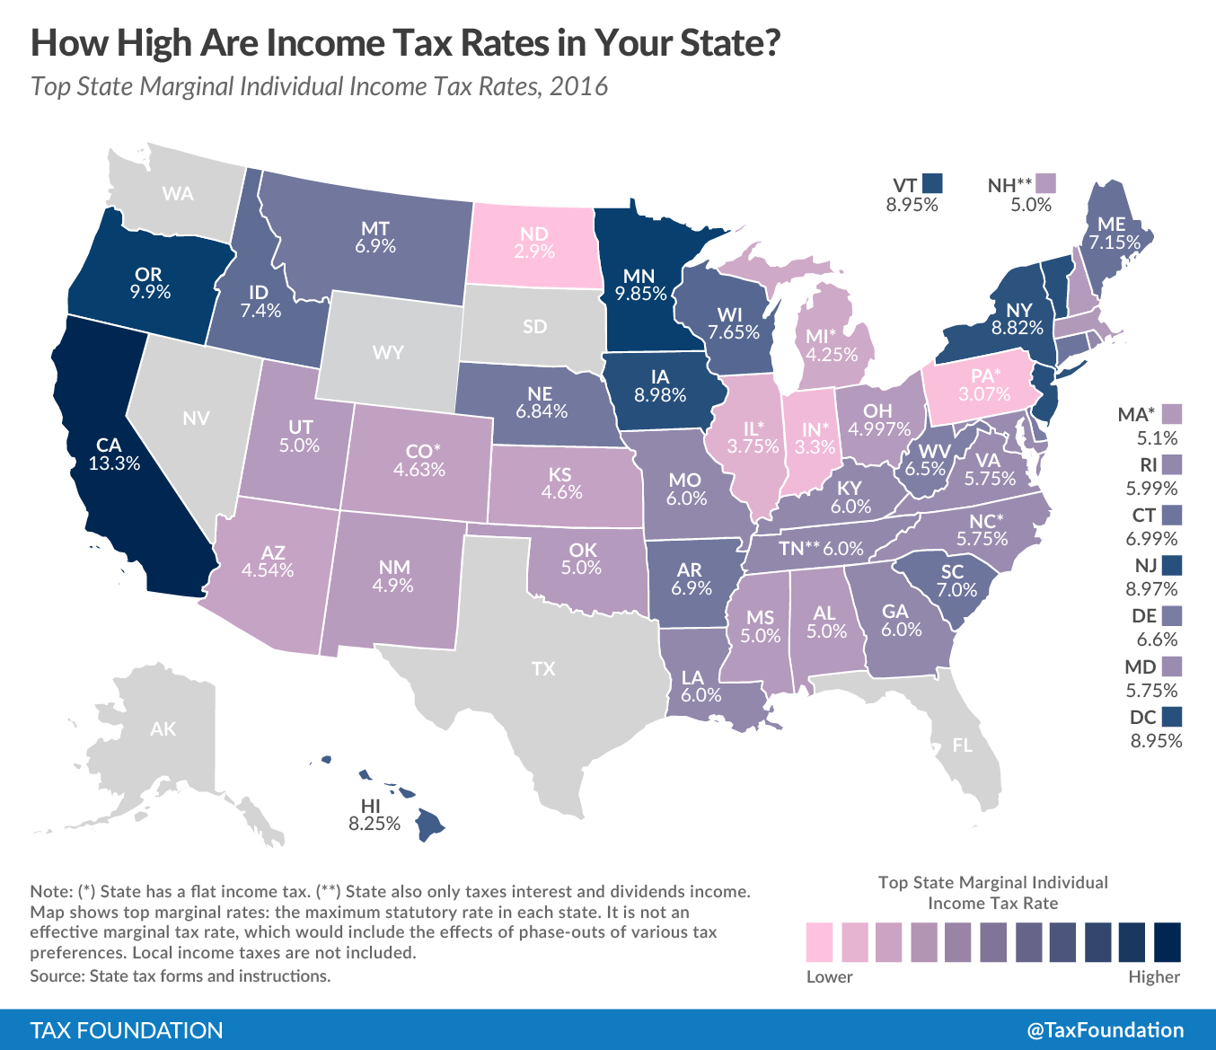

Slide 76
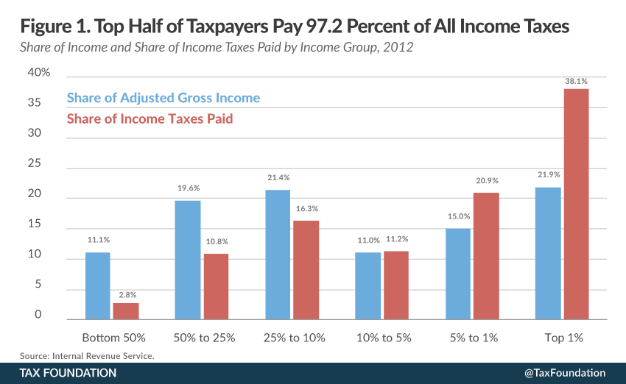

Slide 77
2016 Republican Platform
We believe in American exceptionalism.
We believe the United States of America is unlike any other nation on earth.
We believe America is exceptional because of our historic role — first as refuge, then as defender, and now as exemplar of liberty for the world to see.

Slide 78
The Washington Post explains “America Exceptionalism” as an ideology based on five ideas: Liberty, individualism, the belief in equality of all men, the philosophy that appeals to the common man rather appealing to a traditional party or partisan ideologies, and an attitude of letting things take their own course, without interfering [laissez faire].

Slide 79
In 2014, the Republican National Committee condemned the new AP US History framework as “a radically revisionist view of American history that emphasizes negative aspects of our nation’s history while omitting or minimizing positive aspects.”
The framework is about “teaching kids to see complexity and draw their own conclusions,” says Fritz Fischer, a history professor at the University of Colorado and author of “The Memory Hole: The U.S. History Curriculum Under Siege.”

Slide 80
The problem with people pushing “American exceptionalism” in the curriculum, Professor Fischer says, is that they want to teach “that America was always right.… They believe the US is the best country now and therefore it has always been the best country.”
Fischer agrees there are many examples of shining moments for the nation, but worries that some backers of exceptionalism don’t want students to be exposed to anything negative. Some have objected to letting students know about some founders of the country being slaveholders, while others have said America’s expansion westward can only be called expansionism, not imperialism.
“It’s much too simplistic for the classroom, where you want to teach critical thinking,” according to Fischer.

Slide 81
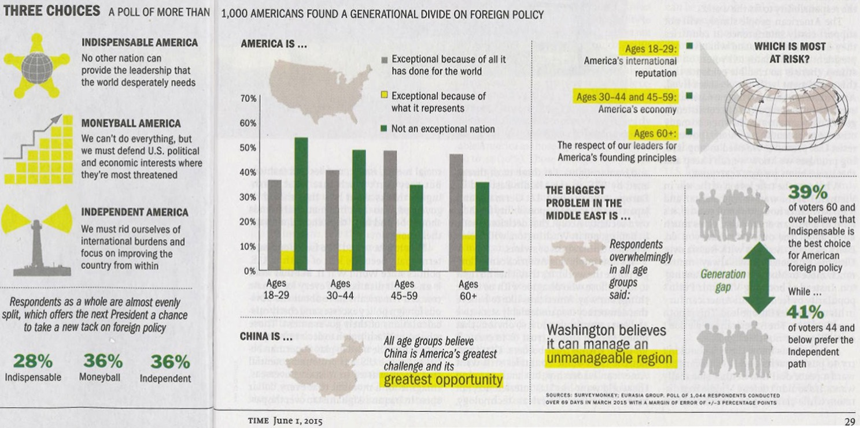

Slide 82
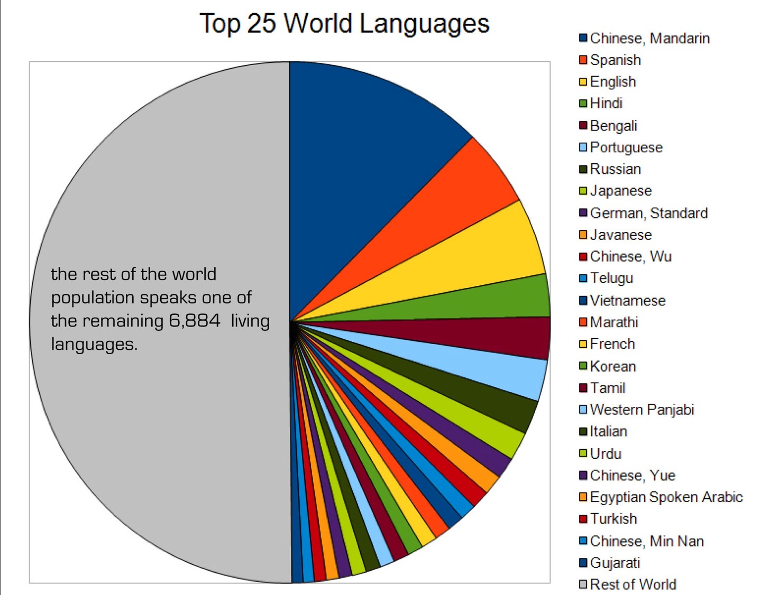

Slide 83
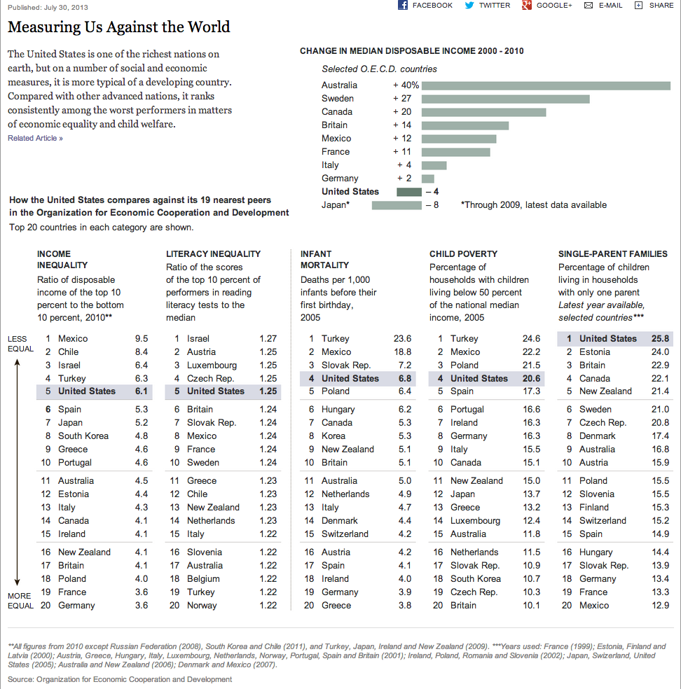

Slide 84
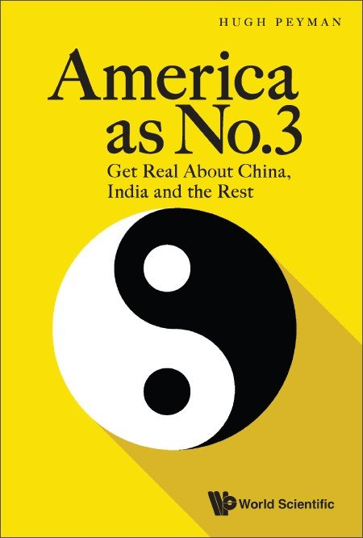
Is there anything about the USA that will make it different from previous powerful countries, such as the Roman and British
Empires, and not at some point suffer decline?

Slide 85
Global Trends: Economic
Percentage of World GDP
2004
2025
2050
India
India
China
India
Japan
Other
Other
Other
China
Japan
China
US
EU
US
US
EU
Japan
EU
China, India, Japan are expected to be 50% of world GDP within 30 years -- up from 18% in 2006.
Source: Keystone India

Slide 86
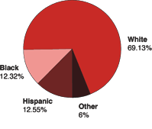
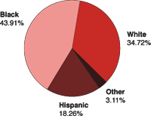
US Population by Race
US Prison Population
by Race

Slide 87
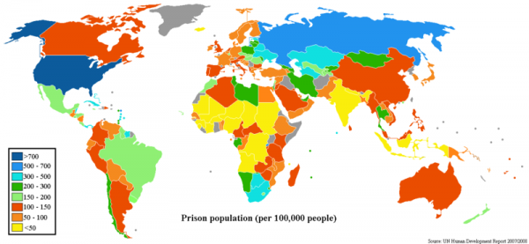
Prison Population by Country

Slide 88
Why are so many Americans in Prison?
In small groups brainstorm 5 reasons that the U.S. prison population is exceptionally high.
Drug Laws (War on) 7
Harsh Penalties/Long Sentences 6
Death Row 2
Poverty 2
Underage Drinking/DUI 2
Lack of Rehabilitation 2
Bad Communities 2

Slide 89
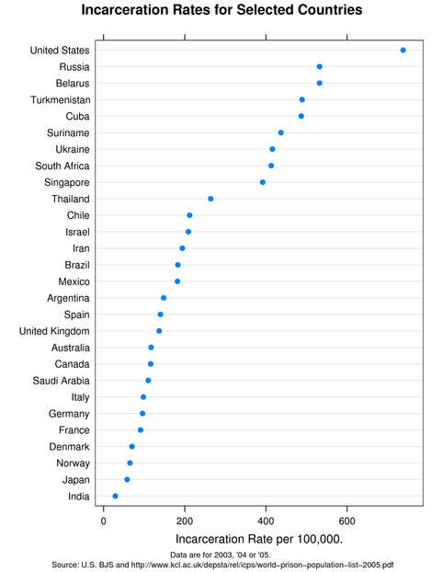

Slide 90
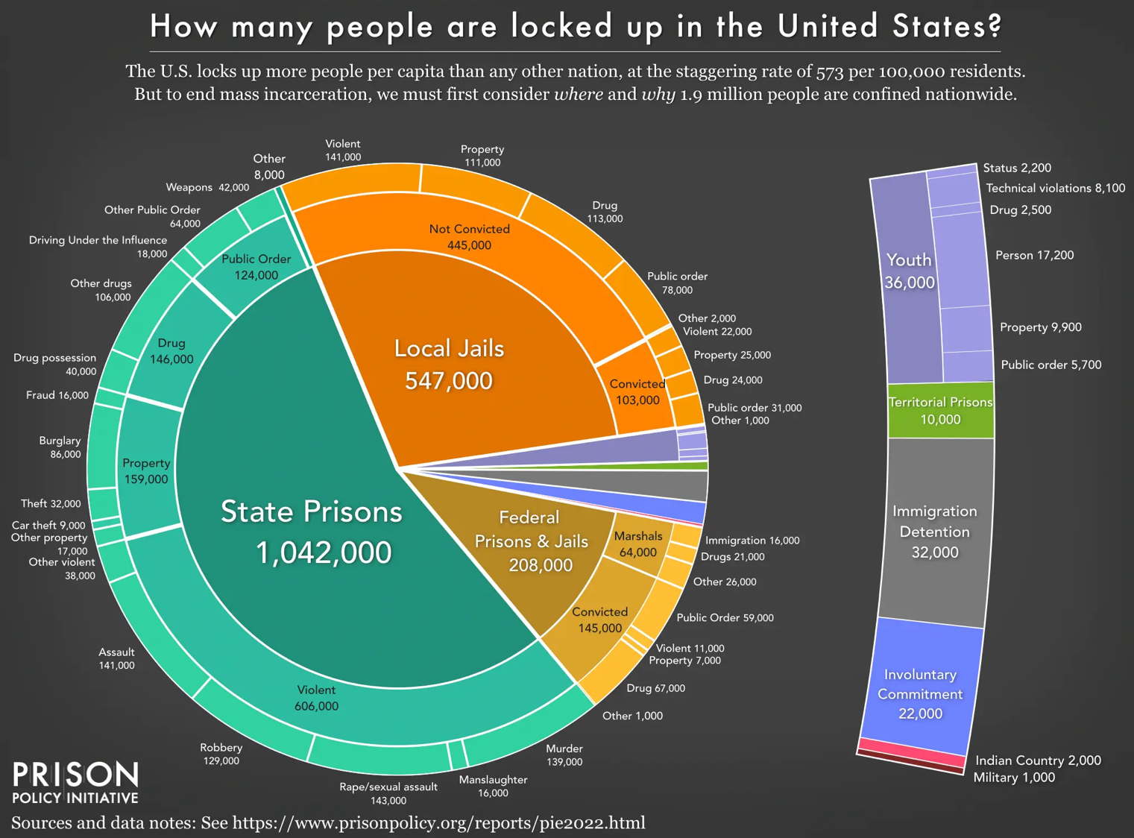

Slide 91

Of course there are different ways of looking at things.

Slide 92
School Suspension Rates over Time by Race/Ethnicity, K-12

Slide 93
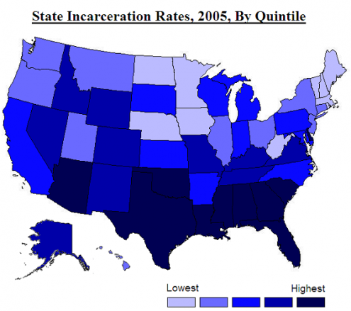
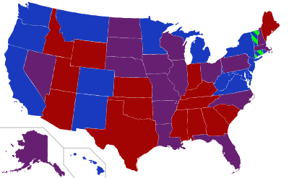
Current U.S. Senate
Representation
Red= 2 Republicans
Purple= 1 Each
Blue= Democrat
Green=Independent

Slide 94


Slide 95


Slide 96

Why Are So Many Americans In Prison Today?
https://www.manhattan-institute.org/prageru-why-are-so-many-americans-in-prison

Slide 97


Slide 98

Arizona Republic, Sunday, January 23, 2022

Slide 99

Arizona Republic, Sunday, January, 23, 2022

Slide 100

Or Maybe the Fake News Age?

Slide 101


