Slide 1

Human Rights What Are Basic Human Rights That Should Be Respected? BME 210 Week 9 Powerpoint
Jon Reyhner, Professor of Education

Slide 2
Through much of the history of the United States, Australia, Canada, New Zealand, and other colonized countries, schools have been designed to assimilate both immigrant and Indigenous populations with often (but not always) negative effects. Education was very Eurocentric and anything but multicultural!
For example, there was the pervasive ethnocentrism that contrasted Euro-American “civilization” with Indigenous “savagery.” Teacher and Indian agent Albert H. Kneale noted a century ago the U.S. government’s “Indian Bureau…went on the assumption that any Indian custom was, per se, objectionable, whereas the customs of whites were the ways of civilization.”

Slide 3
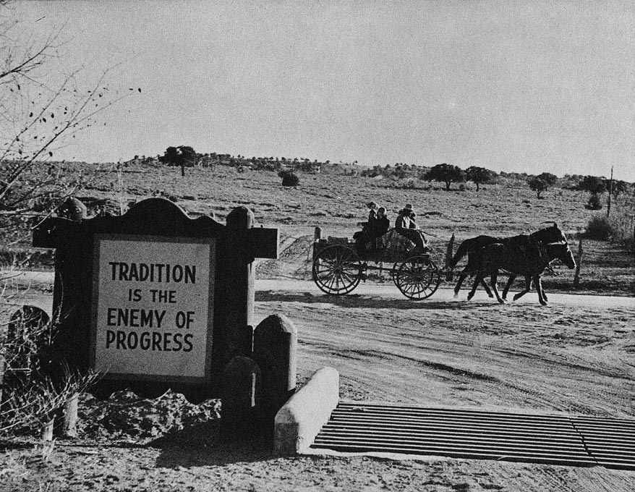
Ganado Mission School’s Entrance About 1950

Slide 4
Damage from Assimilationist
and Ethnocentric Education
Dillon Platero, the first director of the Navajo Division of Education, described in 1975 the experience of a typical Navajo student: “Kee was sent to boarding school as a child where—as was the practice—he was punished for speaking Navajo. Since he was only allowed to return home during Christmas and summer, he lost contact with his family.”

Slide 5
“Kee withdrew from both the White and Navajo worlds as he grew older because he could not comfortably communicate in either language. He became one of the many thousand Navajos who were non-lingual—a man without a language. By the time he was 16, Kee was an alcoholic, uneducated, and despondent—without identity.”

Slide 6
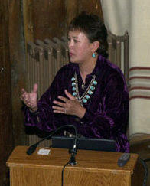
Dr. Lori Arviso Alvord, the
first Navajo woman surgeon
writes in her 1999 autobiography
The Scalpel and the Silver Bear,
“In their childhoods both my
father and my grandmother had
been punished for speaking Navajo in school. Navajos were told by white educators that, in order to be successful, they would have to forget their language and culture and adopt American ways.”

Slide 7
“They were warned that if they taught their children to speak Navajo, the children would have a harder time learning in school, and would therefore be at a disadvantage. A racist attitude existed. Navajo children were told that their culture and lifeways were inferior, and they were made to feel they could never be as good as white people.… My father suffered terribly from these events and conditions.”
Dr. Arviso Alvord concludes that “two or three generations of our tribe had been taught to feel shame about our culture, and parents had often not taught their children traditional Navajo beliefs–the very thing that would have shown them how to live, the very thing that could keep them strong.”

Slide 8
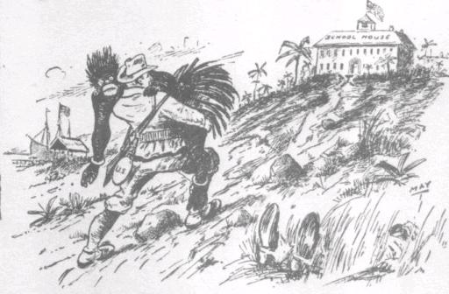

Slide 9
Is Ethnocentrism Still Alive?
Writing in The Wall Street Journal in 2002, John J. Miller declared that the increasing pace of language death is “a trend that is arguably worth celebrating [because] age-old obstacles to communication are collapsing” and primitive societies are being brought into the modern world.
Former Speaker of the House Newt Gingrich, wrote on his website in January 2007, “English is the language of American success and provides the basis for American cultural unity.”

Slide 10
U.S. Representative Tom Tancredo from Colorado in the New Hampshire Republican Presidential Debate on June 5, 2007 declared, “The preservation of the English language is important for us for a lot of reasons, not the least of which is because it is what holds us together. It is the glue that keeps a country together—any country. Bilingual countries don’t work, and we should not encourage it.”

Slide 11
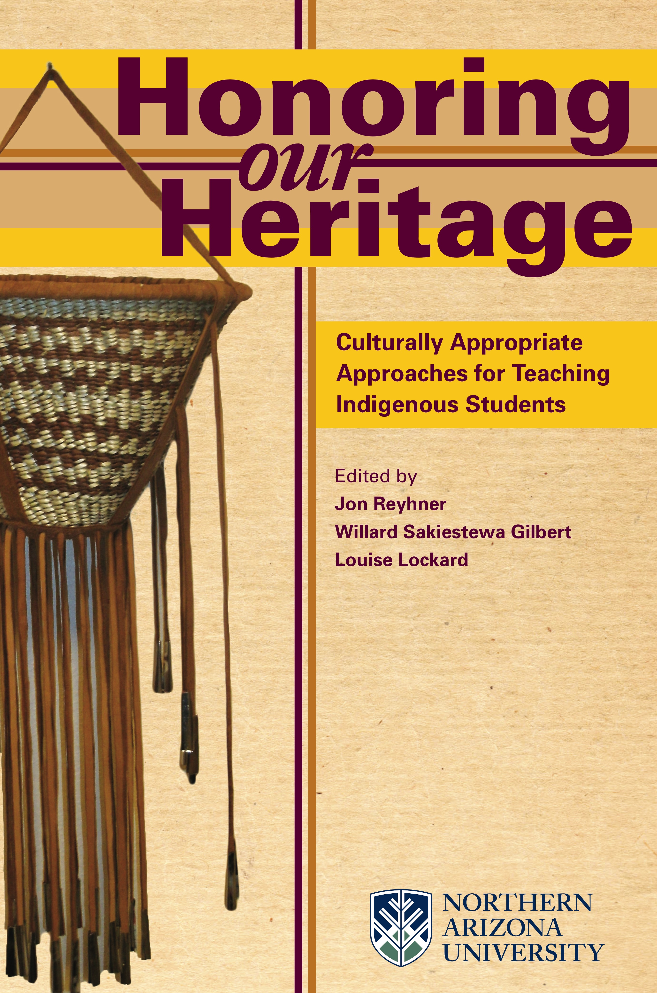
Should we not recognize that all cultures—African, Asian, European, Indigenous, etc.— have values and languages worthy of recognizing, appreciating and maintaining?

Slide 12
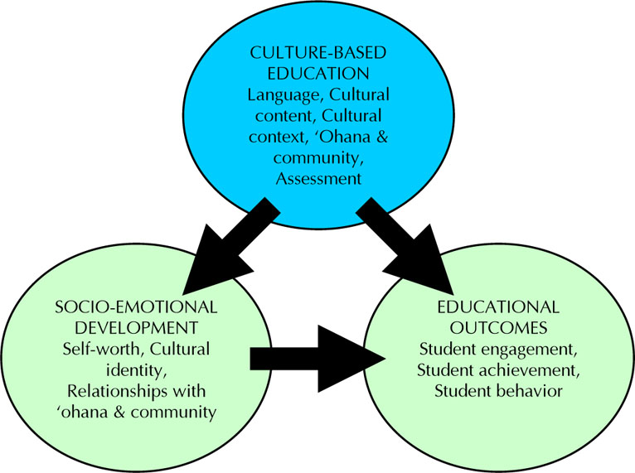

Slide 13

Far too often our
modern English-only
world is one of a
materialistic and
hedonistic MTV
Culture. The 1948
Universal Declaration
of Human Rights
adopted by the United
Nations states in Article 26 that, “Parents have a prior right to choose the kind of education that shall be given to their children.”

Slide 14
In 1948 the UN’s General Assembly adopted the Universal Declaration of Human Rights. Its Article 26 states:
“Everyone has the right to education”
“Education shall be directed to the full development of the human personality and to the strengthening of respect for human rights and fundamental freedoms.”
The General Assembly called upon all member countries to publicize this declaration and “to cause it to be disseminated, displayed, read and expounded principally in schools and other educational institutions,” a call often ignored by the United States and other countries.
http://www.humanrightsactioncenter.org/

Slide 15
In 1966 the UN adopted an International Covenant on Civil and Political Rights that went into force in 1976. Article one states, “All peoples have the right of self-determination. By virtue of that right they freely determine their political status and freely pursue their economic, social and cultural development.”
The UN’s Convention on the Rights of the Child entered into force in 1990. In section 1, of article 29:

Slide 16
States Parties agree that the education of the child shall be directed to:
(b) The development of respect for human rights and fundamental freedoms, and for the principles enshrined in the Charter of the United Nations.
(c) The development of respect for the child’s parents, his or her own cultural identity, language and values, for the national values of the country in which the child is living, the country from which he or she may originate, and for civilizations different from his or her own.

Slide 17
Article 30 reads: In those States in which ethnic, religious or linguistic minorities or persons of indigenous origin exist, a child belonging to such a minority or who is indigenous shall not be denied the right, in community with other members of his or her group, to enjoy his or her own culture, to profess and practice his or her own religion, or to use his or her own religion.
The United States and Somalia are the only countries who have not ratified this Covenant.

Slide 18
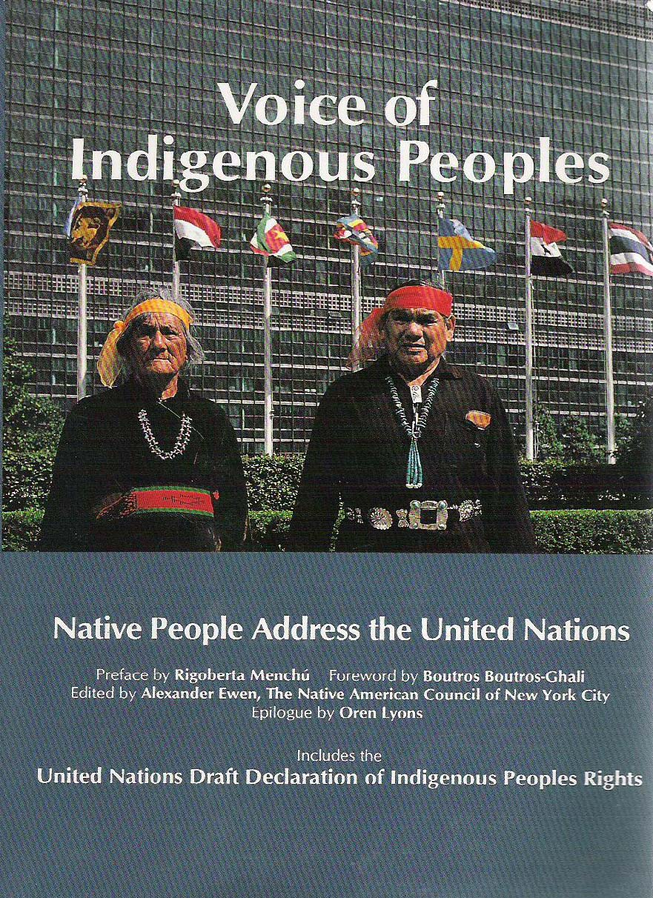
The UN adopted the
Declaration on the Rights of
Indigenous Peoples in 2007
on a vote of 143 to 4 with
only Canada, Australia,
New Zealand, and the U.S.
Opposing.
Article 2 affirms, “Indigenous
peoples have the right of self-
determination” and article 8, “indigenous peoples and individuals have the right not to be subject to forced assimilation or destruction of their culture.”

Slide 19
Article 13 declares that Indigenous peoples have the “the right to revitalize, use, develop and transmit to future generations their histories, languages, oral traditions, philosophies, writing systems and literatures, and to designate and retain their own names for communities, places and persons.”
Article 14 states they have “the right to establish and control their educational systems and institutions providing education in their own languages, in a manner appropriate to their cultural methods of teaching and learning.”

Slide 20
In 2010, President Barack Obama declared:
“And as you know, in April, we announced that we were reviewing our position on the U.N. Declaration on the Rights of Indigenous Peoples. And today I can announce that the United States is lending its support to this declaration.
The aspirations it affirms--including the respect for the institutions and rich cultures of Native peoples--are one we must always seek to fulfill. And we're releasing a more detailed statement about U.S. support for the declaration and our ongoing work in Indian Country. But I want to be clear: What matters far more than words--what matters far more than any resolution or declaration--are actions to match those words.... That's the standard I expect my administration to be held to.

Slide 21
In colonized countries where the Indigenous populations remained a numerical majority, as in many places in Africa & Asia, the Indigenous populations have been able to regain their sovereignty. However, where they became a relatively small minority, as in the four countries voting against the 2007 Declaration, they remain in many ways second-class citizens.
Tove Skunabb-Kangas concluded, “many governments applaud…human rights, as long as they can define them in their own way, according to their own cultural norms.” She noted that the United States as of May 1998 had only ratified 15 of 52 universal human rights instruments, which puts it well down on a list, accompanied by Somalia and just below Saudi Arabia, that is led by Norway with 46 ratifications.

Slide 22
The United States is moving away from human rights (see e.g., Roth 2000), including repressing the use of non-English languages. For example, more and more states are making English their “official language.” Thirty states now have some type of “Official English” law, with almost half of them passed since 1990. While these laws can boil down to what can amount to empty rhetoric, California, Arizona and Massachusetts have also passed by popular vote “English for the Children” laws that pretty much require English-only instruction in public schools whatever their parents’ wishes.

Slide 23

Jim Cummins emph-
asized in a speech to the
National Association for
Bilingual Education (NABE)
in Phoenix in 2001 how the
“English for the Children”
Proposition 203 passed in Arizona by the voters in 2000 (and modeled after California’s earlier Proposition 227) reflected a “xenophobic discourse” that is telling students to “leave your language [and culture] outside the schoolhouse door.”

Slide 24
Wayne E. Wright at the University of Texas notes that Arizona's Proposition 203 passed by voters in 2001 places restrictions on bilingual and ESL programs and essentiality mandates English-only education for English language learners (ELLs) finds that Arizona’s Proposition 203 and its implementation are political spectacle, rather than democratic rational policy making with true concern for ELL students.

Slide 25
ELLs Fairing Poorly in English-Only Arizona
“Structured English immersion” (SEI), mandated by law in 3 states, is failing English language learners, according to several recent reports. A group of researchers at Arizona State University found:
More than 7 out of 10 ELLs made no progress in English acquisition in 2003-04, following a decision by Superintendent of Public Instruction Tom Horne to strictly enforce Proposition 203.
60% of ELLs in grades 1-5 had “no gain” in oral English, while 7% lost ground. Only 30% showed any improvement.
In grades 6-12, the picture was worse, with only 21% of ELL students making gains in English during the year

Slide 26
The results are especially significant, because Arizona's English-only law – as interpreted and enforced by Superintendent Horne – is the “purest” experiment of its kind.
All of Arizona’s ELL students are being used as guinea pigs to test a vaguely defined program that has no track record of success.
Unlike California, where parents are still allowed to sign “waivers” requesting bilingual education for their children, Arizona has effectively eliminated that option.
Bilingual education is simply no longer available to ELLs, which helps explain why their acquisition of English has stalled.

Slide 27
Another Arizona Study documented a corresponding decline in academic achievement in 2003-04, as Tom Horne was tightening the screws on parents' right to choose bilingual education. It reported that, in Arizona elementary schools, the achievement gap between ELLs and other students is increasing on Stanford 9 tests in English reading and math.
Ron Unz, the Silicon Valley millionaire who sponsored Proposition 203 and other English-only initiatives in California and Massachusetts, promised that SEI would teach children English within one year. That has not occurred in any state where such “programs” have been mandated.

Slide 28
The Arizona State University study found that only 11 percent of ELLs were reclassified as fluent in English in 2003-04; in California the figure was just 8 percent. A survey by the Massachusetts Department of Education reported that just 9 percent of 5th and 6th grade ELLs were being reclassified as fluent in English each year.
English-only proponents claim one year of ESL is enough to get non-English speaking students ready for a mainstream classroom.

Slide 29
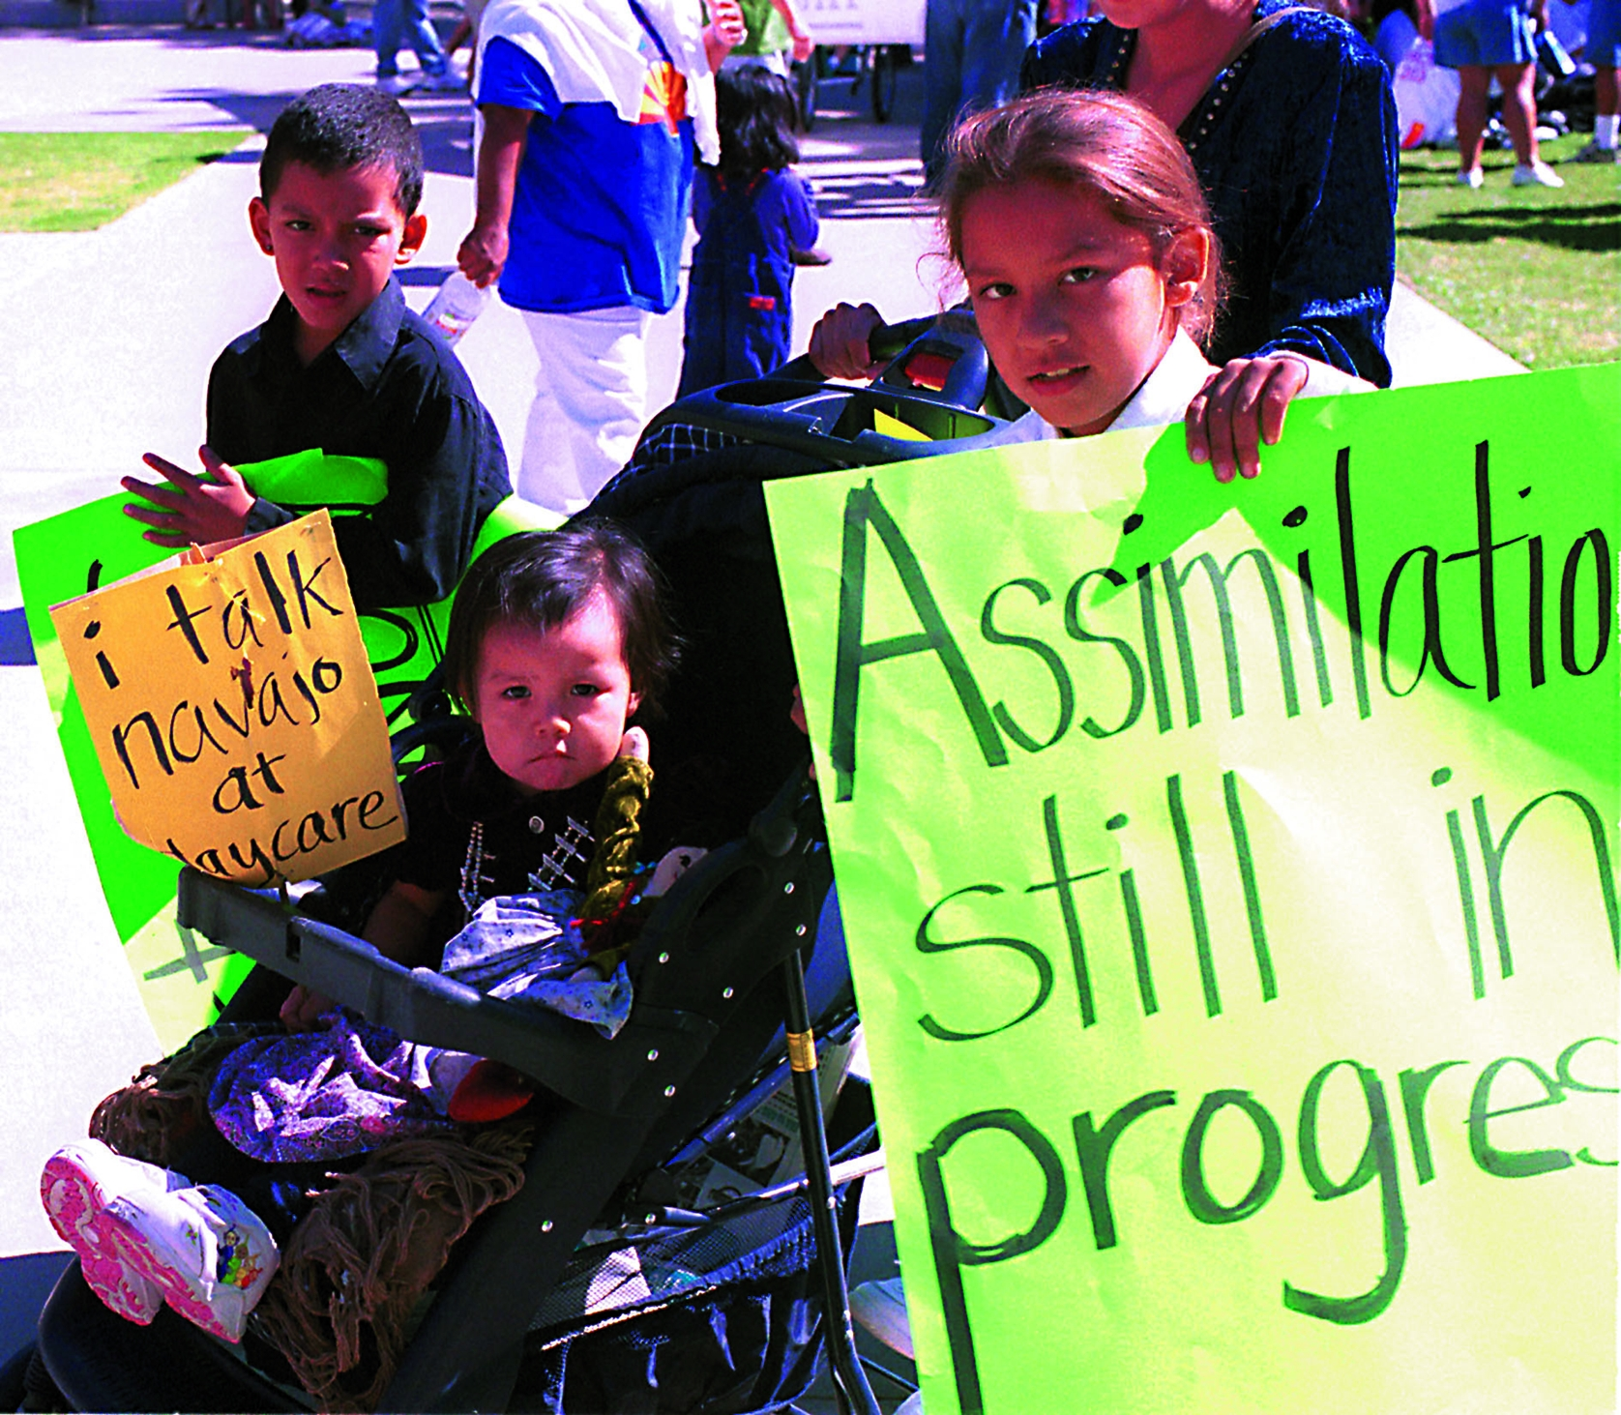

Slide 30
Arizona’s Indian Nations viewed Arizona’s “English for the Children” Prop. 203 as an attack on their attempts at language revitalization and strongly opposed it. In a September 2000 press release, Navajo Nation President Kelsey Begaye declared that the “preservation of Navajo culture, tradition, and language” is the number one guiding principle of the Navajo Nation.”
In 4 of Arizona’s 15 counties a majority of the voters were against Prop. 203, and 3 of those counties comprised large portions of the Navajo Nation.
These “English for the Children Propositions” are examples of Lani Guinier’s “Tyranny of the Majority.”

Slide 31
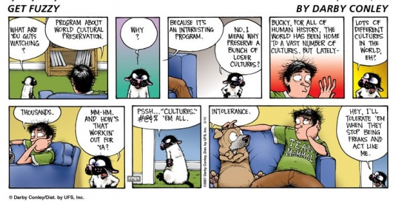

Slide 32
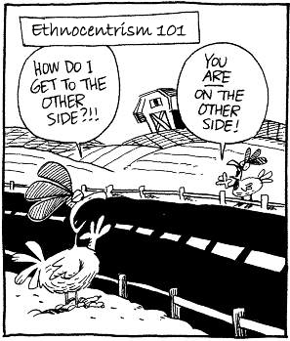

Slide 33
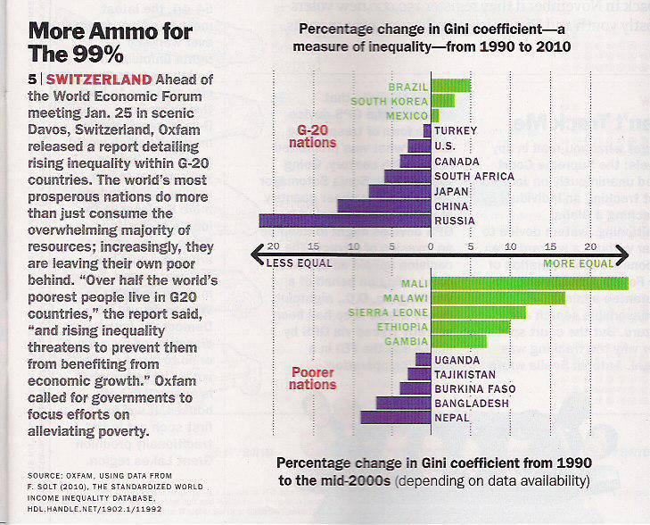

Slide 34
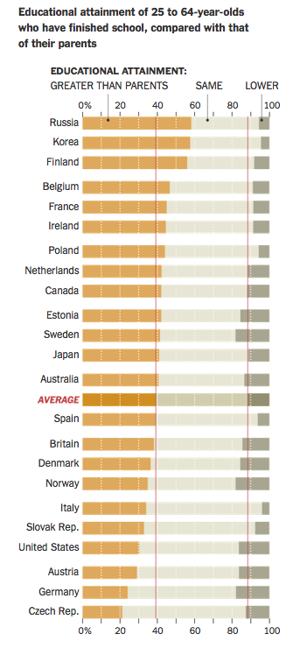
Educational attainment of 25 to 64-year-olds who have finished school compared with that of their parents
New York Times
September 10, 2014

Slide 35
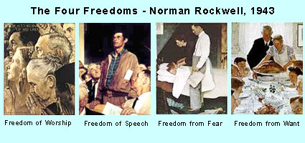
President Franklin Roosevelt’s Four Freedoms:
Promoting the General Welfare

Slide 36
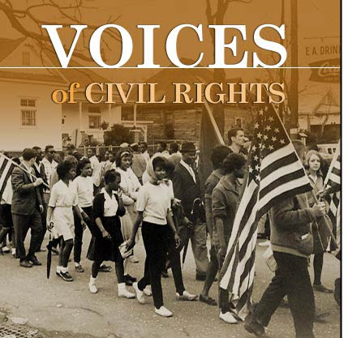
Civil Rights Movement

Slide 37
United States Naturalization Law of March 26, 1790
Provided the first rules to be followed by the United States in the granting of national citizenship. This law limited naturalization to immigrants who were free white persons of good character. It thus excluded American Indians, indentured servants, slaves, free blacks, and Asians.
The Immigration and Nationality Act of 1952 prohibits racial and gender discrimination in naturalization.

Slide 38
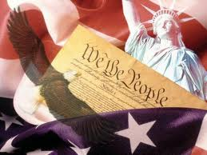
CIVIL WAR Amendments
13th: 1865 abolished slavery
14th: 1868 established citizenship and due process
15th: 1870 universal male suffrage

Slide 39
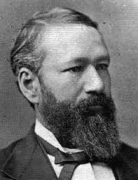
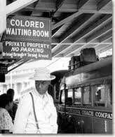
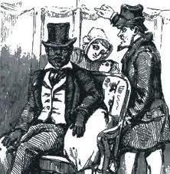
Plessy v. Ferguson
1896 US Supreme Court legalizes segregation in the United States
“SEPARATE BUT EQUAL”

Slide 40
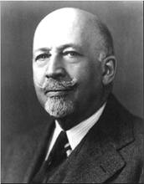
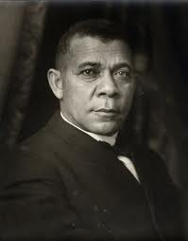
Early Civil Rights Leaders
W.E.B. DuBois—pushed for immediate civil rights and equality. Leader of NAACP
Booker T. Washington founder of Tuskegee Institute—Gradualism, be careful about rocking the boat

Slide 41
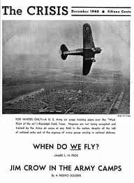
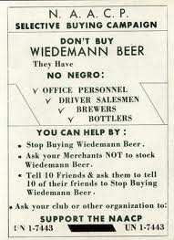
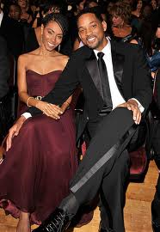
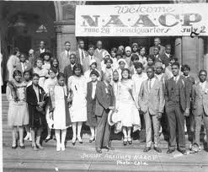
1909 NAACP
National Association for the
Advancement of Colored People
established.

Slide 42
1920 Women Get Vote (19th Amendment)
1924 Indian Citizenship Act

Slide 43
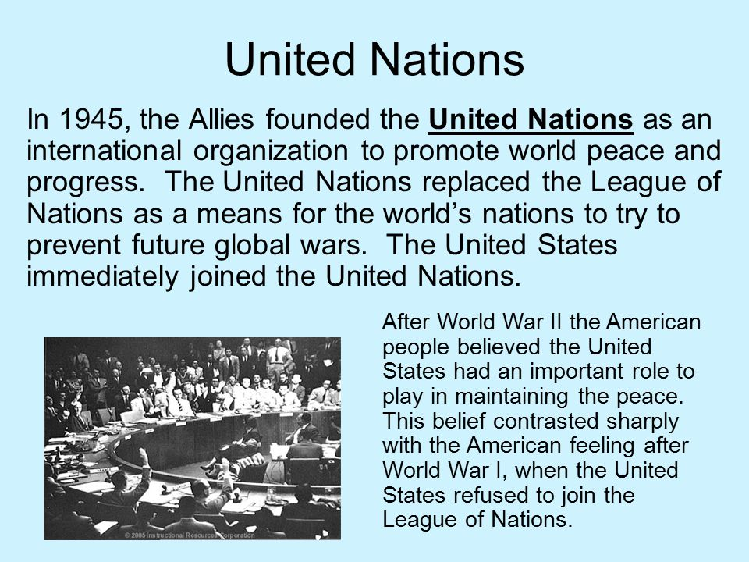

Slide 44
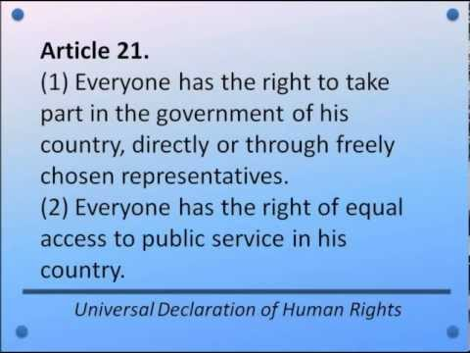
1948

Slide 45

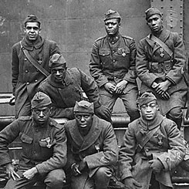
Post-WWII
African Americans grew dissatisfied with their second-class status after WWII
Risked their lives defending freedom abroad
Civil Rights Movement - a broad and diverse effort to attain racial equality

Slide 46
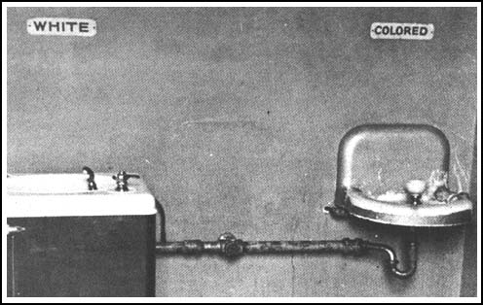
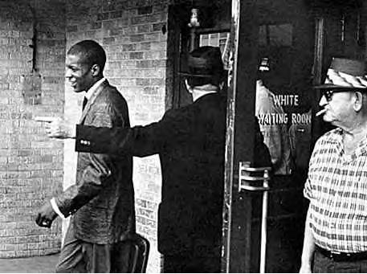
Segregation divides America
Jim Crow laws-enforced strict separation of the races in the South
Schools, hospitals, transportation, & restaurants
De jure segregation-imposed by law
1896 Plessy vs. Ferguson-”Separate but equal”

Slide 47
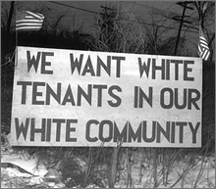
Segregation in the North
De facto segregation: segregated by unwritten custom or tradition, fact of life
Blacks were denied housing in many neighborhoods and faced discrimination in employment (NORTH)

Slide 48
The Impact of Segregation
African Americans received low-paying jobs
Higher rates of poverty and illiteracy
Lower rates of homeownership and life expectancy (redlining of neighborhoods made it hard to get government backed home loans.
Couldn’t vote in the south

Slide 49

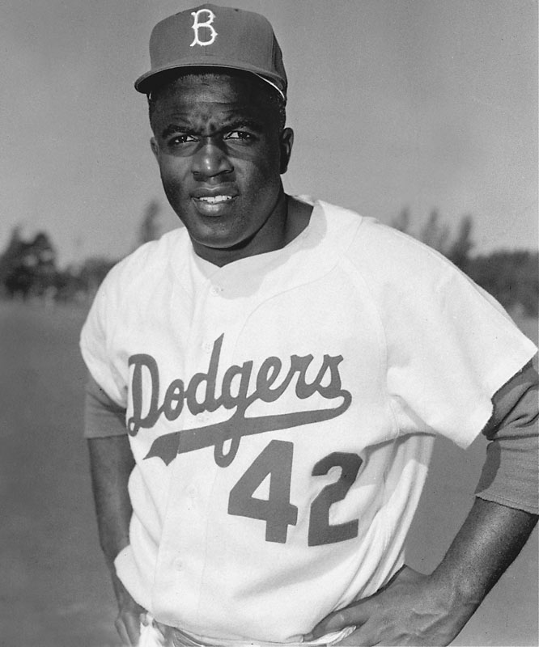
The Civil Rights Movement Grows
Congress of Racial Equality (CORE) founded 1942: became convinced to use non-violent methods to gain civil rights
Organized Protests in northern cities
Jackie Robinson breaks color line in baseball 1947

Slide 50

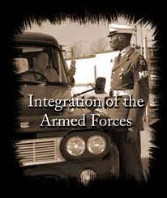

1948 President Harry S. Truman integrates the military by executive order.

Slide 51

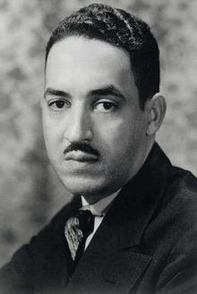
NAACP Challenges Segregation
NAACP became the largest and most powerful civil rights organization
Thurgood Marshal-headed the team that challenged the legality of segregation

Slide 52
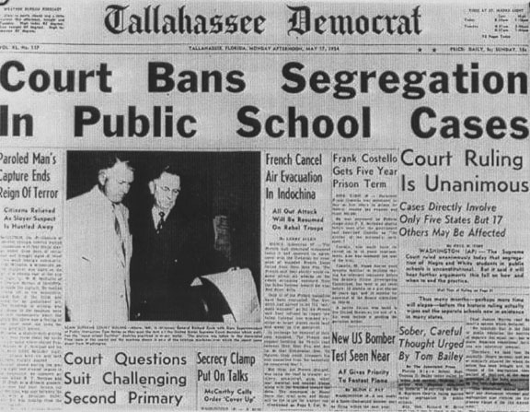
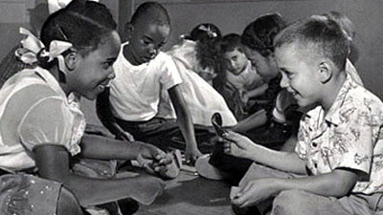
Brown vs. Board 1954
NAACP challenged the “separate but equal” ruling
The Supreme Court agreed with NAACP argument that segregated public education violated the U.S. Constitution
Effects:
Great impact since it touched so many Americans
Opposition to the ruling declared that the South would not be integrated (White Citizens Council)

Slide 53
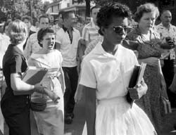
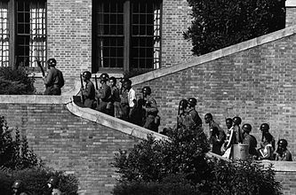
Little Rock Nine
President Eisenhower sent federal troops to Little Rock to protect the African American students and to enforce Brown vs. Board
For the entire school year, federal troops stayed in Little Rock escorting the students to and from school

Slide 54
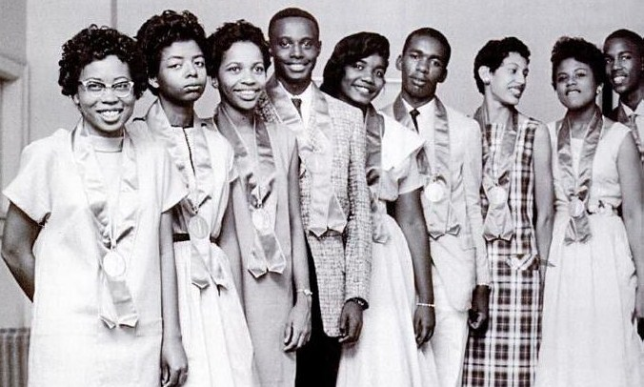
Effects of Little Rock Nine
It demonstrated that the President would not tolerate open defiance of the law
However, most southern states found ways to resist desegregation and it would take years before black and white children went to school together
Schools becoming increasingly segregated today based on where people live (de facto vs de jure segregation.

Slide 55
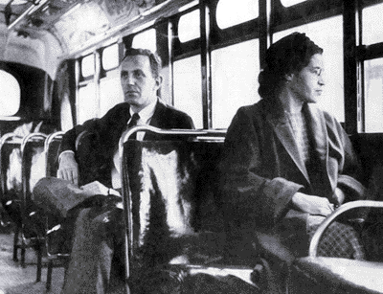
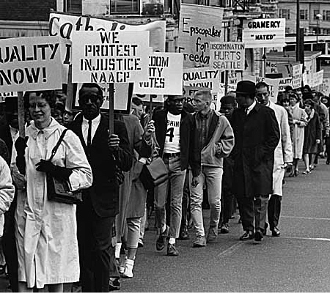
Montgomery Bus Boycott
Rosa Parks actions transformed the movement
NAACP began preparing a legal challenge
Rise of Martin Luther King who urged non-violence
Bus boycott lasted a year
In 1956 the Supreme Court ruled the Montgomery bus segregation law was unconstitutional

Slide 56
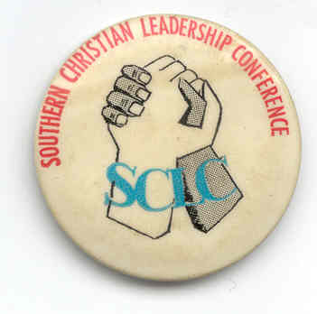
Effects of the Boycott and the Supreme Court Victory
Revealed the power African Americans could have if they joined together
Martin Luther King established the Southern Christian Leadership Conference (SCLC)
Advocated nonviolent resistance to fight injustice

Slide 57
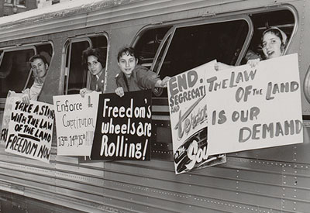
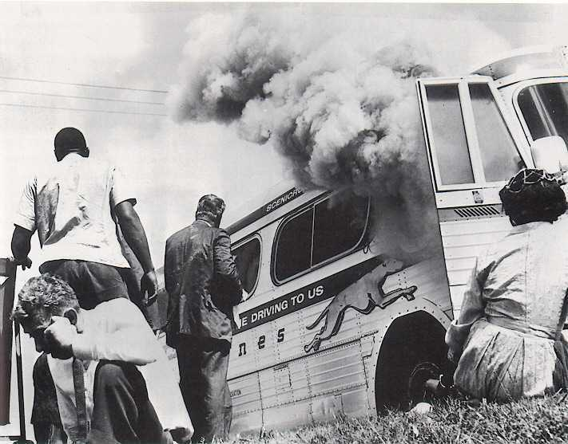
Freedom ride
Test the federal government’s willingness to enforce that segregation on interstate buses was illegal (Boynton v. Virginia 1960)
En route, they defied segregation codes
In Alabama one bus was firebombed and the riders on a second bus were attacked

Slide 58
Effects of the Freedom Ride
President John F. Kennedy takes action
Federal Transportation Commission issued an order mandating the desegregation of interstate transportation
Civil rights activists achieved their goal and that intimidation would not defeat them

Slide 59
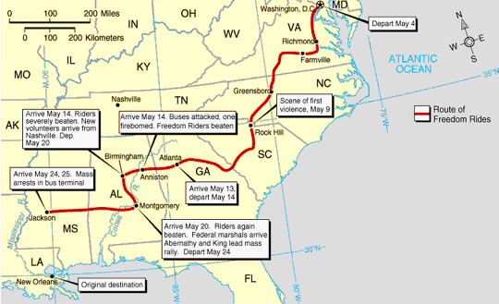

Slide 60
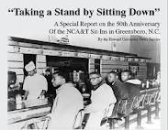
Sit-ins
Four black students at North Carolina sat down in a white diner and were told that they would not be served
Sit ins became a new way to protest segregation of public facilities

Slide 61
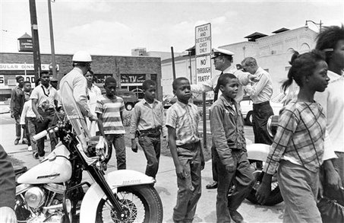
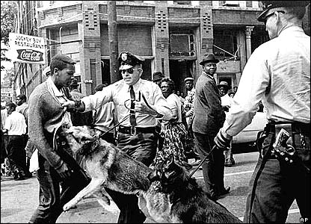
Focus on Birmingham
Letter from Birmingham jail by Martin Luther King 1963
Freedom marches: schoolchildren joined the demonstrations
Many Americans were shocked by the news coverage of nonviolent protestors set upon by dogs and jets of water
John F. Kennedy approves civil rights bill

Slide 62
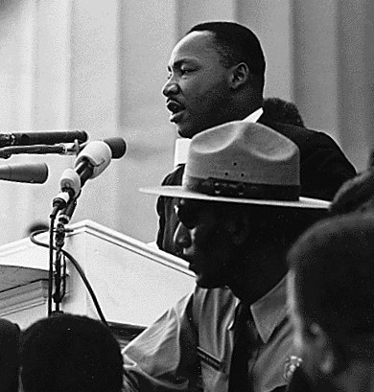
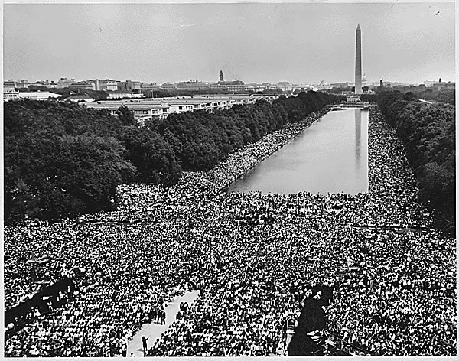
1963 March on Washington
To put pressure on Congress to pass the new civil rights bill
Drew more than 200,000
MLK-”I have a dream”
One of the largest political demonstrations
A model for peaceful protest

Slide 63
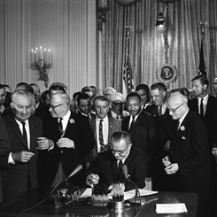
Civil Rights Act of 1964
The act banned segregation in public accommodations
Gave the federal government the ability to desegregate schools
Prosecute individuals who violated people’s civil rights
Outlawed discrimination in employment
Established the Equal Employment Opportunity Commission (EEOC)

Slide 64
The Push for Voting Rights
Literacy tests
Poll taxes
Intimidation
All kept blacks and American Indians from voting in some areas

Slide 65
Voting Rights Act of 1965
Spurred by actions of protesters and the President, Congress passed the act
It banned literacy tests and empower the federal government to oversee voting registration
By 1975, Congress extended it to Hispanic voters
Black voter participation jumped from 7% in 1964 to 70% in 1986

Slide 66
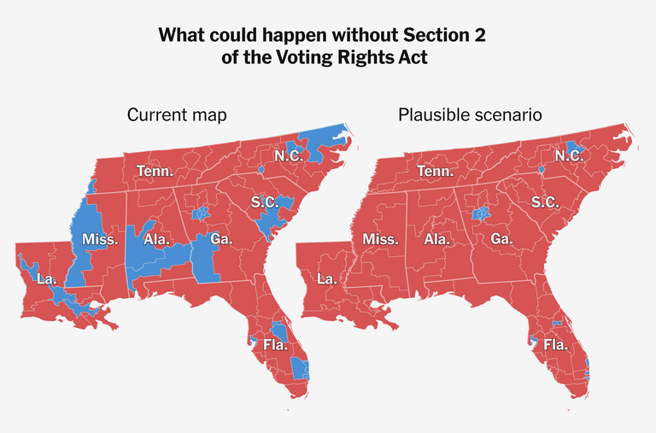
New York Times 10/16/25

Slide 67


Slide 68

Electoral Map in 1950s Before Civil Rights Act

Slide 69

2016 Election Results

Slide 70

Why do White Christians vote Republican and Black Christians vote Democratic
https://www.facebook.com/watch/?v=2052252051573848

Slide 71


Slide 72


Slide 73


Slide 74


Slide 75


Slide 76


Slide 77


1964 24th Amendment
Outlawed poll tax. Black voter registration begins to increase.

Slide 78

The Riots
Frustration over discrimination and poverty
Worst in Newark, New Jersey and Detroit, Michigan in the summer of 1967
Blacks using violence against police and white business owners in black neighborhoods

Slide 79

Loving vs. Virginia 1967

Slide 80
The Kerner Commission
It concluded racial discrimination as the cause of the violence
They recommended by extending federal programs to Urban black neighborhoods
Controversy surrounding the Commission
President Lyndon Johnson did not follow up

Slide 81

Malcolm X
Influenced by race riots
Grew up in poverty and had a difficult childhood in contrast to Martin Luther King’s middle class upbringing
While in jail, converted to the Nation of Islam (Black Muslims)
Strict rules of behavior, no drugs or alcohol, and demanded a separation of the races in contrast to M.L.K’s support of integration

Slide 82
Malcolm X
He became the Nation of Islam’s most prominent minister
However, he broke away and formed his own group.
Assassinated 1965
Three Nation of Islam members were later convicted of assassinating Malcolm
After his pilgrimage to Mecca, Malcolm was more willing to consider limited acceptance of whites

Slide 83

“Black Power”
Move away from nonviolence
Stokley Carmichael’s definition: it meant African Americans should collectively use their economic and political muscle to gain equality
Fought Institutional Racism
http://www.history.com/videos/stokely-carmichael#stokely-carmichael

Slide 84


Black Panthers
Symbol of young militant African Americans
Protected urban neighborhoods from police abuse
Created antipoverty programs
Stokely was “honorary Prime Minister”

Slide 85
MLK’s final days
Understood the anger and frustration of many urban African Americans
Disagreed with the call for “black power”
Condemned Vietnam War and supported labor unions
King’s assassination in 1968 triggered riots in more than 100 cities
2 months later Robert Kennedy was assassinated

Slide 86


Slide 87
Significant Gains of Civil Rights Movment
Eliminated legal or de jure segregation
Knocked down barriers of voting and political participation for African Americans
Poverty rates fell
Increased the number of African Americans high school graduates
Appointment of Thurgood Marshall as the first African American Supreme Court Justice in 1967
Fair Housing Act

Slide 88

Controversial Issues
Affirmative Action: increase African American representation in schools and the workforce
Racism
Social and Economic gap

Slide 89



Civil Rights Today
Do we face civil rights issues today?
Are we a desegregated, equal society?
Are there other groups dealing with civil rights questions today?

Slide 90

The Results of Lower “White” Birth Rates
and Changing Immigration Patterns
Is this “Replacement Culture” as Tucker Carlson asserted on Fox News?

