Slide 1

Ethnic & Self Identity:
Humility vs. Self Esteem
What Do Students Need for Academic & Life Success?
BME 210: Week 9

Slide 2
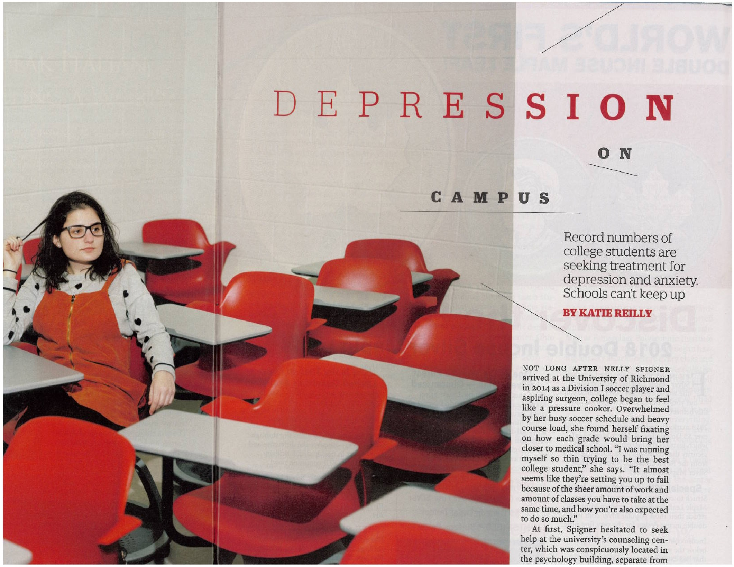

Slide 3
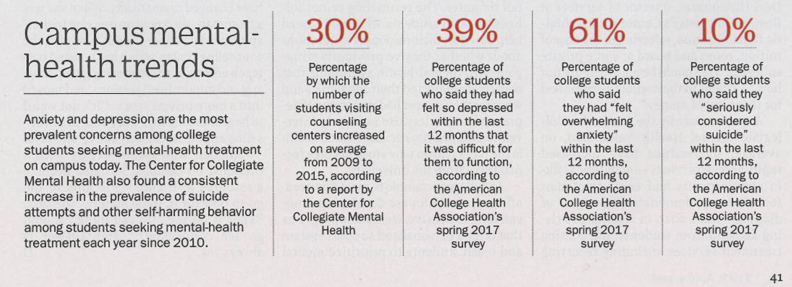
What Is It In
Modern American Culture/Campus Culture Causing These Trends?
What is the Role of Social Media in These Trends?
Time Magazine, April 9, 2018

Slide 4
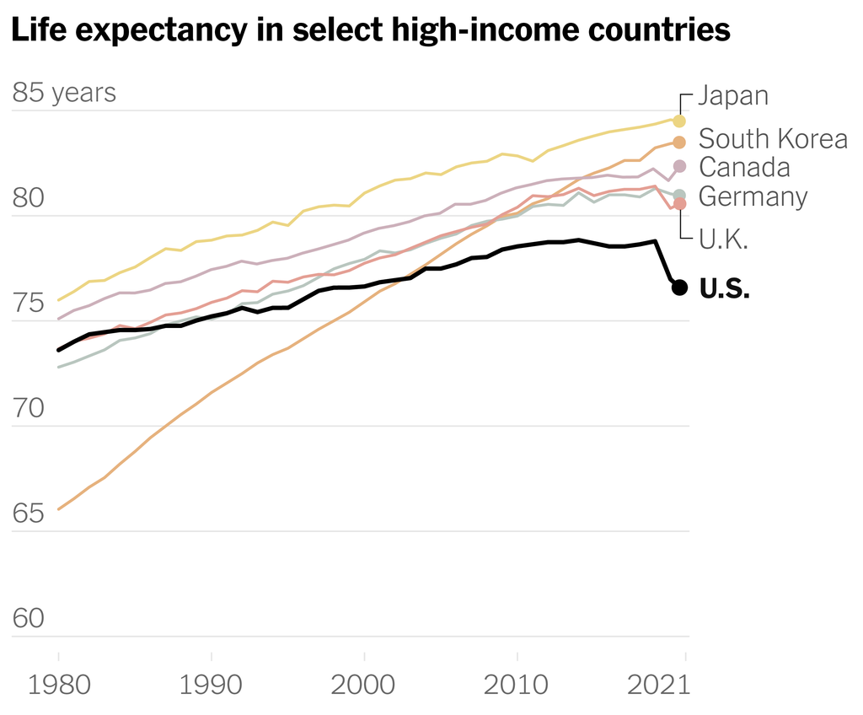

Slide 5
Is using social media making our kids unhappy? Evidence is mounting that there is a link between social media and depression. In several studies, teenage and young adult users who spend the most time on Instagram, Facebook and other platforms were shown to have a substantially (from 13 to 66 percent) higher rate of reported depression than those who spent the least time.
Does that mean that Instagram and TikTok are actually causing depression? These studies show a correlation, not causation. But it’s worth a serious look at how social media could be affecting teenagers and young adults negatively. Some schools are banning cell phones.
https://childmind.org/article/is-social-media-use-causing-depression/

Slide 6
Why are so many American white men killing themselves and others? Princeton researchers Anne Case and Angus Deaton refer to these as “deaths of despair” and trace the causes to various social problems—especially the economic problems of unemployment. “These deaths of despair have been accompanied by reduced labor force participation, reduced marriage rates, increases in reports of poor health and poor mental health. So we are beginning to thread a story in that it’s possible that [the trend is] consistent with the labor market collapsing for people with less than a college degree. In turn, those people are being less able to form stable marriages, and in turn that has effects on the kind of economic and social supports that people need in order to thrive.” --The Killing of the American White Male, April 3, 2018 by D. Longenecker

Slide 7
Self-esteem
Self-esteem is liberally sprinkled throughout American English. Every talk show host, every talk show guest has uttered the word. “I overate because I had low self-esteem.” “I allowed my partner to abuse me because I had low self-esteem.” I eagerly await the day when someone says, “I overeat because I am surrounded by food ads and fast-food outlets that sell nothing but high-fat, unhealthy food, and as a poor person it is more difficult to buy fresh fruits and vegetables and take time to prepare them.”
--Gloria Ladison-Billings
Culturally Relevant Pedagogy, 2021

Slide 8
Hap Gilliland devotes a whole chapter to self esteem in his book Teaching the Native American and concludes: “Self-esteem is the most important factor in achievement.”
https://www.youtube.com/watch?v=B8XYmA_8-H4
In contrast, the Hopi Tribe’s home page in the past noted that their “lifeway…is based on humility, cooperation, respect and earth stewardship.”

Slide 9
The National Museum of the American Indian’s Anishanabe exhibit notes the teachings of their Seven Grandfathers include, along with wisdom, love, respect, bravery, honesty and truth, the teaching of dbaadendizin — humility: You are equal to others, but you are not better.
Standing In vs. Standing Out

Slide 10
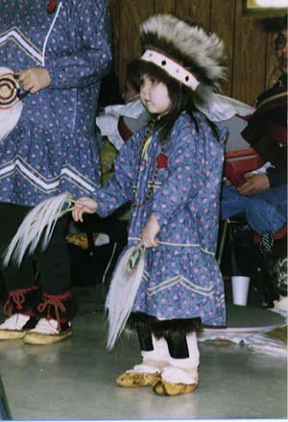
Lipka et al. found that
Yup’ik teachers
rejected the profuse
“bubbly” praise
promoted by non-Yup’ik teachers because traditional Yup’iks believed “overly praising will ruin a person.”

Slide 11
Should Schools Try to Boost Self-Esteem?
Beware of the Dark Side
The self-esteem approach…is to skip over the hard work of changing our actions and instead just let us think we’re nicer.
High self-esteem can mean confident and secure—but it can also mean conceited, arrogant, narcissistic, and egotistical.
Self-esteem is mainly an outcome, not a cause.

Slide 12
In practice, high self-esteem usually amounts to a person thinking that he or she is better than other people. If you think you're better than others, why should you listen to them, be considerate, or keep still when you want to do or say something?
Bullies ‘do not suffer from poor self-esteem’…. People with high self-esteem are less willing than other to heed advice, for obvious reasons.
Far, far more Americans of all ages have accurate or inflated views of themselves than underestimate themselves. They don't need boosting.

Slide 13
The modest correlations between self-esteem and school performance do not indicate that high self-esteem leads to good performance.
Efforts to boost the self-esteem of students have not been shown to improve academic performance and may sometimes be counterproductive.
Those with high self-esteem show stronger in-group favoritism, which may increase prejudice and discrimination.
If anything, high self-esteem fosters experimentation, which may increase early sexual activity or drinking, but in general effects of self-esteem are negligible.

Slide 14
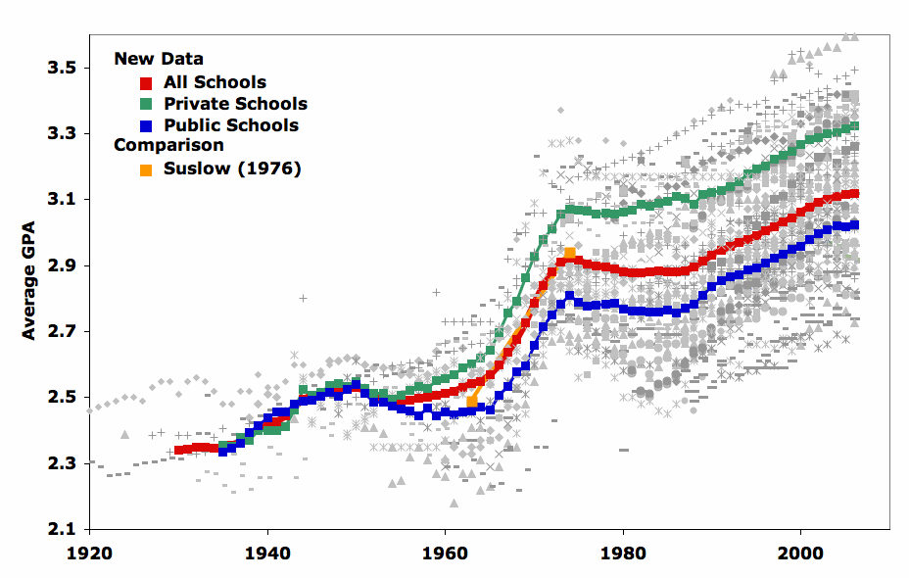
Grade Inflation

Slide 15
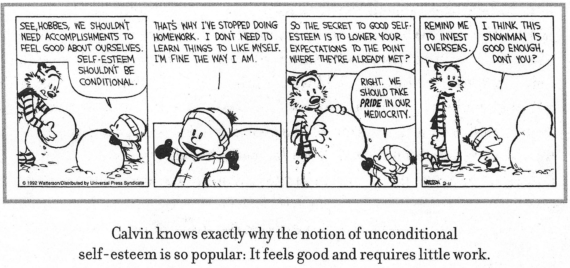

Slide 16
In a university study a whopping 25 percent of students claimed to be in the top 1 percent! Similarly, when asked about ability to get along with others, none said they were below average.
There is one psychological trait that schools could help instill and that is likely to pay off much better than self-esteem. That trait is self-control (including self-discipline).
Self-efficacy is also an important concern. Self-efficacy is an earned self-esteem through the development of competencies.

Slide 17
So, if self-esteem is not that important for academic (and life) success, what is?
As mentioned previously this semester, self-discipline correlates with better academic and life success.

Slide 18
In addition, a strong sense of group identification helps individuals maintain a sense of well-being.
How does this relate to the “individualism” that researchers say characterizes modern American culture?

Slide 19
If the dominant group in a society holds the traits or characteristics of an ethnic group in low esteem, then ethnic group members are potentially faced with a negative social identity and low self-regard, even self-hatred (Bank’s Stage 1 Ethnic Psychological Captivity), they may try to “pass” as a member of the dominant group, in other words try to assimilate into the dominant culture, but skin color, speech patterns, etc. can greatly hamper this attempt.

Slide 20
Culture-, Place-, and Community-Based Education
Success in school and in life is related to people’s identity, how as a group and individually people are viewed by others and how they see themselves. Identity is not just a positive self-concept. It is learning your place in the world with both humility and strength. It is, in the words of Vine Deloria (Standing Rock Sioux), “accepting the responsibility to be a contributing member of a society.” It is children as they grow up finding a “home in the landscapes and ecologies they inhabit.”

Slide 21
We Are All Related
Amy Bergstrom, Linda Cleary and Thomas Peacock in their 2003 study of Indian youth titled The Seventh Generation found that “Identity development from an Indigenous perspective has less to do with striving for individualism and more to do with establishing connections and understanding ourselves in relation to all the things around us.”

Slide 22
The Curse of Fry Bread
or
Powdered Eggs and Spam
Students who are not embedded in their traditional values are only too likely in modern America to pick up a culture of consumerism, consumption, competition, comparison, and conformity.

Slide 23
Kyril Calsoyas for his 1992 doctoral dissertation The Soul of Education: A Navajo Perspective interviewed Navajo Elder & Medicine Man Thomas Walker who stated:
“For over one hundred years the white man has defined what education will be for the Navajo people…. I was brought up with the old philosophy and what I see now with the White Men’s way in today’s world there is a wide difference and the intent of education does not relate any more. Because of this, in this present time, the children that are taught whatever is real, the old philosophy does not touch. The old language does not touch on these things. The children are given too much power.

Slide 24
“Whenever you try to correct a child from wrongdoings it becomes difficult to discipline them because of the laws that have been developed to protect children from abuse. When one is trying to discipline a child they say that they are being called names and are being abused. When you try to tell them something and you touch them, the report they were hit. Because of this law that protects them many are wandering and doing whatever they feel like. Because of this others act as if they are the authorities on everything. Because of this, the school administrators are getting in trouble to the point that they lose their jobs. I do not agree with this.”

Slide 25
Diné [Navajo] Medicine woman Eva Price stated “there were a lot of teachings back then [in the old days]. There were no bitter words. There were whips and plenty of discipline. Elders didn’t have to demand things twice and they were for your own good. Grandparents have a responsibility to their grandchildren. The relationship is nothing but compassion…. Discipline is always there, is never absent. That is the way I was taught.

Slide 26
Healing
“The Elders tell us that it is alright to feel angry about stuff like this [e.g., the Sand Creek massacre] and it is good.
However, in the end you must go down to the river, offer a gift of tobacco to the Creator and simply let the anger go ....
Otherwise the anger will poison your spirit…”

Slide 27
Alfie Kohn in his1993 book Punished by Rewards looked at the research on student motivation and concluded that external or extrinsic rewards, including praise, grades and tokens (like smelly stickers and candy for younger students or even money for good grades for older students), can have negative effects on students' academic performance. He concludes:
don't praise people, only what people do
make praise as specific as possible
avoid phony praise
avoid praise that sets up competition

Slide 28
Instead of external rewards [including praise] to motivate students, Kohn recommends educators should give students interesting material to learn, a learning community environment, and choice. When students find what they are studying is interesting and enjoyable they are being intrinsically rewarded for their learning.

Slide 29
Exemplary teachers evaluated student work based more on effort and improvement than simply on achievement status. This focus meant that all students had a chance at earning good grades, regardless of their achievement levels. This creates an instructional environment quite different from one where grades are awarded based primarily on achievement status. In those cases, the high-achieving students do not typically have to work very hard to earn good grades. Lower-achieving students often have no real chance to earn a good grade regardless of their effort or improvement.

Slide 30
Achievement-based grading – where the best performances get the best grades – operates to foster classrooms where no one works very hard. The higher-achieving students don't have to put forth much effort to rank well and the lower-achieving students soon realize that even working hard doesn't produce performances that compare well to those of higher-achieving students. Hard work gets you a C, if you are a lucky low-achiever, in an achievement-based grading scheme.
-Richard L. Allington

Slide 31
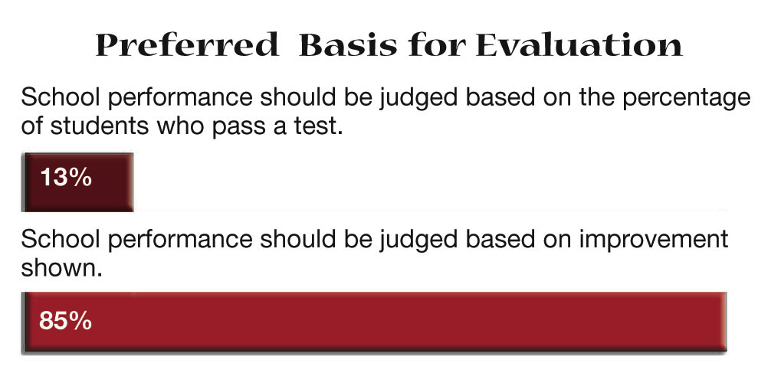

Judging School Performance
2005 PDK/Gallup Poll
Americans believe that school performance should be judged by the improvements students show and not by the percentage of students passing the state-selected test.
Notes:
Finding: The public strongly believes that school performance should be judged by the improvement students show and not by the percentage of students passing the state-selected test. This belief may well explain the public’s concern with NCLB.
Implications:
Those at the federal and state levels might consider shifting to a growth model of achievement that measures gains students make.
Those at the local level can help themselves by fostering an understanding of the need for a growth model and by adding their support to the efforts to create one.

Slide 32
Foundations of Resilience
Iris Heavy Runner
Sense of Purpose
  Spiritual Connectedness
  Optimism
  Goals
Autonomy
  Sense of Identity
  Self-Awareness
  Adaptive Distancing
  Task Mastery
Social Competence
  Cultural Flexibility
  Sense of Humor
  Caring
Problem-Solving
  Planning
  Critical Thinking
  Help Seeking

Slide 33
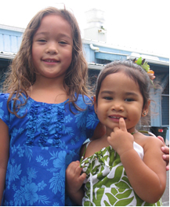
Cultural Guiding Threads
Ka Moÿopuna I Ke Alo
College of Hawaiian Language, UHHilo
Building a legacy for the children of today, and the generations of tomorrow
HONUA (Sense of Place): Developing a strong sense of place, and appreciation of the environment
and the world at large, and the delicate balance to maintain it for generations to come.
HÖÿIKE (Sense of Discovery): Measuring success and outcomes of our learning through multiple
pathways and formats.
KUANA'IKE (Perspective/Cultural lens): Increasing global understanding by broadening the
views and vantage points from which to see and operate in the world. (Developing the cultural lens
from which to view and operate in the world)
MAULI (Cultural Identity): Strengthening and sustaining Native Hawaiian cultural identity by
incorporating practices that support the learning, understanding, behaviorsw/actions, and spiritual
connections through the use of the Hawaiian language,
culture, history, heritage, traditions and values.
NA'AUAO (Wisdom): Instilling and fostering a lifelong desire to seek knowledge and wisdom, and
strengthening the thirst for inquiry and knowing.
PIKO (Sense of Connection): Enriching our bonds with the people, places and things that
influence our lives through experiences that ground us to our spirituality and connect us to our
genealogy, culture, and history through time and place.
PIKOÿU (Sense of Self): Promoting personal growth and development, and a love of self, which is
internalized and develops into a sense of purpose/role. (Growing aloha and internalizing kuleana to
give back)

Slide 34
Indigenous language and culture programs promote traditional tribal values, including respect for elders and others. Improving student behavior has been shown to promote student success (Jackson, 2019).

Slide 36
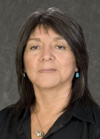
Sheilah Nicholas (2011) notes that her Hopi Elders link Hopi language loss to “un-Hopi” behavior by youth that includes “substance abuse, gang membership, and domestic violence” and how the “fundamental principles of the Hopi way of life are those of reciprocity and humility,” which need to be transmitted to each successive generation to live a good life.”

Slide 37
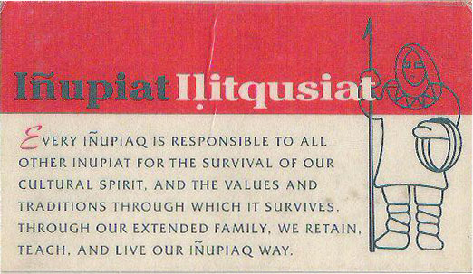
I picked up this card at the 22nd BMEEC in Alaska in1996 and still carry it in my wallet.

Slide 38
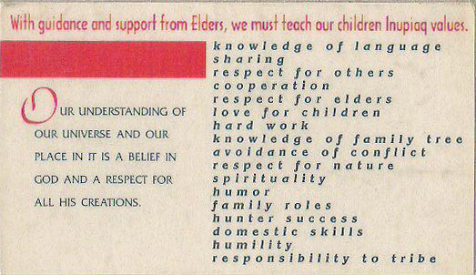
Similar lists of values can be found for Indigenous peoples around the world.

Slide 39

Are their aspects of Indigenous cultures in general and Navajo culture in particular that can lead to a longer, more fulfilling life? That is something to think about during the National Native American Heritage Month

Slide 40
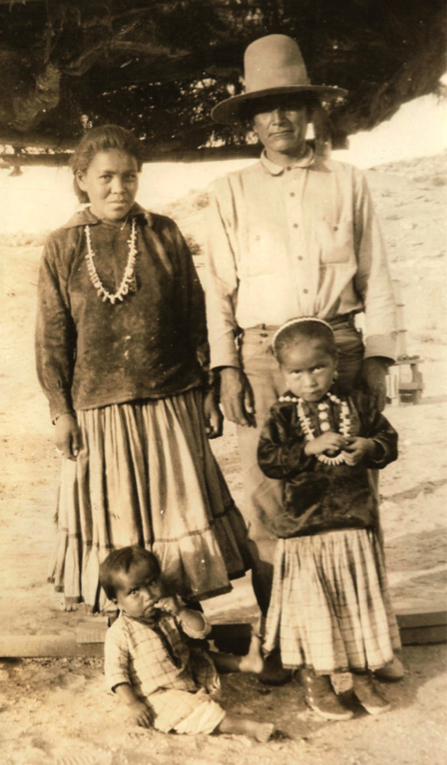
Viewing photographs from her childhood Dr. Parsons Yazzie found no obese Navajos because Navajos used to eat a better diet and exercise more.
A nurse from the 1950s remembered a dentist saying he could tell how far Navajo children lived from a trading post by looking at their teeth. Those near the trading post had many cavities because of the soda and candy they ate.

Slide 41
In 2004, the Bureau of Indian Affair’s Office of Indian Education Programs (OIEP) held its third Language and Culture Preservation Conference in Albuquerque, New Mexico. OIEP director Ed Parisian welcomed the large gathering of Bureau educators to this meeting, emphasizing the BIA’s goal that “students will demonstrate knowledge of language and culture to improve academic achievement.” He went on to say that “we know from research and experience that individuals who are strongly rooted in their past—who know where they come from—are often best equipped to face the future.”

Slide 42
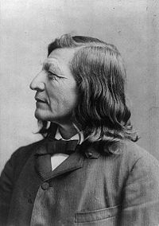
Sioux teacher and author Luther
Standing Bear (1933) recalled being the first student through the doors of
Carlisle Indian Industrial School in
1879 and taught in an American
Indian day school; he concluded in his autobiography that young Indians needed to be “doubly educated” so that they learned “to appreciate both their traditional life and modern life.”

Slide 43
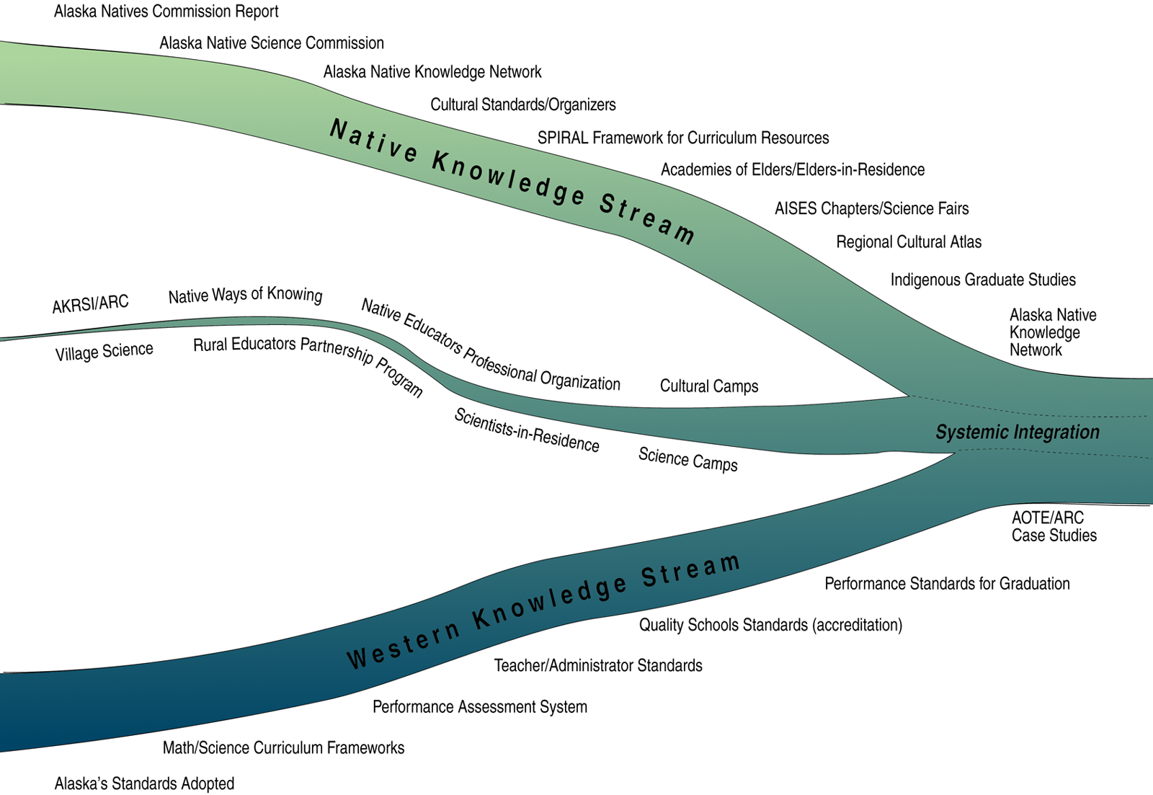

Slide 44
What are we doing today to make NAU, Flagstaff, the United States, and the world a better place for all of us to live?

Slide 45
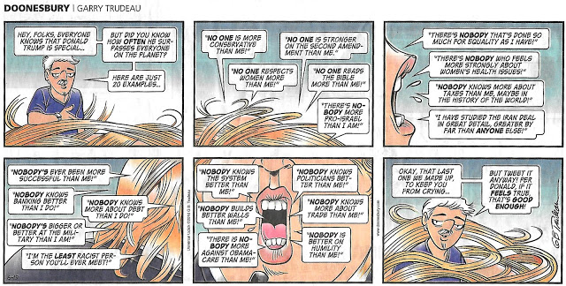
EGOCENTRISM
&
HYPERBOLE

Slide 46
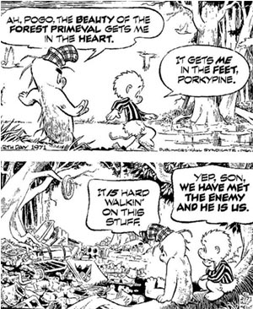
Walt Kelley’s
Pogo Cartoon
2nd Earth Day
April 22, 1971.
Are we our own worse enemy?

Slide 47
I hope I have done something this semester to make you more career ready, citizenship ready, and life ready.

Slide 48
References
Allington, Richard D. 2002, June. What I've Learned About Effective Reading
Instruction From a Decade of Studying Exemplary Elementary Classroom
Teachers. Phi Delta Kappan, 740-747.
Banks, James. 1992. The Stages of Ethnic Identity. In P.A. Richard-Amato & M. A.
Snow (eds.), The Multicultural Classroom. Reading, MA: Addison Wesley
Baumeister, R.F., Campbell, J.D., Krueger, J.I., & Vohs, K.D. 2003. Does High
Self-Esteem Cause Better Performance, Interpersonal Success, Happiness, or Healthier Lifestyles. Psychological Science in the Public
Interest 4:1-44.
Baumeister, R.F., Smart, L., & Boden, J.M. 1996. Relation of Threatened Egotism to
Violence and Aggression: The Dark Side of High Self-Esteem. Psychological
Review 103:3-33.
Calsoyas, Kyril. 1992. The Soul of Education: A Navajo Perspective. Unpublished
doctoral dissertation, Northern Arizona University, Flagstaff, AZ.
Cleary, Linda Miller, & Peacock, Thomas D. (998. Collected Wisdom: American
Indian Education. Boston, MA: Allyn & Bacon.
Deloria, Jr., V., & Wildcat, D.R. 2001. Power and Place: Indian Education in
America. Golden, CO: Fulcrum Resources.

Slide 49
Deyhle, Donna. 1992. Constructing Failure and Maintaining Cultural Identity:
Navajo and Ute School Leavers. Journal of American Indian
Education 31(2):24-47.
Gilliland, Hap. 1999. Teaching the Native American (4th Ed.). Dubuque, IO:
Kendall/Hunt.
House, D. 2002. Language Shift among the Navajos. Tucson: University of Arizona.
Jackson, C. Kirabo. (2019). The full measure of a teacher: Using value-added to assess effects on student behavior. Education Next, 19(1). Retrieved from https://www.educationnext.org/full-measure-of-a-teacher-using-value-added-assess-effects-student-behavior/
Kohn, Alfie. 1993. Punished by Rewards. New York: Houghton Mifflin.
Lipka, Jerry, Mohatt, Gerald, & the Ciulistet Group. 1998. Transforming the Culture
of Schools: Yup'ik Eskimo Examples. Mahwah, NJ: Lawrence Erlbaum.
Parsons Yazzie, Evangeline. 1995. A Study of Reasons for Navajo language
Attrition as Perceived by Navajo Speaking Parents. Unpublished
doctoral dissertation, Northern Arizona University, Flagstaff, AZ.
Reyhner, Jon. 2006. Education and Language Restoration. Contemporary
Native American Issues Series. Philadelphia, PA: Chelsea House.
Reyhner, Jon, & Eder, Jeanne. 2004. American Indian Education: A History.
Norman, OK: University of Oklahoma Press.
Reyhner, Jon. (ed.). 1992. Teaching American Indian Students. Norman, OK:
University of Oklahoma Press.

Slide 50
Whitbeck, L.B., Hoyt, D.R., Stubben, D.R., LaFromboise, T. 2001. Traditional
Culture and Academic Success Among American Indian Children in the
upper Midwest. Journal of American Indian Education 40(2):48-60.

Slide 60
Jocks & Burnouts Subcultures
Penelope Eckert
Jocks: Middle Class, see school as access to things important in life.
Burnouts: Working Class, see schools as repressive and not meeting their needs.

Slide 61
Social Class & School Knowledge
Jean Anyon
Working-Class Schools
Middle-Class Schools
Affluent-Professional Schools
Executive-Elite Schools

Slide 62
Scholarship Ladder: Taking the talented poor and co-opting them into the upper class so they don’t become revolutionaries and try to organize the lower class.
Is there a level playing field today offering equal opportunity for all?
Tracking Within and Between Schools
Equity vs. Equality

