Slide 1
Cricket, Colonialism, and Nationalism
Sanjay Joshi, Professor of History, NAU
April 14, 2021
… over Zoom, of course!

Slide 2
Acknowledgements and Caveats
If you want someone to blame for this event, blame the Jacks Cricket Club!
As they started playing again, I happened to share with Raghavendra Singh (Ragh) of CIE, some information about a course I was teaching with this title. From that conversation came the request for this talk
Thanks Ragh, for pushing me to do this, and to Dylan for getting the logistics together for the talk
Shameless plug time! If any of you are interested, the course will be offered again in spring 2022
This is a course I have been wanting to teach for ever, and I draw most of today’s presentation for material I was fortunate to share with my students!
My own research into cricket has been somewhat different so far, e.g., an essay on the history of one of the earliest websites on cricket!
Teaching this course, though, has opened my eyes to many possibilities!

Slide 3
The Context
Most folks in America tend to think of cricket as a quaint, old fashioned game associated with the English upper classes
A quaintness emphasized perhaps by the fact the players take a break for TEA !
George B. Kirsch says, “Today, when many Americans see the word “cricket,” they think of an insect. Or, more tellingly, as Simon Worrall stated in the Smithsonian in 2006, they “dismiss cricket as an elitist game played by girlie-men.”
But cricket, actually, has the second largest popular viewership of all sports in the world, next only to soccer

Slide 4
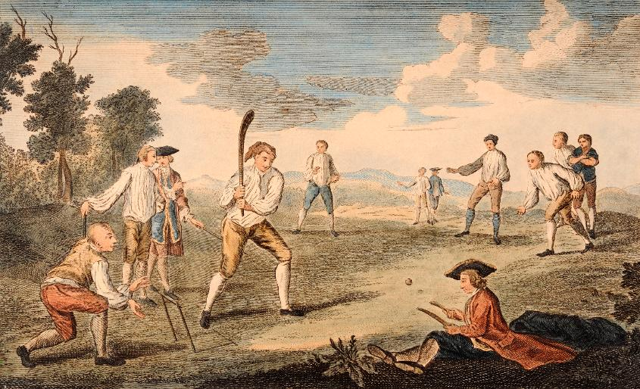
The Question
An estimated one billion people -- mostly from the Indian subcontinent -- watched one of games during the Cricket World Cup of 2015
How did a bat and ball game started in the villages of medieval England get this global reach?
Answer: Colonialism and Nationalism

Slide 5
… or to quote the master!
“What do they know of cricket who only cricket know?”
C.L.R. James, Beyond a Boundary
Born in Trinidad in the Caribbean, James’ is one of the pioneering works locating cricket in a larger social and cultural history

Slide 6
Cricket, Empire and Nation
Cricket’s spread was a direct product of the British Empire, and much of its popularity was the product of nationalism
Arguably, its decline in some parts of the world like the United States was also a product of nationalism
=> A team from Boston, MA ca. 1850s

Slide 7
Mapping Cricket and Empire
British Empire ca. 1900
Major and Minor Cricket Playing Countries Today

Slide 8
It’s Not Cricket!
Other than breaking for tea, there is also a mystique, a myth, about the sport as a “Gentleman’s game”
This has much to do with cricket’s honor code, an unwritten (but oft-repeated) maxim “it’s not whether you win or lose, but how you play the game”
Cricket, we are told, has to be played “with a straight bat” where a “gentleman” never disputes an umpire’s decision, respects an opponent, and always plays within the (unwritten, and therefore nebulous) “spirit of the game”
This has little to do with either the real history, or most of the real way in which the game actually has been played, but has become a shibboleth of the sport
Cricket’s origins in the 18th century saw widespread gambling and fixing of cricket matches; that was a reason why uniform rules had to be created for the sport
The myth around cricket was created in the 19th C, when cricket was made a central part of the British “public [fee-paying] schools” that prepared a cadre of young men for “service to Crown and Empire”

Slide 9
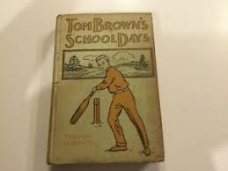
Cricket and the British Empire
Cricket performed different roles for the empire over time
It trained generations of young British boys in becoming “… worthy imperialists, destined to lead the world in an age of empire and expansion.”
Cricket was meant to toughen them up for the jobs demanded by empire, cultivating respect for rules, a subordination of the self in service of the team, and gave them that undefinable thing, “character”
Initially cricket distinguished the colonizers from the colonized, emphasizing the superiority of white, colonial masculinities
It was then meant to discipline the colonized into a new ethos where they acknowledged the physical and moral superiority of colonizers, yet, “permitting chosen inhabitants of empire to develop and maintain emotional ties within an ordered, secure environment”
As CLR James, a critic of Imperialism but enthusiastic cricketer, said, cricket was a major bulwark against social and political change in the Caribbean

Slide 10
Specificities of Empire
Cricket could not be the same across the empire, because the nature of colonialism itself was different
In SETTLER colonies (e.g. North America or Australia) where native populations decimated, cricket remained the preserve of the white settler elite
Its history was different in other settler colonies,
e.g. South Africa where there was a both a conflict between settler populations (English and Boer) and a significant surviving indigenous African population
Or in the Caribbean, where slavery meant the introduction of a new population
It was again quite different in places like the Indian subcontinent (termed “exploitation colonies,” as though settler colonies were not exploited!) where a very small group of colonizers ruled over millions of natives
In all cases though, the relationship between cricket and empire was foundational

Slide 11
Cricket in Settler Colonies: Nascent Nationalism
The nature of colonization did end up shaping the history of cricket in different locations, in ways that are all connected with something we can call “nationalism”
By and large, settler colonies saw the game limited to elites. But, as the settlers themselves drew away from the imperial metropole, cricket became a way to define their own difference, aka nationalism
Some scholars argue that post-Civil War nationalist sentiments were an important part of the decline of cricket in the USA, with the promotion of baseball as a more American bat and ball game
In South Africa, although both European settlers (Dutch and English) initially played the game, but conflicts (Boer War!) and English ascendance limited Boer participation for a while

Slide 12
Cricket and Australian-ness
In Australia, cricket evolved to define white Australian masculinity, which, in the late 19th C, emerged most evidently in cricket competition with England
This, despite the fact that the first Australian sports tour ever was by an Aboriginal cricket team in 1860 to England
The contest for “ the Ashes” (from a satirical 1882 newspaper report after Australia first defeated England in a test match in England), remains a high point in the cricket calendar of both countries even today
Bodyline: A 1932-33 tour of Australia by England, where England used intimidatory tactics to restrict Australian batsmen, led to accusations of unsportsmanlike conduct by the hosts. This escalated conflicts to a point where the two countries considered breaking off diplomatic relations!

Slide 13
Cricket, Empire, and Whiteness
Imperial heritage therefore ensured that cricket had a long history associating the game with whiteness
Although non-white populations did play the game in settler colonies, it was a game associated primarily with the privileged white settlers – in Australia, New Zealand, South Africa, Rhodesia and other settler colonies
Colored populations did take up the game, think of the Aboriginal tour of 1860, but often suffered racist slights about their abilities
Cricket in the imperial mind was associated with the nebulous term “character” and the belief that black and brown men, and all women, were lacking in that
Institutionally, of course, cricket was run by upper class, white, men
Rules for all games set by the Marylebone Cricket Club of London since 1774
In 1909 England, Australia and South Africa set up the Imperial Cricket Conference to regulate international cricket
In 1969 this became the International Cricket Council (ICC) that regulates all international cricket today

Slide 14
Racist Legacies
Racist Imperial legacies continued to mar the landscape of cricket
Only a white man allowed to captain the West Indies as late as the 1960s, when a region-wide agitation led to Frank Worrell being appointed captain
Apartheid twisted all levels of social and cultural practices in South Africa, and only after 1994 have black, white, and colored players been allowed to play together
Association with whiteness has allowed racist cultures to breed in cricket, teams from India and the West Indies are often racially abused by crowds in England and Australia, and earlier, by players as well
There remains institutionalized racism in English cricket, creating sometimes insurmountable racist barriers
The BLM movement has resonated with cricketers but also opened up old racial divides

Slide 15
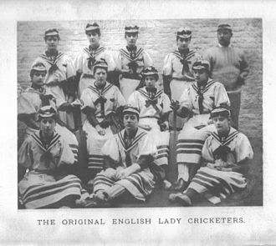
Women, Cricket and cultures of Masculinity
Women have been playing cricket almost as long as men, but you would not know that from most accounts of the game!
The imperial masculinity I have discussed has also written women out of the history of the sport tellingly referred to as “the gentlemen’s game”
Misogyny ruled the corridors of power and women players dismissed as “neither cricketers nor ladies”
But the first county (regional) women’s match in England was played in 1811 with large crowds, and women, across the empire, participated in cricket with little acknowledgement of it in the “gentleman’s game”
The intersection of imperialism and its adjunct racism though, has continued to shape the women’s game too, as Ebony Rainford-Brent, the first black woman to play for England, recently pointed out
A 1779 women’s match

Slide 16
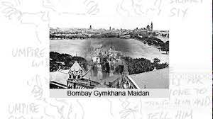
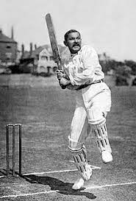
Cricket and Colonialism in the Indian Subcontinent
Spend a little more time on this because nationalism drove the rise of cricket in the subcontinent, and has made it the new epicenter of world cricket today
Parsis, who migrated to India from Persia in the 7th C, were the first Indians to take up cricket in the 1830s
They were followed by other groups, and what started as emulation of the British rulers turned to a forum for competition, among themselves and with the rulers!
The best known Indian cricketer of the 19th C though, played for England. K.S. Ranjitsinhji parleyed his cricket skills to be instated as the ruler of the princely state of Nawanagar even though the succession was a disputed one

Slide 17
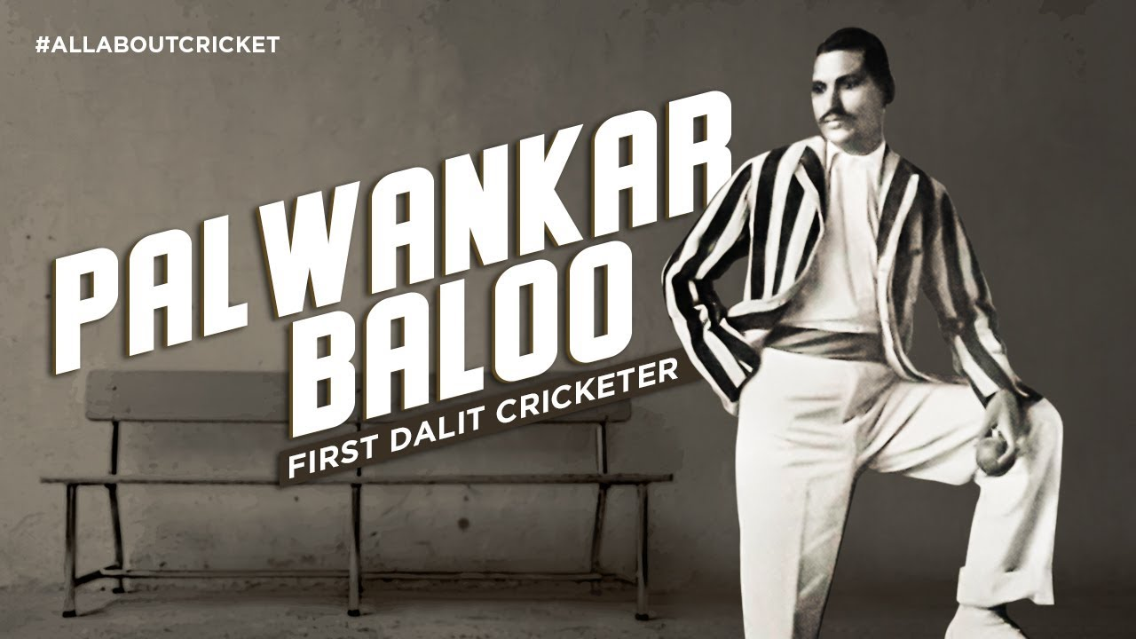
Cricket and Nationalism in India
Thanks in part to the British, Indian cricket in the early 20th C was organized along religious and ethnic lines
The Quadrangular Tournament between Europeans, Parsis, Hindus and Muslims drew huge crowds
Beating the Europeans (British) created particular joy for the others!
While sponsored by Indian princes as well as businessmen, cricket also allowed for otherwise marginal figures such as the Dalit (“untouchable”) cricketer Palwankar Baloo to emerge as an Indian heroes
Baloo and his two brothers represented an “all-India” team that toured England in 1911
Given cricket’s popularity, became a national passion, particularly after mass media, first radio, then satellite TV, and now internet and smart phones bring cricket to 1.4 billion people!

Slide 18
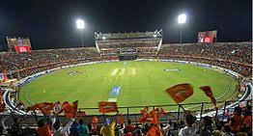
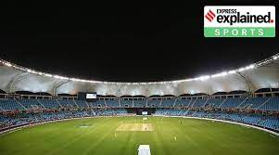
India as Hub of Global Cricket
The huge market that cricket can allow advertisers to reach is what made India crucial to global cricket, the money from an Indian tour can make or break the finances of almost any other cricket board in the world
The Indian Premier League (IPL), a successful club-based cricket tournament, has made the Indian Cricket Board by far the richest in the world
Even before the IPL the huge popularity of cricket and the large reach of advertising through cricket had already made India one of the biggest players in the financial world of cricket
Using their financial muscle and garnering support from smaller cricketing countries (Bangladesh, Sri Lanka, Zimbabwe) the Indian board secured rights to host the Cricket World Cup in 1987. England hosted all of them before 1987!
Today, India is clearly the hub of global cricket, and its influence in dictating terms to former Imperial Cricket Conference members has provoked its share of resentment

Slide 19
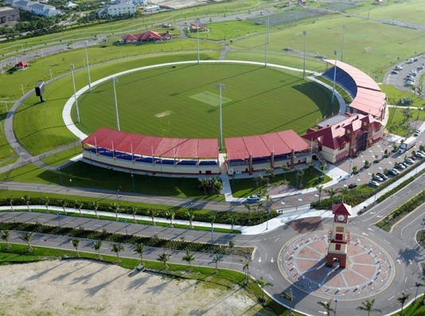
Cricket in the US: Rise, decline and… revival?
From the global, lets move back more to the local
Cricket used to be big in N. America until the mid to late 19th C
In fact, the first ever international cricket game was played between the USA and Canada in 1844 at the St George's Cricket Club in New York
Scholars dispute the reasons for its decline, variously citing the elitism of the cricket establishment, the rise of nationalism, cricket’s inflexibility, complexity, and requiring of long hours of play as opposed to greater adaptability of the (supposedly) indigenous bat and ball game, baseball
Our millennium though, has seen a revival of sorts!
In 2008, Sports Illustrated reported that cricket was the second fastest growing sport in the US, only possibly behind lacrosse. In 2010, there were reportedly 15 million fans, 30,000 registered players, 950 clubs, and 48 cricket leagues in the US
Undoubtedly the Cricket Jacks who brought me here today are part of this trend, as perhaps are many who are still here at the end of this long talk!!
USACA cricket stadium, Lauderdale FL
MLC stadium, Grand Prairie

