Slide 1
INDIA: Diversity and Unity
UNITY IN DIVERSITY?

Slide 2
SOURCES of Diversity
MANY!
GEOGRAPHY
SOCIETY
LANGUAGE
CASTE
GENDER
RELIGION
ECONOMIC REALITIES
POLITICS and IDEOLOGIES

Slide 3
Terms
INDIA
SOUTH ASIA (not SOUTH EAST Asia)
INDIAN SUBCONTINENT
ALL REFER TO THE SAME ENTITY and will be used interchangeably for much of this course

Slide 4
TIME: Geologic and Historical
Much history is about time. We measure HISTORY mostly in terms of human settlements in a region. But geologically, a few thousand years make little difference
First, Pangea, single mass
About 180 million years ago GONDWANALAND (S.America/Anatarctica/Africa and India part of same landmass)
About 54 million years ago, the Indian landmass, bumped into the Asian plate
Himalayan mountains result of the "bump", slow, rate of growth estimated at 2cm per century
Current Geography shaped by that “bump” pretty stable for the last 50 million years
First HUMANS, 400 - 700,000 years ago

Slide 5
Basic Geography
Where
How large?
Compare

Slide 6
Geography
Features
Mountains
Seas
Desert(s)
Forest
Geographical Basis of
UNITY: Mountains, Seas, Deserts give a certain “unity” to subcontinent
and
DIVERSITY: 22 different languages, 13 different scripts ; Most major world religions, differences in culture, diet, clothing, etc.
UNITY IN DIVERSITY was slogan of Indian nationalists, and a focus of this course!

Slide 7
Regions
Main regions (will ignore the “sub-regions” for now)
Himalayan
Indo-Gangetic plain
Peninsular India (Intermediary Zone for Kulke and Rothermund)
Coastal India

Slide 8
Geography and History
Geography has determined patterns of human settlement
compare map of current population density with maps of physical geography
Shows why some regions have been central to history of region
Indo-Gangetic plain
Some coastal concentrations
Connect with Monsoonal flows
Indo-Gangetic plains = rivers => well irrigated, fertile soil
West desert, low
North mountains, low
These regions not as much “movers and shakers” of the history we will study
Topography often responsible for patterns of history

Slide 9
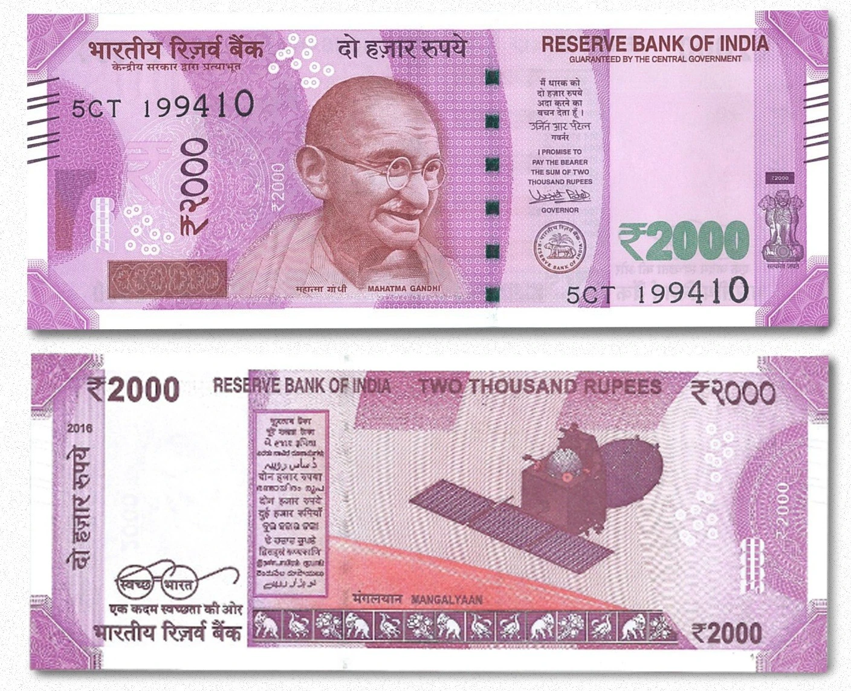
LANGUAGE
22 different Languages and 1000s of dialects are recognized by the Indian constitution as official languages
HINDI (note the I) largest, around 60% speak
Written in at least 11 different scripts

Slide 10
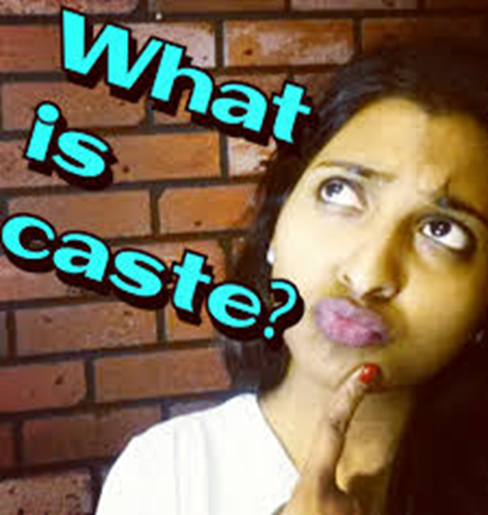
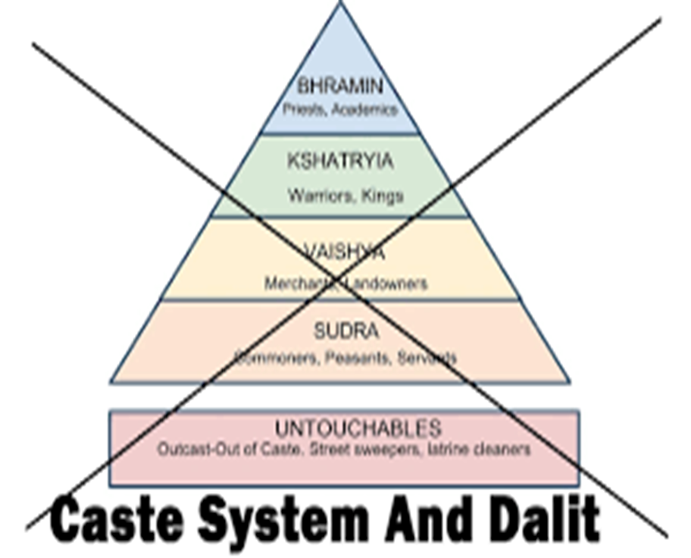
CASTE (more later)
Four VARNA
1000s of JATIs
Primarily HINDU, but caste-like formations in others

Slide 11
RELIGION
Most of the world’s major religions have significant representation in India
70-80% of the population identifies as Hindu
14-15% Muslim (world’s third largest of Muslims by country, and around 10% of the entire Muslim population)
Christianity Small percentages, but significant public presence, some connections to colonialism, but also because of influence in education
Judaism Declined after outmigration post WWII
Indic Religions such as BUDDHISM, JAINISM, SIKHISM etc., all have a significant presence

Slide 12
ECONOMIC Disparities: “Class”
Enormous economic disparities
Third largest population of billionaires (US$ calculations) BUT also 26% of the population living below an artificially low “poverty line”
Huge disparities in landholding (over 60% of the population is connected with agricultural occupations)
Over time this disparity has led to a variety of protests, some of it (e.g. the “Naxalites”) taking to revolutionary activity to create a more economically just society
But even in “mainstream” politics, poverty and inequality have been important issues since 1947

Slide 13
Sources of Unity: History
“India” as a political entity only came into being in 1947, but a long history of cultural unity preceded that although political unity was only sporadic
Pre-colonial political leadership knew how to manage diversity, without resorting to majoritarianism
Islam a part of Indian social fabric since ca. 700 CE, never any question of a separate Muslim country
Hindus held important roles in many Muslim rulers’ kingdoms and vice versa
Basically, religion was not the basis for a POLITICAL identity in pre-colonial India
British colonialism solely responsible for the creation of religion as political identity which led to Partition in 1947 (more on that, soon, unfortunately!)

Slide 14
Sources of Unity: Democracy
About post-independence India Guha says, “At no other time or place in human history have social conflicts been so richly diverse, so vigorously articulated, so eloquently manifested in art and literature, or addressed with such directness by the political system and the media.” (10)
The forces that divide India are many, but equally so are those that keep in together
In this book Guha argues that despite its diversity, huge differences across regions, religions, castes, classes and sexes, it is ULTIMATELY the successful working of a major democratic experiment that has kept India together.
Along with the American and French revolutions, “one of three great experiments of world history”
But “democracy” means more than simply voting in elections, it also depends on the political imagination of India itself

Slide 15
Politics: Ideologies and Imagining of India
As important as the fact that *all* Indian people were given a vote at the start of the republic was the ideological orientation of early nationalist leaders such as Gandhi and Nehru
The two had their differences, but on one issue they were as one: that regardless of what other parties or individuals believed, their idea of India was one where Indian-ness – legal citizenship or cultural belonging -- was not tied to a single religion, region, language or caste
Ironically, this was an idea shared across the new border by Mohammad Ali Jinnah, the founder of Pakistan who said in his opening speech to the new nation
You are free; you are free to go to your temples, you are free to go to your mosques or to any other place or worship in this State of Pakistan. You may belong to any religion or caste or creed -- that has nothing to do with the business of the State
Not everyone agreed with them, but a handful of extremists were enough to assassinate Mahatma Gandhi in January 1948
Indian democracy though, overwhelmingly chose Nehru and an inclusive vision of a diverse India, rather than a vision of a Hindu nationalist India when the first General Elections were held in 1952

Slide 16
Gandhi-Nehru’s vision of an inclusive India
Jawaharlal Nehru’s cabinet was inclusive, included those who “were lifelong adversaries of the Congress…. Gandhi had reminded them that ‘freedom comes to India, not to the Congress’, urging the formation of a Cabinet that included the ablest men regardless of party affiliation” (22)
But Gandhi unhappy, partition and the accompanying violence had robbed him of any joy in the celebration of independence
“At the initiative of Gandhi and Nehru, the Congress now passed a resolution on ‘the rights of minorities’…. it still believed that ‘India is a land of many religions and many races, and must remain so’… India would be ‘a democratic secular State where all citizens enjoy full rights and are equally entitled to the protection of the State, irrespective of the religion to which they belong’. The Congress wished to ‘assure the minorities in India that it will continue to protect, to the best of its ability, their citizen rights against aggression’.” (35)

Slide 17
The Hindu Nationalists Differ
The Rashtriya Swayamsevak Sangh (RSS) explicitly opposed “the idea of a secular state that would not discriminate on the basis of religion.”
The founder of the RSS, GOLWAKLAR, believed:
The non-Hindu people of Hindustan must either adopt Hindu culture and language, must learn and respect and hold in reverence the Hindu religion, must entertain no idea but of those of glorification of the Hindu race and culture . . . in a word they must cease to be foreigners, or may stay in the country, wholly subordinated to the Hindu nation, claiming nothing, deserving no privileges, far less any preferential treatment – not even citizens’ rights (35)
The RSS had support from refugees, some of whom even shouted “let him die” as they marched past a location where Gandhi was fasting for peace. Gandhi believed
“that, though geographically and politically India is divided into two, at heart we shall ever be friends and brothers helping and respecting one another and be one for the outside world”
On January 30, 1948, a Hindu nationalist shot the Mahatma to death

