Slide 1
What does India teach us about Diversity?
Sanjay Joshi, Northern Arizona University
Presentation for OLLI, Yavapai Community College, Sedona Campus
March 12, 2025
Trigger Warning: If terms like diversity make you angry, if a discussion about weird places like India upset you, you may want to skip the talk and go directly to dinner!

Slide 2
DEI: Diversity Equity and Inclusion
In our political context an attempt to turn DEI into a term of abuse.
But what is DEI, other than a belief that all people (regardless of skin color, race, sexual orientation, etc.) need to be included, to be considered as fellow humans whose opinions and identities are as important as ours?
Contemporary vilification
  Both in the US and in India
  While I won’t speak to American politics, I will briefly try to trace the history of both inclusivity and its vilification in India in this talk.
Lessons from Indian History?
  Will speak of moments when diversity was celebrated and why, and a history of its undermining too
  “Lessons”? … Perhaps too strong a word. It will really depend on what we want to take away from this

Slide 3
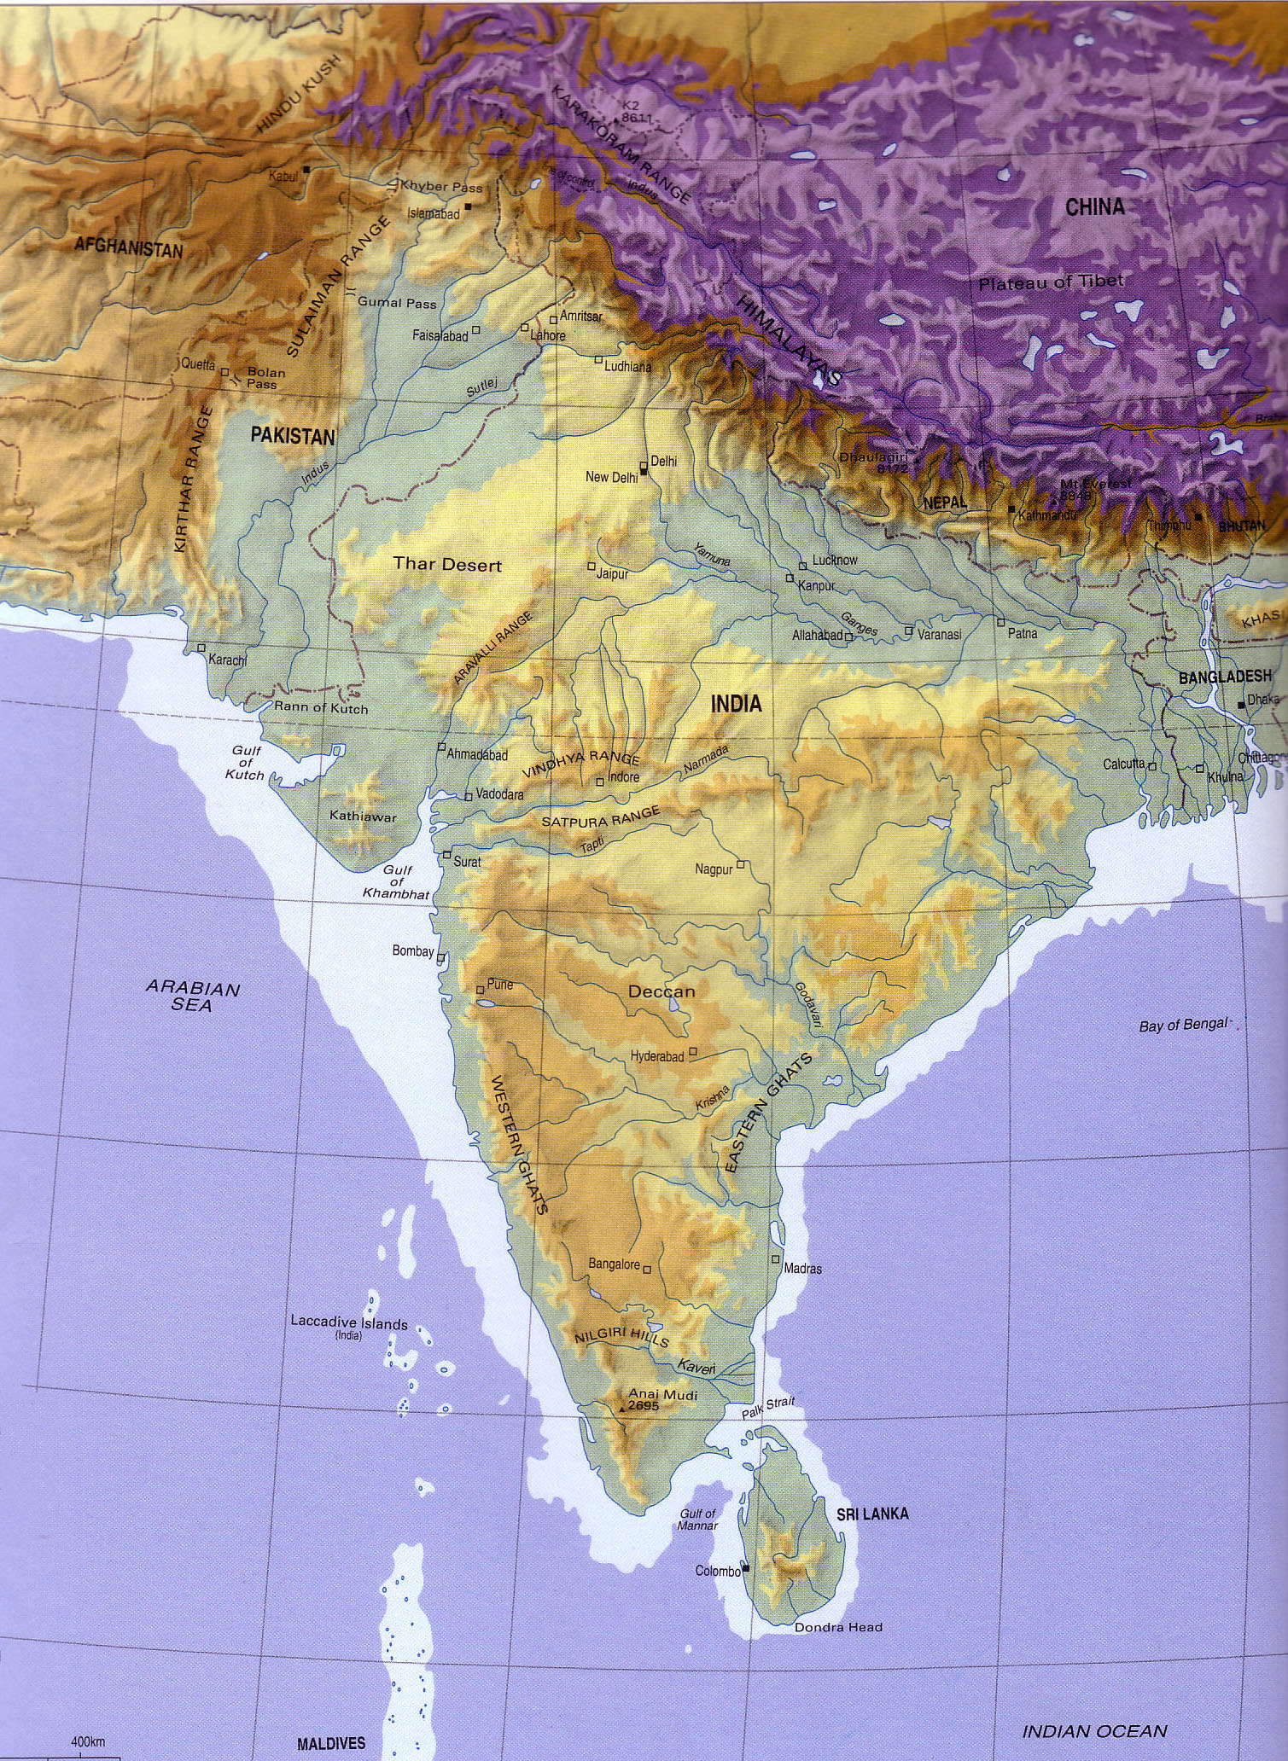
India: Basic Geography
Where
How large?
  Compare
What?
Mountains/Rivers, Seas, Desert(s)
UNITY: Mountains, Seas, Deserts give a certain “unity” to subcontinent
  And are a source of DIVERSITY
UNITY IN DIVERSITY was slogan of Indian nationalists and something I want to explore in this lecture.

Slide 4
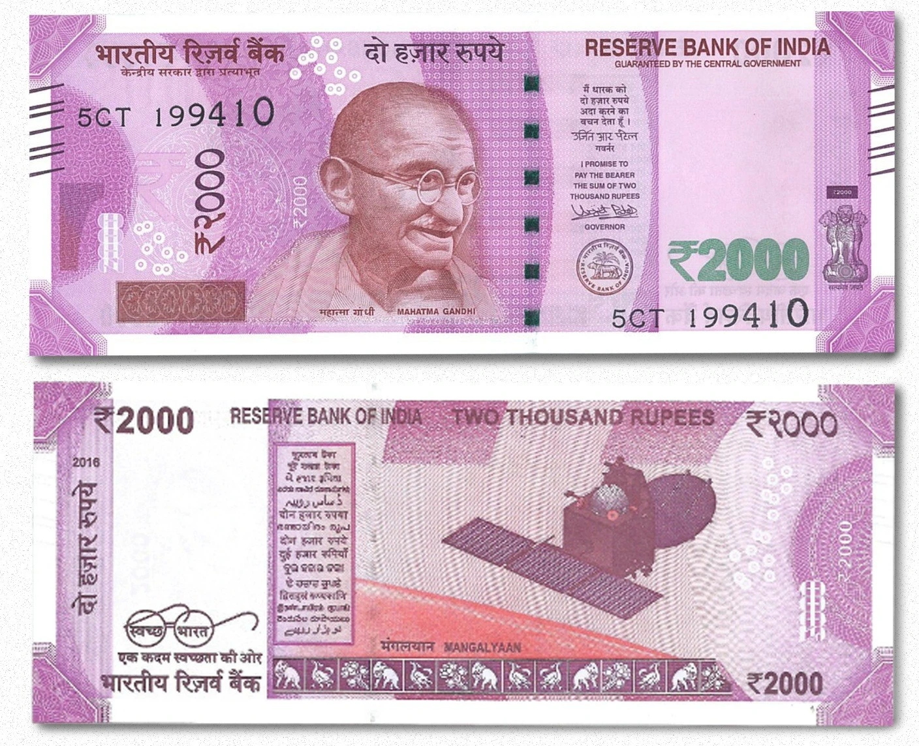
Sources of Diversity 1
LANGUAGE: Internal Geography and History created many Languages
  22 languages and 1000s of dialects are recognized by the Indian constitution as official languages
  Written in at least 11 different scripts
  HINDI (note the I) largest, around 60% speak
CASTE (too complex to elaborate upon today)
  Four VARNA
  1000s of JATIs
  Primarily HINDU, but caste-like formations in other
  religions too

Slide 5
RELIGIOUS DIVERSITY
Most of the world’s major religions have significant representation in India
70-80% of the world’s most populous country today identify as Hindu
14-15% Muslim (world’s second or third largest number of Muslims by country [only Indonesia and perhaps Bangladesh have more], and around 10% of the entire Muslim population of the world)
Christianity Small percentages, but significant public presence, some connections to colonialism, but also because of influence in education
Judaism Declined after outmigration post WWII
Indic Religions such as BUDDHISM, JAINISM, SIKHISM etc., all have a significant presence
Pre-“Hindu” so called “folk” religions

Slide 6
Other Disparities: Class and Gender
Enormous economic disparities
Third largest global population of billionaires (US$ calculations) BUT 26% of the population living below an artificially low “poverty line”
Huge disparities in landholding (over 60% of the population is connected with agricultural occupations so this matters)
All societies are patriarchal, and India is no different
Women needed to be exceptional to rise to prominent positions, and a very few did, in learning, in politics, in business
British colonialism reinforced the most retrograde elements of Indian patriarchal traditions, reducing the spaces available to women in public life

Slide 7
India: A Long History
“CLASSICAL PATTERN” ca. 1500 BCE – 1100 CE refers to:
  POLITICAL: Kingship State formation, Empires
  SOCIAL : formations, Varna / Caste
  CHALLENGES : Upanishads, Buddhism, Jainism etc
  Migrations and Absorption
KEY to this tradition was DIVERSITY and PLURALISM
Long Term Pattern of political CENTRALIZATION / DECENTRALIZATION
REGIONAL and CULTURAL DIVERSITY
  Regional Kingdoms and Languages (700-1200 BCE)
  Islam 700 CE onwards: makes a new contribution, radical egalitarianism & refusal of Caste
    Delhi Sultanates 1200-1500
    Mughals 1526-1857
1757-1947 British Rule: Gives us a SINGULAR VISION of India, undermining diversity

Slide 8
Two Selected Examples
For reasons of time, I will start with only two examples of diversity from two very different epochs of Indian history. I could point to many!
  Emperor Ashoka’s reign in the 3rd century BCE who establishes an empire exceeding boundaries of contemporary India
  Almost another 1700 years later, the period of Mughal rulers, who were Muslims, particularly emperor Akbar’s reign, 1556 to 1605.
Why? To show that pre-colonial political leadership knew the crucial importance of managing, even celebrating diversity, without resorting to majoritarianism or brute force
  Vigorous debates between different religious ideas, but no “state religion” -- no history parallel to those of the European Inquisition
  It was politic to be inclusive in a diverse place like India, majoritarianism and intolerance were simply not good politics or economics!

Slide 9
Ashoka The Great? 268-233
Grandson of founder of India’s first Imperial dynasty, the Mauryas
Fought many wars, the most important the campaign against KALINGA ca. 261, a very bloody campaign, and 100,000 killed, 150K displaced
This experience converted Ashok to non-violence and to Buddhism. He renounces violence henceforth
After the war, Ashoka began his campaign of edicts, placed across his empire, urge people to follow non-violence and good moral conduct
  His Lion Capital found on top of one of his pillars, is also the official emblem of the Indian state today, akin to the American Eagle
Sent out DHAMMA MAHAMATRAS (officers to ensure right conduct) also undertakes many humanitarian measures, like planting trees along major highways, digging public wells, and making water tanks at strategic places
Revered by Indian nationalists, as first benevolent and humanitarian ruler, who truly cared about the people

Slide 10
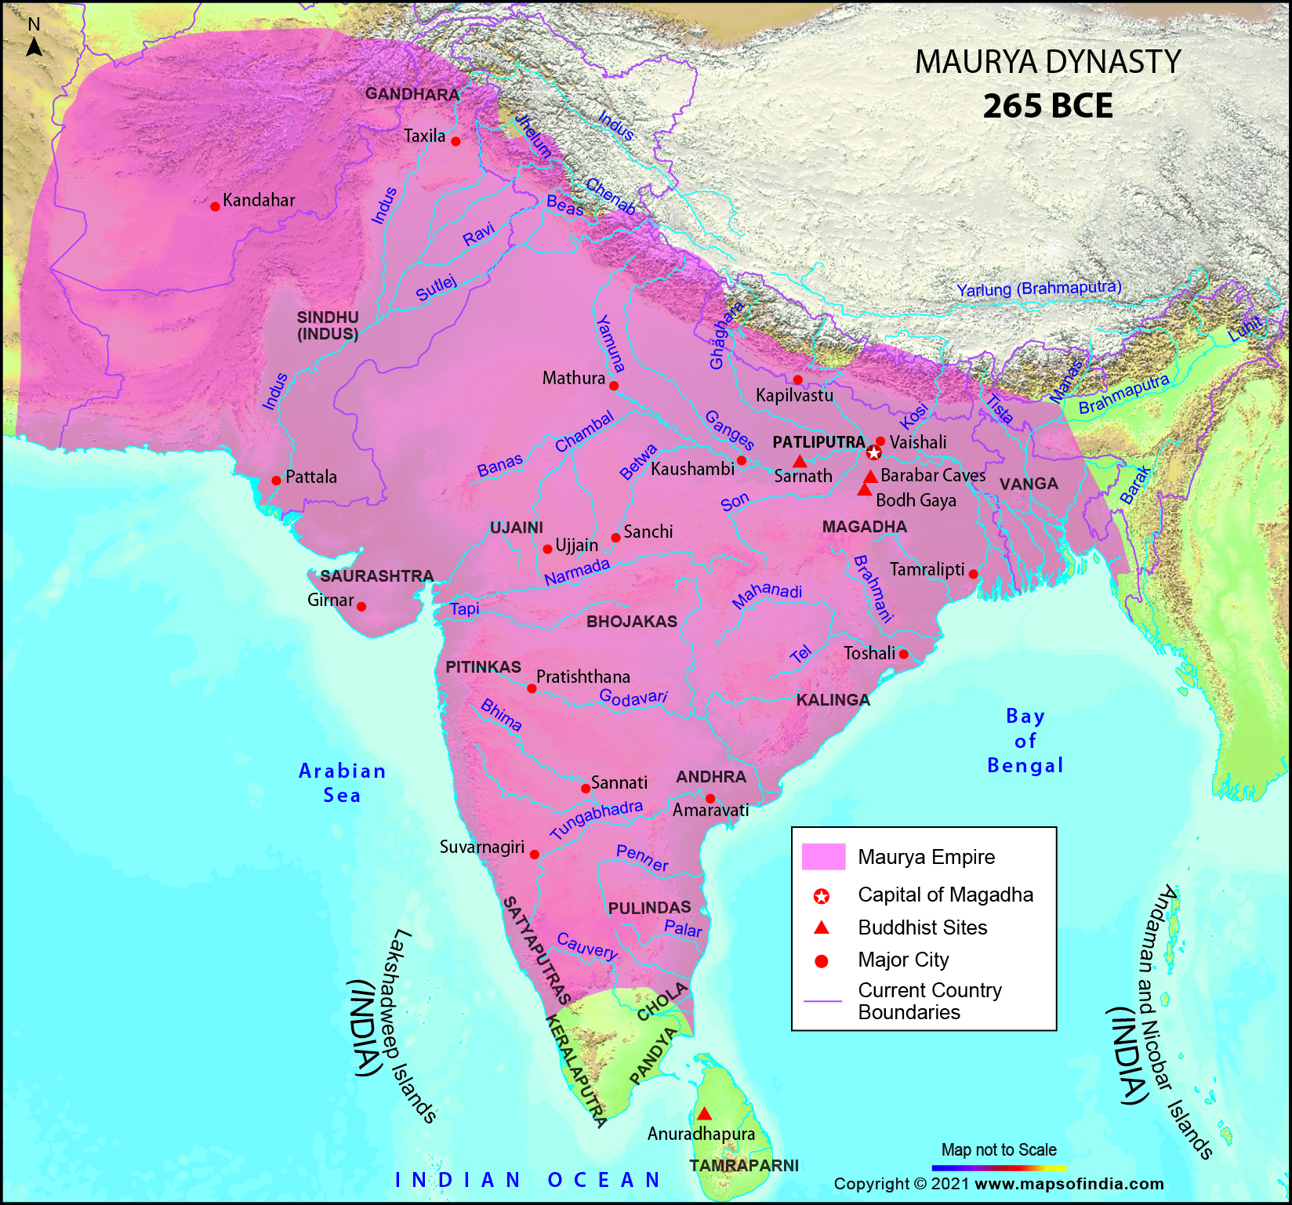
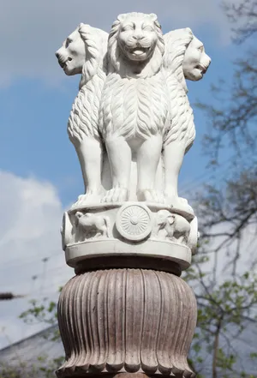
Ashoka (Mauryan Dynasty) 268 B.C.E to 232 B.C.E.
Rather than impose his will on the population he respected all religious sects and through his edicts exhorted them to respect the ideas of others
Peace and persuasion rather than force were his post-Kalinga-war tactics

Slide 11
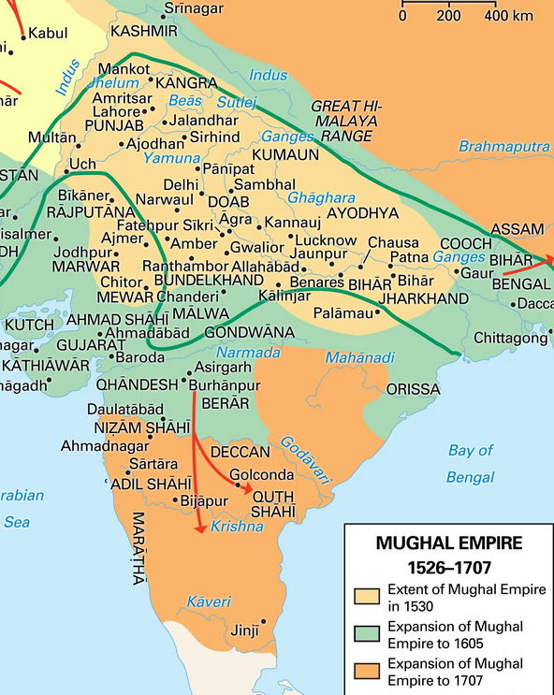
Akbar: Reigned1556 to 1605
Born a Sunni Muslim, grandson of the founder of the Mughal Dynasty
  So rich and powerful were the Mughals that Europeans who visited came to use their name to signify anyone with wealth and power: hence Hollywood “Mogul” e.g.
Significantly expanded the empire
Developed new ways of collecting taxes, that made his empire one of the riches places in the world in his time
Collected around him advisors from all different ethnicities and religion
  Tax System created by Raja Todar Mal, a Hindu Kayastha
  Closest advisor was a Brahmin, Birbal
  Commander of his army was a Rajput Hindu, Man Singh

Slide 12
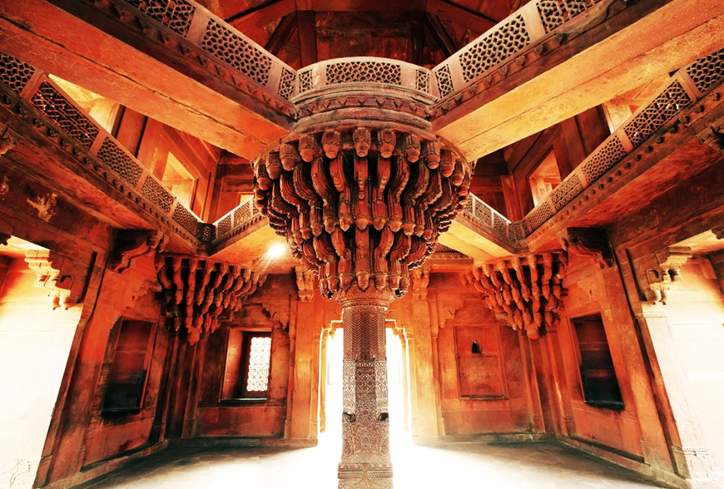
Akbar and Religious Diversity
Advocated SULH I KUL (peace with all)
Married Hindu Rajput princesses
Built the Ibadat Khana ("House of Worship") where theologians and mystics of different faiths discussed matters of spirituality with the emperor
Combined different religious doctrines into a new ethical, moral code Din-i-Ilahi (a new religion?)
Comparison: Europe torn apart by religious wars at that time (Catholic counter-reformation 1545)
IBADAT KHANA at Fatehpur Sikri

Slide 13
Was this the result of their personal “greatness”?
No!
While both may well have been “great men” their greatness does not explain why Ashoka and Akbar celebrated diversity and practiced inclusivity.
  Ashoka fought for power, possibly killing his brothers in fight for throne
    Never disbanded army despite his vows of non-violence
  Akbar fought more than his share of wars before advocating Sulh I Kul. When he captured a fortress that had held out for four months, he had 30,000 defenders massacred
Historical contexts and the innate diversity of the subcontinent are better explanations for their actions
Having conquered, there was need for consolidation. Inclusion was the best possible strategy
Akbar (and Ashoka before him) knew that trying to impose a minority perspective on a diverse population would be counter-productive

Slide 14
Change with British Colonialism
The British come to power in India taking advantage of divisions after the end of the Mughal empire (when regional identities reasserted their importance)
British strategy was to further divide and hence consolidate their rule
As previous rulers (Mughals) had been Muslims, vilification of Islam and Muslims a way of justifying their own rule
  Islam a part of Indian social fabric since ca. 700 CE, and Hindus held important roles in many Muslim rulers’ kingdoms and vice versa
But religion had never been (could not be) the basis for a POLITICAL identity in pre-colonial India
This was something that had to be created under colonialism

Slide 15
Colonialism and Sources of DisUnity
Hindu-ISM is a 19th century word brought into being during British rule (-ISM is a 19th C suffix)
  No self-identification as “Hindu” until 16th C, as late as 1921 folks identifying as “Hindu-Mohammedan [Muslim]”
British created ‘colonial forms of knowledge’ (Cohn, 1996) which objectified and categorized India in discrete ways
  Academic works, Censuses, and later politics, was all organized divided into religious categories
  These “normalize” politics based on religious identity
  Indian elites, both Hindu and Muslim, see advantages for themselves in this
  Some like Gandhi refuse to accept (non-cooperation and civil disobedience) but the vast majority of nationalists

Slide 16
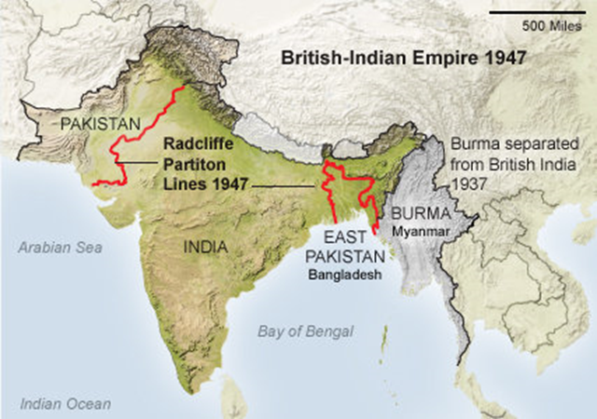
Partition: Divide and Quit
British colonialism primarily responsible for the creation of religion as political identity and hence Partition in 1947
A million people died and 10 million forced to migrate when British leave the subcontinent divided into India and Pakistan (in two parts, E and W)
Indian and Pakistani nationalist leaders prefer this outcome as it gave them unchallenged power after British withdrawal

Slide 17
Post 1947 Sources of Unity: Democracy
So, what AFTER the British leave?
A huge set of problems in 1947: “At no other time or place in human history have social conflicts been so richly diverse, so vigorously articulated, so eloquently manifested in art and literature, or addressed with such directness by the political system and the media.” (Guha, 2007)
ULTIMATELY the successful working of a major democratic experiment that kept India together at the time
The Constitution of 1950 was based on Universal Suffrage, no adult of any religion, caste, sex, or region was denied a vote.
  Along with the American and French revolutions, “one of three great experiments of world history”
But “democracy” means more than simply voting in elections, it also depends on the political imagination of India itself

Slide 18
Imagining India After the British
As important as the fact that *all* Indian people were given a vote at the start of the republic was the ideological orientation of early nationalist leaders, who said:
  ‘India is a land of many religions and many races, and must remain so’… India would be ‘a democratic secular State where all citizens enjoy full rights and are equally entitled to the protection of the State, irrespective of the religion to which they belong’. The leaders wished to ‘assure the minorities in India that it will continue to protect, to the best of its ability, their citizen rights against aggression’.” (Guha, 2007: 35)
Jawaharlal Nehru and Gandhi had their differences, but on one issue they were as one: that regardless of what other parties or individuals believed, their idea of India was one where Indian-ness – legal citizenship or cultural belonging -- was not tied to a single religion, region, language or caste. Not everyone agreed with them.
A handful of Hindu Nationalist extremists succeeded in assassinating Mahatma Gandhi in January 1948

Slide 19
The Hindu Nationalists Differ
The Rashtriya Swayamsevak Sangh (RSS) explicitly opposed “the idea of a secular state that would not discriminate on the basis of religion.”
Hindi (language) Hindu (religion) Hindustan (a Hindu Nation) was their slogan
The most important leader of the RSS, GOLWAKLAR, believed:
  The non-Hindu people of Hindustan must either adopt Hindu culture and language, must learn and respect and hold in reverence the Hindu religion, must entertain no idea but of those of glorification of the Hindu race and culture . . . in a word they must cease to be foreigners, or may stay in the country, wholly subordinated to the Hindu nation, claiming nothing, deserving no privileges, far less any preferential treatment – not even citizens’ rights (35)
On January 30, 1948, a Hindu nationalist shot the Mahatma to death

Slide 20
After 1952: A political overview
Indian democracy though, overwhelmingly chose Nehru and an inclusive vision of India, celebrating “unity in diversity” rather than the majoritarian vision of a Hindu nationalist India when the first General Elections were held in 1952
  The Indian National Congress (INC - political party of Gandhi and Nehru) won all national elections until 1977.
Hindu nationalists totally marginalized particularly after Gandhi’s assassination
  Make a comeback as part of a coalition government 1977-79, but the National Congress returns to power 1980
Not as popular as before, INC now resort to populist politics that opposition also picks up on
Riding on the wave of populist mobilization, the Hindu Nationalist party the Bhartiya Janata Party (BJP), forms a coalition government 1998-2004
2014, the BJP under Narendra Modi wins national elections, re-elected in 2019 and 2024

Slide 21
Modi’s India
In many respects the polar opposite of Nehru’s India
  Diversity and inclusion are anathema to Hindu nationalists who want the Hindu majority to reign supreme, want HINDI to be the primary language
  Willing to use populist rabble rousing, targeting religious minorities, particularly Muslims, to create a Hindu voting bloc
Authoritarian in outlook
  Jailed those who speak out, and destroyed the homes of protestors
  Disqualified political opponents
  Undermined the rights of states laid out in the constitution
Vitiated political discourse with hate speech targeting minorities
Undermined institutions such as an independent judiciary or statutory watchdog bodies such as the Election Commission or the Auditor-General
Made possible by his business associates essentially buying up the mainstream media outlets, making them propaganda arms of the government

Slide 22
Real Consequences of Hindu Nationalism
Despite a compliant media singing the government’s praises, the last 11 years have not been great for ordinary Indians
2019-2024 saw the lowest period of GDP growth since India liberalized its markets in the early 1990s
  Per capita income over 2014-2014 grew half as fast as the previous decade under the INC government
Economic disparity has grown immensely, in an already unequal society
  In 2022-23, 22.6% of the national income went to the top 1%
Unemployment is a real issue
  44% of those between ages of 20-24 are unemployed
India ranks 111 out of 125 countries in the Global Hunger Index
Democracy is failing
  US-based Freedom House downgraded India’s status from a free democracy to a “partially free democracy” in 2021. Sweden’s V-Dem Institute classified India as an “electoral autocracy” on its way to further autocratization

Slide 23
Potential Consequences
Nehruvian or Gandhian inclusivism was a way of managing India’s immense diversity – following models of Ashoka and Akbar
Rejecting it could lead to strains, demands for break up
  Late 1950s had seen a serious secessionist demand from southern Indian states who resented “Hindi [language] Imperialism.” Defused through active participation in democratic process, where secessionism gave way to the creation of regional political parties who contested elections
Alienating a significant religious majority today might encourage further secessionism in areas such as Kashmir
This will be exacerbated given the growing economic inequalities across India
Hence a real worry about India’s future under majoritarian populism, particularly one moving towards greater autocracy each year

Slide 24
Lessons?
People can’t eat slogans … or acronyms
Liberal democracies depend on a degree of buy-in from the people
If enough people feel excluded, they will look for alternatives to liberal democracy
For the longest time, the west used to be a template used to compare locations in the global south, western models of liberal democracy were held up as those to emulate as a post WWII world decolonized
I wonder though, if India of the last decade has some lessons for us living here in the US today?
Where will slogans, minority-baiting, global flexing of muscles take us in the next decade?
As I said at the start, a lot will depend on what we WANT to take away from a possible historical parallel

