Slide 1
Mughal Empire: 1526-1739/1857?

Slide 2
Themes for this section
Basis of the Mughal Empire: what made it tick, what kept it going, what was different from earlier empires? AND, what led to its collapse? Too often this question is reduced to the level of individual personalities, e.g. the "greatness" of Akbar and the folly of Aurangzeb, weakness of later Mughals
Two other themes before end of course
1. Religious developments, which too, often trivialized
2. Cultural fusion and shaping of India

Slide 3
Overview of Emperors and some events
1526 BABUR defeats Sikandar Lodi, last of the Sultans. Importance of mobile artillery. MUGHAL empire begins
1542 SHER SHAH SUR an AFGHAN defeats HUMAYUN, Babur's son and briefly displaces the Mughals. Starts a series of economic reforms later continued by Akbar
1554 HUMAYUN re-establishes the Mughal dynasty.
1556-1605 AKBAR, real basis of Mughal authority established in his era
1605-27 JAHANGIR AND NUR JAHAN his wife who is said to have played an important role in the politics of the court
1627 SHAH JAHAN: Great Builder, among other buildings he commissioned was the TAJ MAHAL as a mausoleum for his wife, Mumtaz Mahal
1658-1707 AURANGZEB, Mughal empire at its peak, but also present are seeds of decline
Regional identities reassert during and after Aurangzeb’s time, but the crushing blow is raid by Persian ruler NADIR SHAH in 1739
Though Mughals nominally remain in control until 1857, they are no longer politically significant after the 1730s

Slide 4
Significance of Mughals
First early modern state in India, systematic basis for administration and revenue collection
Quite different from states of both the Samanta era and those of the Sultanate
Last indigenous rulers before 200 years of British rule (Portuguese land in India before the Mughals, incidentally!)
Huge impact on influencing culture of South Asia: building, cuisine, music, lifestyle. Much of what we think of as “Indian” today develop during Mughal era
Rather than covering by ruler, focus on themes

Slide 5
Basis of Mughal state
Like all states, taxation was the basis of the Mughal state. Though trade also taxed, main source of revenue was agriculture
The major EXPENSE of any state at this time was on the army, to secure borders against raids, to conquer larger territories, and hence increase the number of taxpayers, or to gather the accumulated revenues of another state. Sometimes the army was needed to ensure that tax was paid and collected
Though both Babur and Humayun contributed to the conquests that made the Mughal empire, it was under Akbar that the empire, the Mughal state, was consolidated
Systems of revenue collection and military mobilization of the former Sultans of Delhi was much like their predecessors, not foolproof
Sultans divided the country unto IQTAS, under important nobles, who were to collect revenue. But when Sultans weak, and especially under the LODI sultans and then under Sher Shah Sur, IQTA holders establish themselves locally, and did not provide either the revenue or the service they were supposed to. If revenues increased, then did not tell the Sultan, and keep the increase

Slide 6
Akbar and Mansabdari / Jagirdari
MANSABDARI -- aimed at preventing the problems with the IQTA system, create a state bureaucracy rather than feudal style fiefs
Akbar ordered officials to submit revenue yields of all districts for 10 years. On this basis, calculate the average agricultural yield, and potential tax base of each district
Appointed important officers as MANSABDARS, officials of the court. Each M'DAR was given a dual rank -- ZAT and SAWAR. ZAT = salary; SAWAR= denoted the number of troops, particularly cavalry, that he was expected to maintain for the Emperor
Each of these M’DARs given a JAGIR, or the right to collect revenue of a part, territory whose yield closely matched his salary and expected expenditures on troops
Different from IQTAS in that a Mansabdar had NO rights other than to collect revenue. Usually Jagir in an area where the office was NOT posted. Plus frequent transfers, sometimes as often as 2 years, changed Jagirs
Checks and balances: The emperor received almost daily reports by local intelligence officers, plus separating judicial and administrative authority over area meant that over taxation led to petitions to crown
Using a mix of force and diplomacy, carrot and stick, Akbar able to win over some of the recalcitrant RAJPUTS in western India, who were major opposition even for SULTANS. Akbar incorporates them as officers. ONLY RAJPUTS given Jagirs in OWN areas

Slide 7
Mansabdari: Strengths and Weaknesses
As Mughal state expanded, used new lands to incorporate more local nobility into this system, paid for by expanded land under Mughal control
This system work very well, until royal authority was strong, AND Empire keeps expanding. BUT, when Aurangzeb's attempts at expansion in the Deccan ran into problems, this very system of administration was one reason for Mughal collapse
The system serves the Mughal empire well for three generations, making them one of the most powerful, rich, splendid empires of their time in the entire world. That is where the word MOGUL enters the English language
Positions as Mansabdars give many regional nobles high status in the Mughal court, but also spark ambitions to do better. The family of SHIVAJI had been high ranking officials, but now Shivaji decided that he would do better by himself, hence launch guerilla warfare against Mughal state

Slide 8
Crisis of the Jagirdari/ Mansabdari System
But over time some problems inherent in the system did reveal themselves. Because of frequent transfers, JAGIRDAR, holder of jagirs, had no real interest in maintaining productivity of land, or to improve, increase yield. Jagirdars surreptitiously increase demand from peasants to point where peasants rebelled, either under the leadership of JATS or the SIKHS in Punjab, or under the MARATHA leadership in Deccan in the time of AURANGZEB
Moreover to expand in Deccan, AURANGZEB took in many Deccan nobles as MANSABDARS, but the expected expansion of land did not come, because of effective guerilla warfare by Marathas. So not enough jagirs to go around. With Aurangzeb busy in Deccan for last 26 years of his life, less attention to administration. After his death, more confusion. In this confusion, JAGIR holders refused transfers, and entrenched themselves, no revenue payment, large jagir holders declare independent kingdoms, such as Hyderabad, Awadh, Bengal

Slide 9
Mughals and Religion
The British, for their own reasons, claimed all Muslim kings oppressed Hindus (an idea that “Hindu nationalists” later took on)
But even beyond that, religious policies of Mughals often reduced to a difference in personalities of Akbar and Aurangzeb
Personalities do play a part, but more important than personalities is historical context – in that context the economic situation and political imperatives facing the state are key!
A comparative note: This is not a time when religion can be separated from state anywhere in the world
Akbar, e.g. reigned1556 to 1605 at a time when Europe being torn apart by religious wars with the Catholic counter-reformation (starting 1545)
The context makes Akbar’s eclecticism quite remarkable

Slide 10
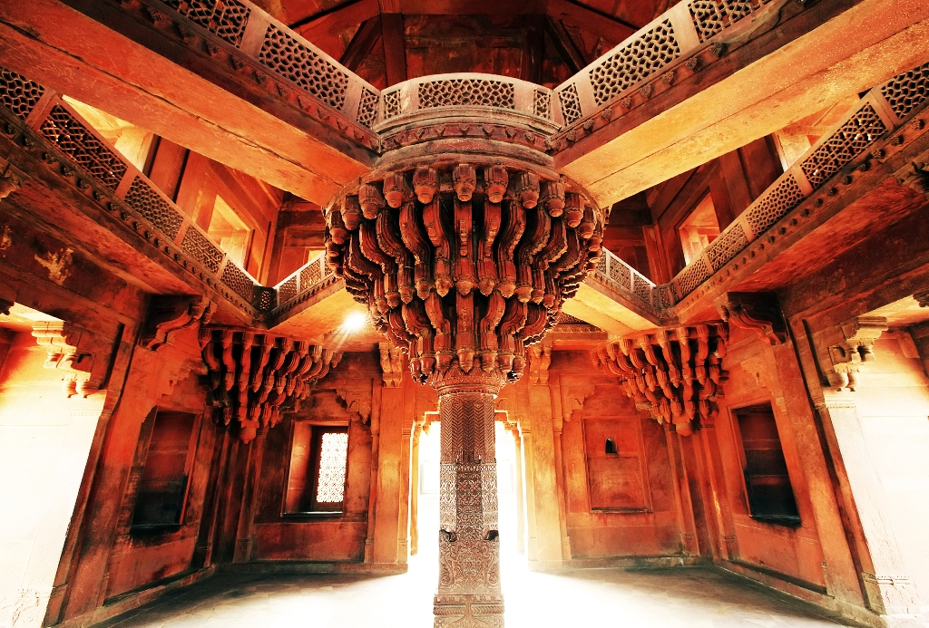
Akbar and Religion
Advocated SULH I KUL (peace with all)
Married ( aka matrimonial alliances!) with Rajput princesses
Built the Ibadat Khana ("House of Worship") where theologians and mystics discussed matters of spirituality with the emperor
Sought to combine different doctrines into a new ethical, moral code Din-i-Ilahi (sometimes referred to as a new religion)
IBADAT KHANA at Fatehpur Sikri

Slide 11
Religious Diversity under Mughals
Religions, diverse ones, flourished under the Mughals. Rulers were Sunni Muslims and their faith was important to them
But Sufi saints, mystics, often close to many of the emperors
Large-scale spread of Islam, was through patronage of SUFI saints by in Punjab, and other PIRs in Bengal by the MUGHALS
But the support for Muslim saints or proselytizers did not make AKBAR, JAHANGIR or SHAHJAHAN stop patronizing HINDU or JAIN scholars and specialists, whether it was for horoscopes, for translations of Sanskrit texts into Persian (court language of the Mughals)
Even the much maligned AURANGZEB gave many grants of land to Hindu temples and religious institutions. Though stop patronage of Sanskrit, HINDI grew under his patronage and did not stop his courtiers from being patrons of Sanskrit scholarship either

Slide 12
More than Eclecticism, Fusion
Much of what we know of as Indian today the result of Mughal influence, a fusion of older Indic with traditions associated with Persian, Arab, and Turkic cultures
The visual landscape of India, from the famous Taj Mahal. to the shape of everyday buildings, developed in a distinct way under the Mughals
Many of aspects of everyday life in India today, are the products of the cultural synthesis that occurred under Mughal rule: Food, music, languages, poetry, literary forms, all reveal strong influences of Mughal traditions
Even “Bollywood,” or some of its products at least, reflect Mughal influences in a variety of ways

Slide 13
Context for Akbar’s Policies
MANSABDARI allows AKBAR consolidate MUGHAL empire, and a regular source of revenue was one reason why he was able to undertake a more “tolerant” religious policy. No need for Jaziyah, that he was then able to abolish. This also allows Akbar to follow SULH I KUL (peace with all)
Akbar was expanding and consolidating empire. For that needed to win over Rajputs. That desire, though, did not prevent Akbar from military campaigns against the Rajputs who defied him. A massacre at the fort of Chittor is said to have resulted in deaths of 30,000 non-combatants
But did have Rajputs (and other Hindus) in very important positions in his court
Married Rajput princesses and they were allowed to worship as they pleased

Slide 14
Aurangzeb: The Contrasts
Reimposes Jaziyah (poll tax on non-Muslims)
End patronage Sanskrit scholars (Truschke)
Destroys Hindu temples
Demonstrable personal Islamic piety
BUT
Grants land to Hindu institutions
Patronizes HINDI, vernacular, over the classical SANSKRIT
Retains Hindus in many important positions in his administration

Slide 15
Aurangzeb, Religion, Jagirdari, and Shivaji
Strains in the jagirdari system limit Aurangzeb’s options as far as religious tolerance are concerned. Jaziyah reimposition was a financial move
Such policies may have been hurtful to Hindu subjects and leaders like SHIVAJI who wanted own domination over Deccan, quick to seize upon it, and take leadership of disaffected peasants. But in fact SHIVAJI’S taxes on peasants as high!!
Although Shivaji represented himself as a Hindu Ruler fighting against "foreign" Mughal rule, to accept it at face value clearly preposterous. Aurangzeb was as much an Indian as Shivaji, even his great grandfather, Akbar, had been born and raised in India
As many of his opponents (Shivaji a prime example) were using their religious identity to mobilize support against Aurangzeb, hardly surprising that Aurangzeb destroyed many symbols of the opposition – Hindu temples

Slide 16
Decline of Mughals and Successor States
Aurangzeb meet RESISTANCE, challenges from NEW emerging social groups: Challenges that he ignored while expanding SOUTHWARD
JAT, and also MARATHAS given lots of PRIVILEGES under Aurangzeb. e.g. Shivaji and his family. Led to greater demands.
Rulers after Aurangzeb not able to maintain the system, FAULT LINES open up
1. ZAMINDARS who or what are they?
Independent landholder holders not owners ran “little kingdoms”
2. PRINCES
Mughal ruler = Shahenshah, Prince of Princes
3. GOVERNORS
Mughal Administrators, e.g. Hyderabad, Bengal, Awadh
WHERE ELSE did the challenges come from?
1. SIKHS/ JATS north India
2. MARATHAS western India
3. INVADERS = Nadir Shah, 1739; Abdali 1748, 1757
4. Own governors
BY MIDDLE OF 18th CENTURY a VARIETY OF “SUCCESSOR STATES” IN PLACE Mughal Authority only titular, not real

Slide 17
Successor States and the European Traders
OUDH, BENGAL, MARATHAS, HYDERABAD and MYSORE among the most important successor states
Each hoping to replace the Mughals as the new “centralizing” power
But new players in the picture in the form of European trading Companies, Dutch, French and English. Portuguese a declining presence over 17th Century
IMPORTANT TO KEEP IN MIND THAT EUROS EEIC IN PARTICULAR TOOK OVER FROM THE SUCCESSOR STATES, NOT THE MUGHALS, WHO WERE A SPENT FORCE BY THE THIRD QUARTER OF 18th CENTURY, 1770s OR SO

