Slide 1
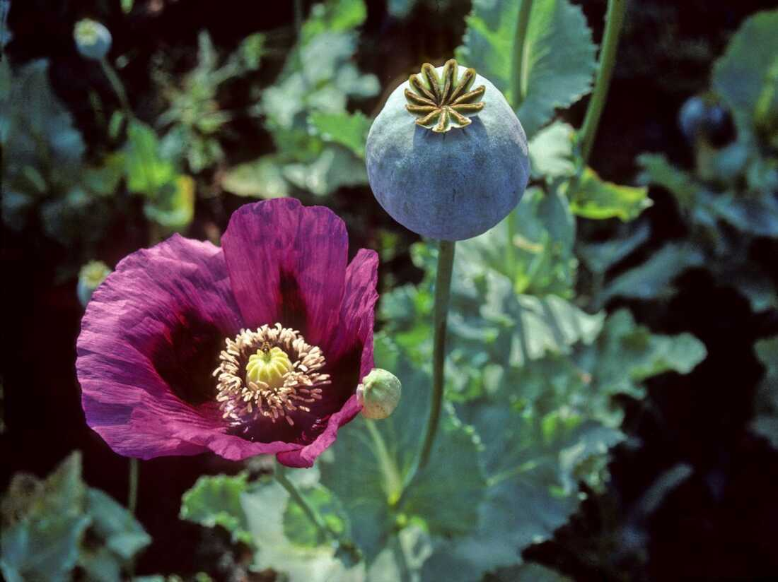
River of Smoke by Amitav Ghosh
Connecting India and China via stories of opium and imperialism
EXTRACTS:I have used pages 58-71; 81-89; 120-126; 160-166; 169-191; 216-229; 293-312; 319-327; 331-341; 373-380; 429-439; 458-465; 476-486. These are all from the John Murray (UK) edition.

Slide 2
What is it about?
The River of Smoke is the second part of a trilogy of books, often called the Ibis Trilogy. The third volume is Flood of Fire
The novel tells us about the events that led up to the Opium Wars. At the same time, the novel brilliantly illuminates the world of foreign traders and fanqui-town in Canton (as it was then called, now Guangzhou), and exposes very well the hypocrisy of the ideology of “free” trade that was used to justify the drug trade in the early decades of the nineteenth century.
Some have also read the book as a critique of the celebration of free markets and globalization we are seeing in our own day.

Slide 3
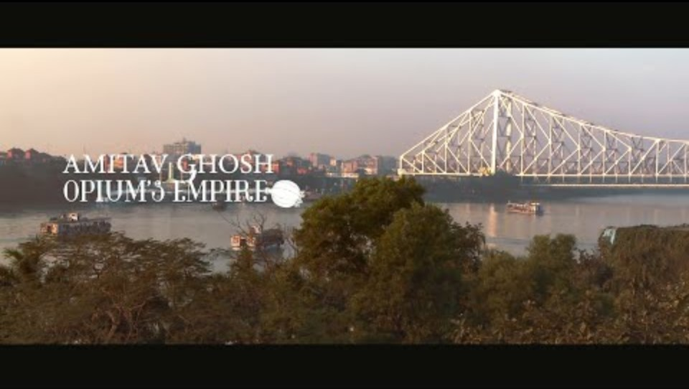
Ghosh on the Novel/Trilogy

Slide 4
Bahram Modi
The novel is primarily the story of one character, an Indian opium trader
  We see the urge to financial profit that drives traders like Modi
  His subordinate place in the world of opium traders
  How he battles with his own conscience, fails, and the price he ultimately pays for this

Slide 5
Why This book ?
The story in this novel CONNECTS, helps us understand how colonialism LINKED histories of India and China.
At its center is OPIUM, grown in India
  Long history as opiate, but also for pharmacology
With control over Bengal EIC able to compel peasants to grow opium there
Used opium to balance their trade deficit with China
It is ONE STORY that connects India and China, not two separate histories but one
  E.g. Ah Fatt/Freddie e.g. is literally the product of two cultures. In this novel, his hybridity is celebrated rather than looked down upon

Slide 6
Why this Book (2)
The book helps us understand the EVERYDAY of the opium trade, as a lived experience rather than an analytical, historical, approach
We get a sense of the impact of opium, not just on the protagonist, but on China as a whole
  On p.126 or conversation with Bonaparte, see how the Chinese state, even EARLY 19thC opposed opium
  See the everyday corruption, how the opium trade undermined the working of state
WE can better understand the relationship between Co Hong and Merchants. (323-27) and of course, the coming of Commissioner Lin and the prelude to war

Slide 7
In short, the novel/extract brings history to life
History alone gets boring, often does not capture the sort of texture of everyday life that makes the study of the past so fascinating.
We understand what it was like for opium traders from all over world to live in fanqui town, a place without women from their own countries, their relationships not just with Chinese women (and men) but also among themselves --the jealousies, the sexual tensions that animate these relationships, all of this helps bring a dry history to LIFE in a way that only a novel can!
We understand that despite their forced intimacy, race and colonialism played a central role. Achha Hong the only one without a flag!! (175)
We can appreciate the moral dilemmas of a man like Bahram, and the principled opposition to opium trade by some of the traders, such as Charles King, and the duplicity of men like Jardine, Dent and Co, as well as the hypocritical way in which the language of free trade was used to justify drug running

Slide 8
Main Characters
See the document on the course web page

